Slide 1
Developing an Organizational Justice, Equity, Diversity, Inclusion Language
Kevonya Elzia, MA, BS, RN
Director of Justice, Equity, Diversity, Inclusion

Slide 2

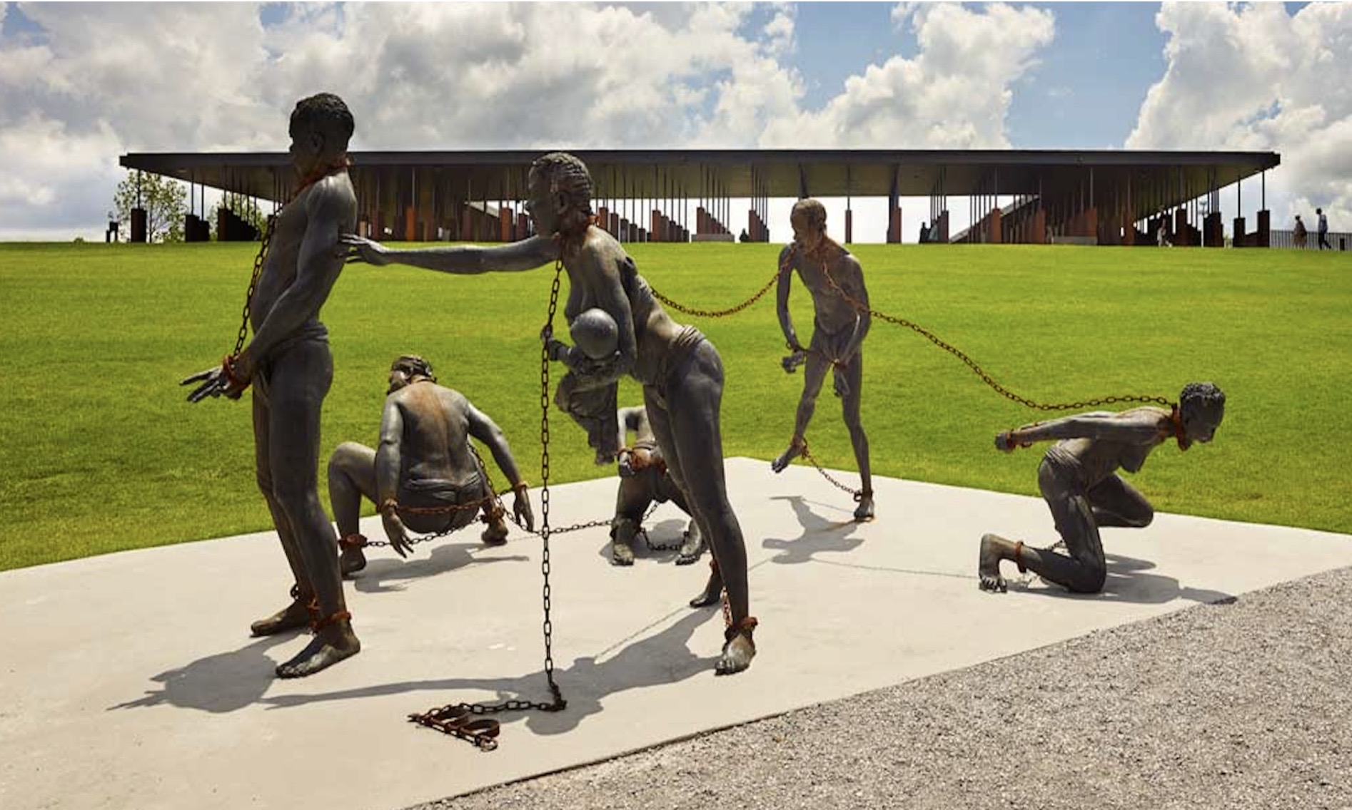

Land & Labor Acknowledgement
Notes:
“I honor & acknowledge the original stewards of this occupied land. We stand on the unceded ancestral lands of the __________________ (name of tribe), people past and present and honor with gratitude the land itself and ______________(name of tribe).”
We acknowledge the labor of Black & African-American people—ancestors and descendants. We recognize that the United States’ and global economies historically and currently rest on the ingenuity, cultural treasures and stolen labor of African-Americans and Black people throughout the diaspora.
We honor the brilliance and humanity of all immigrant labor, including voluntary, involuntary, trafficked, forced, and undocumented peoples who contributed to the building of the country and continue to serve within our labor force. And express our heartfelt gratitude for their infinite contributions. By recognizing the land that was taken from First Americans and the forced labor that was provided by enslaved Africans and black & brown people, we strive to take steps towards create a more equitable and just world for all of us.*

Slide 3
Grounding
Words + Actions + Culture = JEDI language
This work ISN’T copy & paste/ cookie cutter/ one size fits all
Universally applied perfectionism ISN’T welcomed
Know your personal why & help your org find it’s professional why
Be prepared for challenge/ resistance/ losing privilege
This is about SYSTEMIC ACCESS
SELF CARE is MANDATORY!!

Slide 4
Legacy of Marginalization
Scientific Racism
Genocide Slavery
Settler Colonialism
Sociocultural Discrimination
Socioeconomic Oppression & Discrimination
What feeds the widening chasm of health disparities? What is not being acknowledged?
Whose cultural ideals is being centered in the care being offered?
How do we cause harm even if unintentionally?
Notes:
Biological Racist: one who is expressing the idea that the races are meaningfully different in their biology & that these differences create a hierarchy of value.

Slide 5
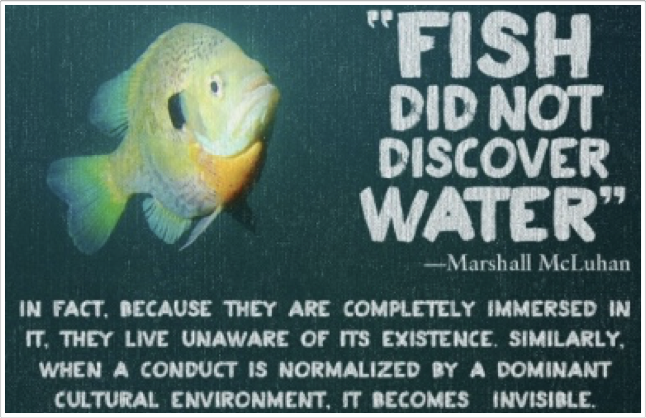
The Water We Swim In
the idea (ideology) that white people and the ideas, thoughts, beliefs, and actions of white people are superior to People of Color and their ideas, thoughts, beliefs, and actions.
is ever-present in our institutional and cultural assumptions that assign value, morality, goodness, and humanity to the white group while casting people and communities of color as Other
also refers to a political or socio-economic system where white people enjoy structural advantage and rights that other racial and ethnic groups do not, both at a collective and an individual level.
Notes:
Sociocultural & socioeconomic discrimination

Slide 6
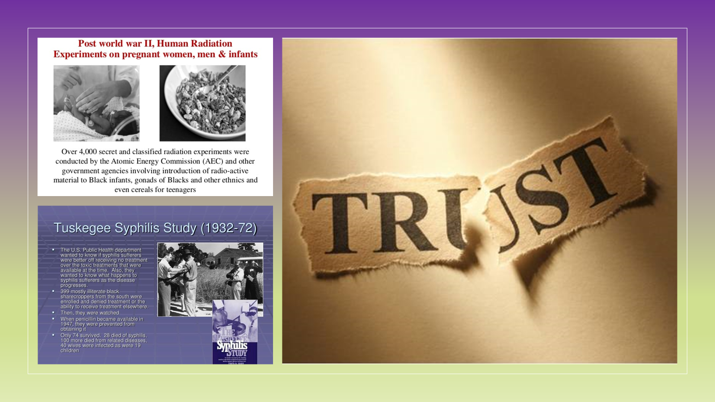

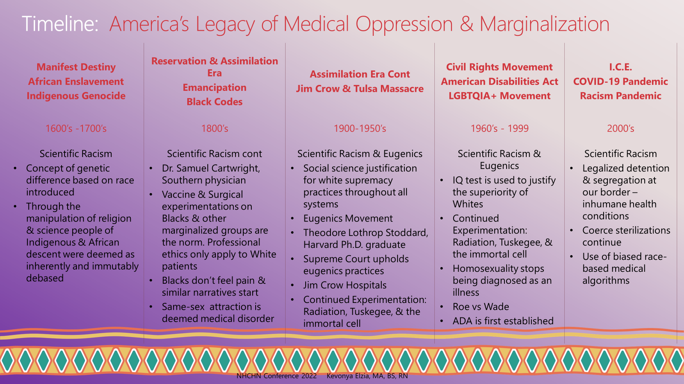

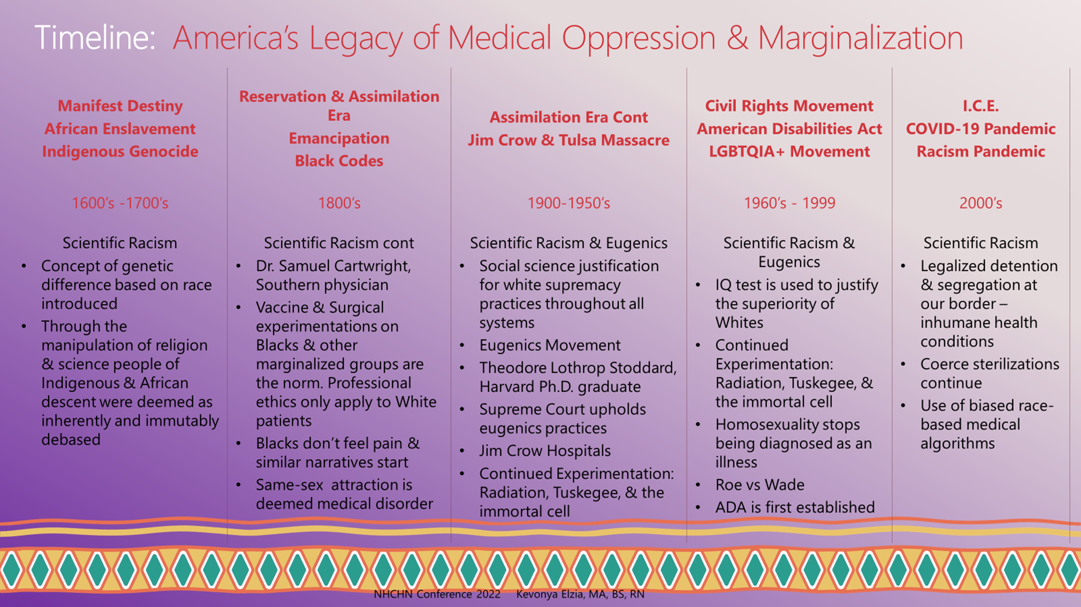
Timeline: America’s Legacy of Medical Oppression & Marginalization
Manifest Destiny African Enslavement Indigenous Genocide | Reservation & Assimilation Era Emancipation Black Codes | Assimilation Era Cont Jim Crow & Tulsa Massacre | Civil Rights Movement American Disabilities Act LGBTQIA+ Movement | I.C.E. COVID-19 Pandemic Racism Pandemic
1600’s -1700’s | 1800’s | 1900-1950’s | 1960’s - 1999 | 2000’s
Scientific Racism Concept of genetic difference based on race introduced Through the manipulation of religion & science people of Indigenous & African descent were deemed as inherently and immutably debased | Scientific Racism cont Dr. Samuel Cartwright, Southern physician Vaccine & Surgical experimentations on Blacks & other marginalized groups are the norm. Professional ethics only apply to White patients Blacks don’t feel pain & similar narratives start Same-sex attraction is deemed medical disorder | Scientific Racism & Eugenics Social science justification for white supremacy practices throughout all systems Eugenics Movement Theodore Lothrop Stoddard, Harvard Ph.D. graduate Supreme Court upholds eugenics practices Jim Crow Hospitals Continued Experimentation: Radiation, Tuskegee, & the immortal cell | Scientific Racism & Eugenics IQ test is used to justify the superiority of Whites Continued Experimentation: Radiation, Tuskegee, & the immortal cell Homosexuality stops being diagnosed as an illness Roe vs Wade ADA is first established | Scientific Racism Legalized detention & segregation at our border – inhumane health conditions Coerce sterilizations continue Use of biased race-based medical algorithms
NHCHN Conference 2022 Kevonya Elzia, MA, BS, RN

Slide 7
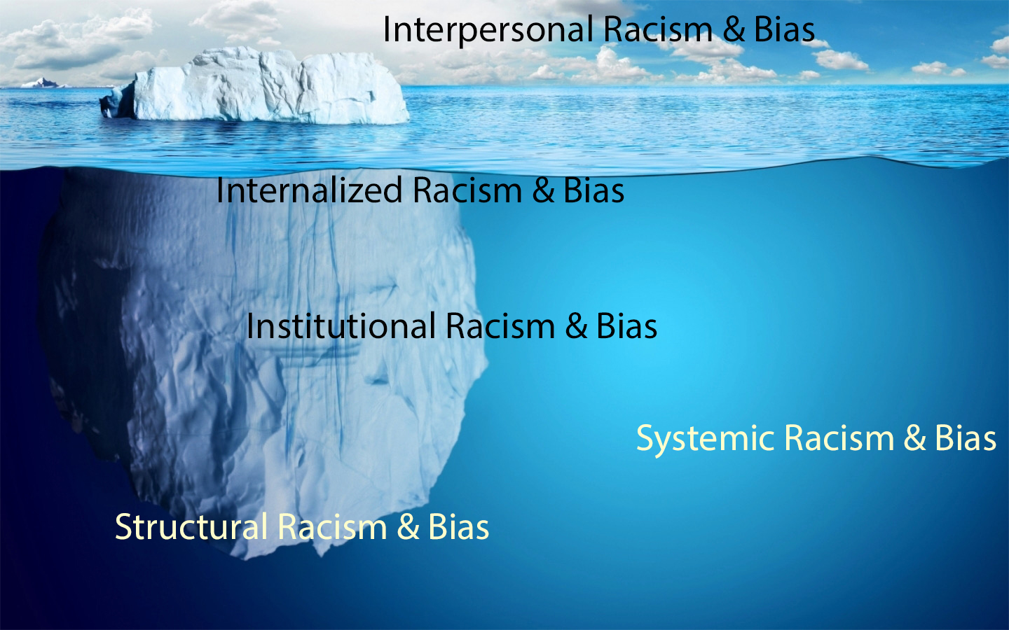
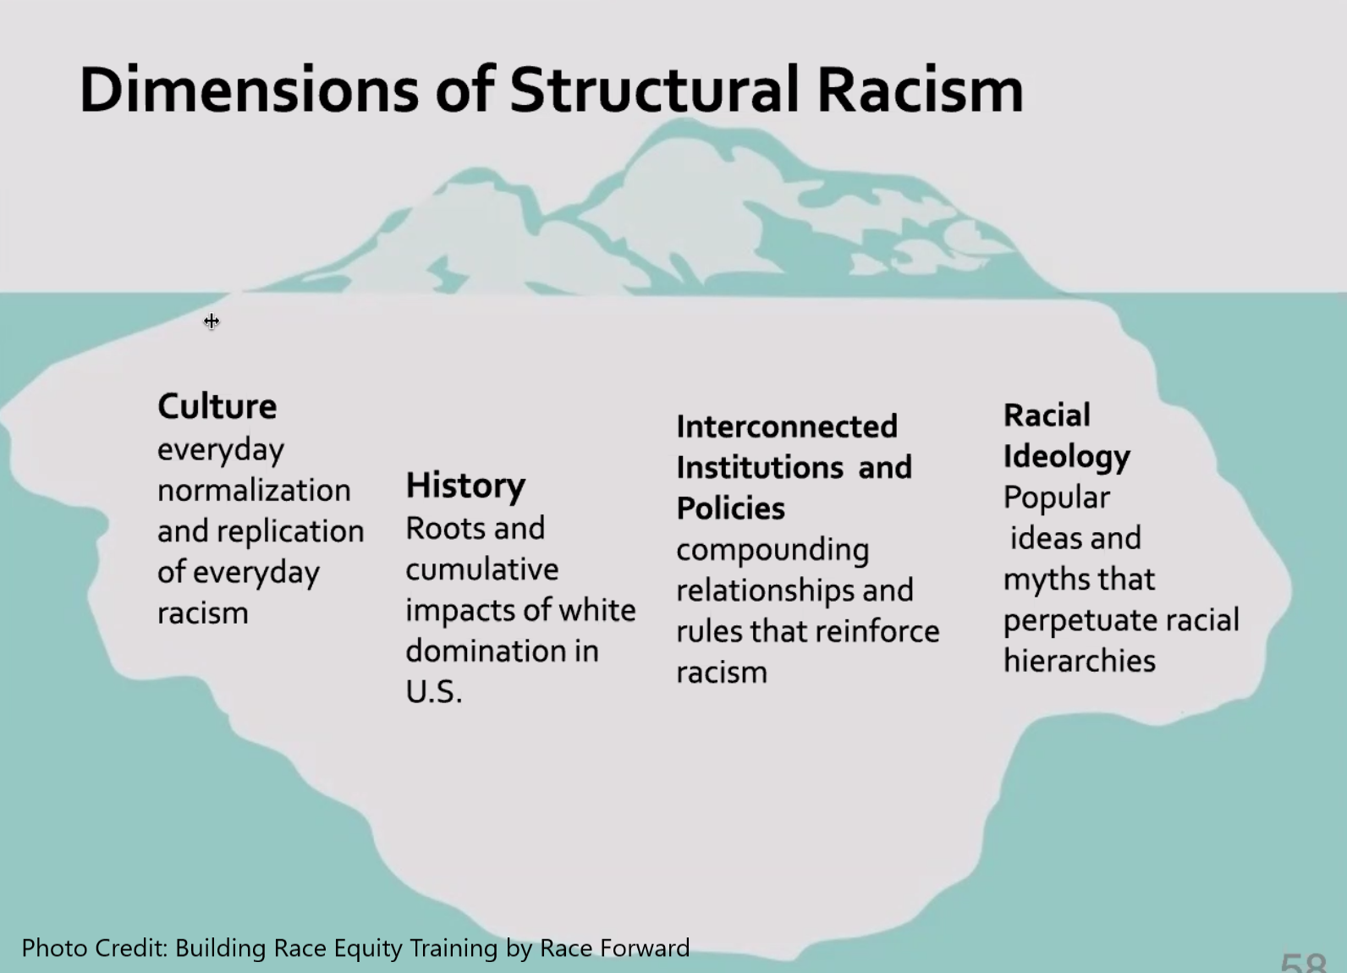

Medical System & Science
Legal System & Military
Education System
Arts, Literature & History
Social & Mass Media
Politics & Religion
Land Rights & Housing
Notes:
25 minute mark

Slide 8
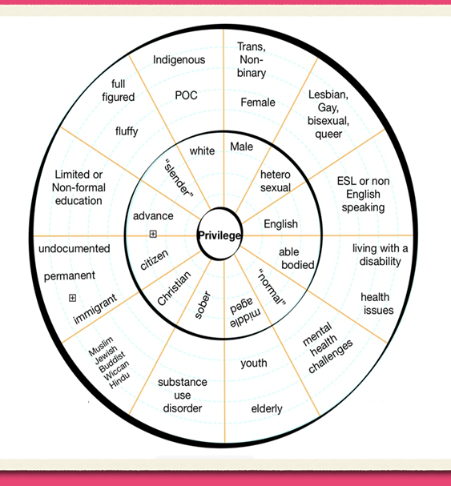
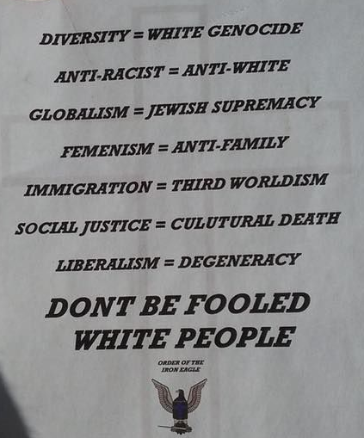

JEDI Core Concepts
Whiteness
White Gaze
White Fear & Rage
Is a hierarchy system that prioritizes white/Anglo Saxon, male, able-bodied, educated, middle class, heterosexual, middle age, Christian at the top & everyone else some classification of less than/other.
A concept most notably articulated by Toni Morrison, explaining how we all have been socialized to consider white perspective & formulate our behaviors with the opinion of white people in mind.
The belief of the loss of a system that has been created to benefit the social group “white’ people. Backlash of actions that play out on the interpersonal, institutional & systemic levels as a result of white fear to prevent perceived loss of privilege.
Notes:
5 + 8 for activity
5 + 8 for activity =
51 minute mark

Slide 9
"WHITENESS" Organizational Norms
Perfectionism
Perfectionist Culture
Worship of Written Word
Concentration of Power
Power Hoarding
Paternalism
Individualism
Individualism
I'm the Only One
Progress is Bigger/More
Right to Comfort
Right to Comfort
Progress is Bigger/More
Only One Right Way
Either/Or Thinking
Defensiveness
Fear of Open Conflict
Objectivity
Quantity over Quality
Sense of Urgency
Notes:
5 + 10 for activity =
66 minute mark

Slide 10
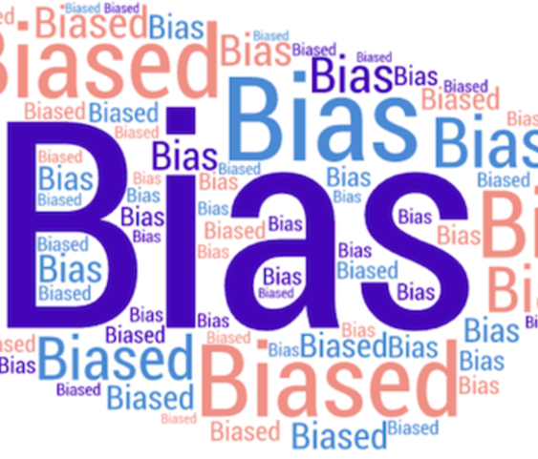
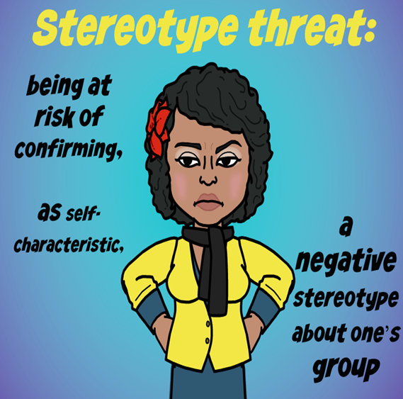
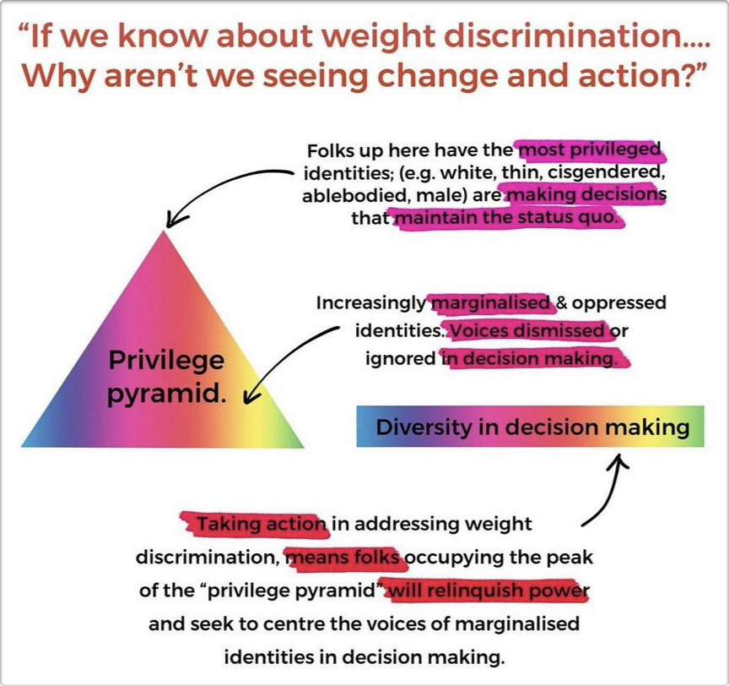
JEDI Core Concepts
Privilege
Bias
Stereotyping
Unearned access to resources (social power) that are only readily available to some people because of their social group membership; an advantage, or immunity granted to or enjoyed by one societal group above and beyond the common advantage of all other groups. Privilege is often invisible to those who have it.
A tendency, inclination, or prejudice toward or against something or someone. Bias is often characterized as stereotypes about people based on the group to which they belong and/or based on an immutable physical characteristic they possess.
A standardized mental picture that is held in common by members of a group and that represents an oversimplified opinion, prejudiced attitude, or uncritical judgment. Contributes to the dehumanization of cultural groups.
Notes:
5 minutes
There is also the reality of sociocultural & socioeconomic discrimination
So if you show up poor, homeless, what “whiteness” deems as uneducated, disabled, old, then you are equally marginalized. And when we apply the lens of intersectionality then this is amplified if you identify as more than one of these.

Slide 11
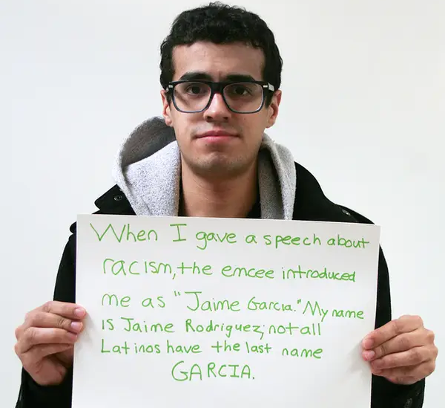
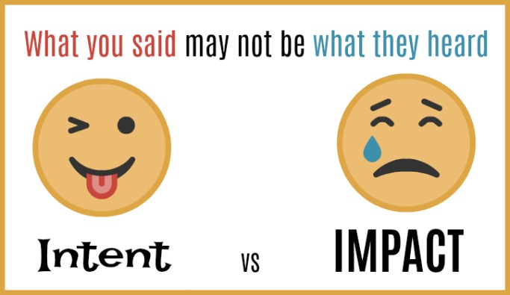

JEDI Core Concepts
Microaggressions
Intent vs Impact
Fragility
Common place daily verbal, behavioral or environmental slights, whether intentional or unintentional, that communicate hostile, derogatory, or negative attitudes toward stigmatized or culturally marginalized groups.
our intentions don’t always align with what we say or do, and this can impact how others receive what we say or do. What we say and do, regardless of our intentions, can impact people in so many ways, especially when we are not aware of the social implications.
Refers to a broad range of responses—often in the form of guilt, excuses, dismissal, or anger—people may have in reaction to discussions. And is supported by the norm of the right to comfort.
Notes:
5 + 14 for activity
=90 minutes mark

Slide 12

The Journey begins with a Single Step
Notes:
Break

Slide 13
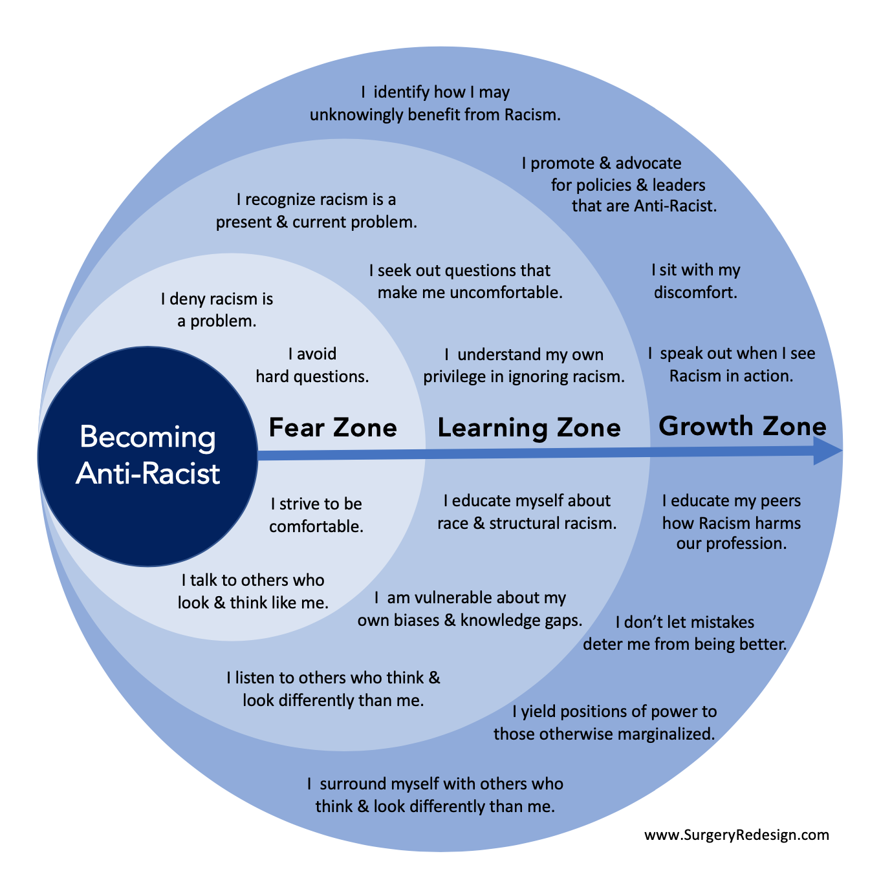
Starting the Conversation
Where is your org on the “Continuum of Becoming an Anti-Racist Multicultural Organization”?
  Informal assessment
What leadership buy-in is needed to do this work?
How to curate advocates & allies
  Health Disparity Outcomes + JEDI = Ethically Right thing to Do
  JEDI + Quality Metrics = ROI {return on investment}
  Health + Equity = Improved Outcomes
Equity Champions
  Identifying your in-house experts
Normalize the conversation
Notes:
Handouts:
Continuum of Becoming an Anti-Racist Multicultural Organization
IHI good resource to start with for ROI evidence
Where are you on the continuum
When we authentically reflect what do we know about ourselves & the waters we swim in both internally & the greater system of medicine?
It depends on the depth and scope of work your trying to achieve. Because this is a journey & we are coming off of a hellish 3 years it’s ok to start with small meaningful steps.
Its important that you not get discouraged if you are unable to get some or all of C-suite buy-in
Without C-suite buy-in it does but some limitations on this but DOES NOT stop the work from being started
Sometimes not having them aware at the beginning allows you to get some work done providing you with direct example of ROI for the org, which might secure you the buy-in that you need to upscale your actions
Addressing health equity is a basic standard of practice now, endorsed by several health-related governing bodies, leverage this practice & expectation. {IHI, HRSA, AAMC, CDC, etc}
When I started this at my prior org, my C-suite leadership didn’t know what we were doing on our team/department to advance equity. While C-suite was slow to move on this work our outreach & school-based team took it upon themselves to integrate this work into their teams daily work flow. As time progressed more teams expressed interest & we got C-suite buy-in
I’m providing you with a list of articles that can help to advance your case for ROI when it comes to health equity & diversity. It includes articles that have a business focus was well as a medical focus. The IHI toolkit is also a valuable resource in my experience.
No one who has an authentic interest in this work has not been thinking about it especially over the last 3 years. This is to say the advocated & allies you need are already present & this is on their radar even if it’s not being discussed in the open at staff meetings.
There are a couple of ways you can identify your allies:
Look at those who’s passion is centered around increasing access. This can look like gender affirming care advocates, harm reduction advocates, food or housing access advocates, community health workers advocates, language services advocates, etc.
Do a general ask during a staff meeting for people interested in being “health equity” champions
Present the case: using the IHI toolkit which is one of the resources provided, covid data, { impact on the poor, impact on the BIPOC community, impact on Ag workers, impact on the elderly, impact on the unhoused, impact on the substance use community} regardless of the community you serve there is covid data out there for you.
When I started this work in my prior org it was Summer 2020, and my teammates were disappointment that our org had not acknowledged the public lynching of George Floyd. One white ally was like even my mounting climbing group is talking about this how are we not! Covid was continuing to surge especially in communities of color & other marginalized groups. So we decided to focus on our team & not wait for our executive leadership to catch up. Our buy-in started with our director supervisors & 2 Directors in the org.
Knowing who your in-house experts are will help when it comes to making sure the work doesn’t fade into distant memory once you get started. They are also a wealth of information when comes to tools & resources for incorporating this into your daily work. And when you get the “we don’t have money for an external training spiel, you can come back with “well Stacie has agreed to lead this training for our team since she has experience in this area.” In the event financial compensation is not obtained for Stacie, they will need to be given time to work on this staff training and this should be apart of Stacie’s year eval showing how they are contributing to the professional development of staff.
Another resource can be local community health boards, here in Seattle we are very privileged we have a Somali, Latinx, Af Am, Afghan, Khmer, Filipino, Congolese, Pacific Islander just to name half of them. They can also be a great source for providing context, need & ROI for this work as well as training for providing culturally responsive care to these communities. Because despite the assumption healthcare is not a one size fits all or even most in some cases.
Normalize the convo: Make JEDI or Health Equity a standing topic on ALL meeting agendas, This is not an additional items to be add but the very lens with which we approach all aspects of the work we do. Utilize community programs as guest speakers for top topics patients express as challenges to their health

Slide 15


Slide 16

Working via a JEDI Lens
Define what this work means to your team/ department/ organization
    Define commitment to JEDI {north star}
    Define what Justice Equity Diversity Inclusion means for us
    Define Health Equity
Find & customize an Equity Lens that works for your organization/ department/ team
What does your team/ department/ org want to apply a JEDI lens to first?
  Formal Assessment to identify what are your “hot spots”?
  Overall team/dept/organizational culture
  Hiring & Onboarding Practices
  Team Development & Training
  Workforce Retention
  Team identified “micro-affirmations”
ACCOUNTABILITY is KEY!!!!
This Photo by Unknown Author is licensed under CC BY-SA-NC
Notes:
When it comes to doing this work I think one of the important things is making it clear from the beginning this is not something we are adding as a side task, it is the lens, mindset & framework we are engaging in our daily work!
Depending on how far up the leadership ladder you get buy in will determine the scope for incorporating this into your daily work
If you only have leadership buy-in from team/department leads fine start there.
When you are drafting definitions, north star, & equity lens this should be done with a diverse group your equity champions would be a great place to start.
Once you are able to get C-suite buy-in:
Put together an advisory committee that meets at least month to help guide the JEDI work going forward.
This committee should be comprised of people that hold various roles at all levels of the organization. It should also be as diverse as possible in terms of race, gender, SOGI, age, ability, cultures, & language.
This committee should be utilized as a vetting group for all health equity, EDI related content
Because we all swim in the waters of whiteness and have assimilated to it expectations its important that this group also engages in internal work to advance their knowledge & understanding. I achieved this by having the second meeting of every other month devoted to training.
With the support of this advisory group
I facilitated this group & my prior c-suite team in drafting out EDI commitment statement as well as defining what Equity, Diversity, Inclusion meant for us as an organization. This was our north star that we referred back to when it came to implementing EDI projects – the question that we asked ourselves was does what is being proposed help use to honor/embody/ achieve this commitment?
Draft an EDI or Equity assessment to assess your org internal equity issues that need to be address. It’s important to do the needed internal work first before focusing on external equity needs otherwise you may inadvertently cause harm to patients.
The assessment shouldn’t take longer than 10 minutes to complete/ easily accessible {try using a QR code to access & post in staff only common areas / be anonymous – absolutely a must – cause you don’t have your staff’s trust yet and regardless of what is said retaliation is a reality!!!/ ask for time in staff meeting to have people complete survey
Another method is to given prompts allowing staff to share their lived experience at the org (explain why I liked this process)
In my prior org Based on our EDI commitment statement I asked the staff via a racial caucus process the following questions:
When it comes to use embodying the EDI commitment statement
“what do you see our our strengths – ie what are we already doing well”
What do you see as our weakness – ie what could we be doing better”
What do you see as our opportunities or areas of growth
What do you see as threats/roadblocks ie what limits or inhibits us from embodying our EDI commitment

Slide 17
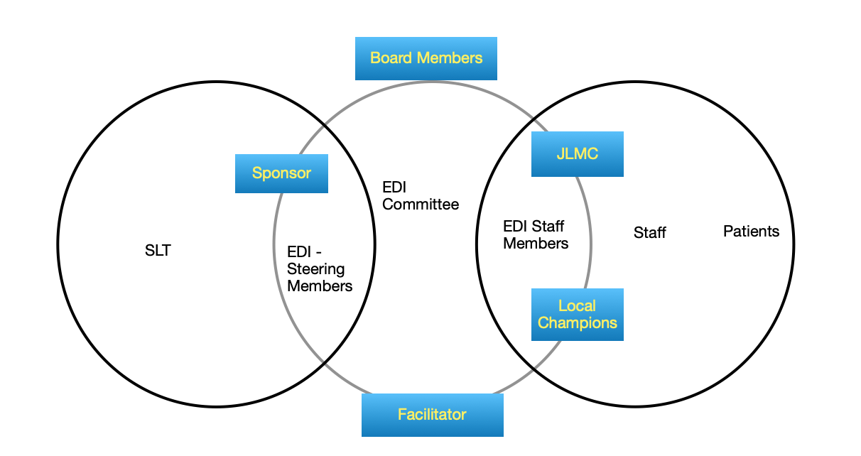
EDI Committee Roles
Notes:
EDI Committee - work in collaboration to identify & address equity, diversity, & inclusions issues within NCH
EDI - Steering Members - {Got Rid of this after the first 2 months found it to be an unnecessary layer}
EDI - Staff Members - provide perspective/insight to needs, thoughts, lived experiences of staff & patients; provide perspective/insight to the receptibility (intent vs impact) of goals/action steps jointly collaborated/generated via EDI committee
Facilitator - navigate gray areas, stalemates, tension, stagnation, guidepost adherence
Local Champions (ea dept/clinic) - provide perspective on intent vs impact in patient care areas and departments
Sponsor - facilitate buy-in from management and commit organizational resources { this was usually an ally on SLT}
SLT - provide managerial support for EDI initiatives & provide perspective/insight to applicability & barriers of goals/actions steps jointly collaborated/generated via the EDI committee & provide recommendations to dismantle barriers & improve application to actions organization wide
Board Members - representative of the community we serve, provide organizational/community support & accountability for EDI initiatives
JLMC - facilitate collaboration between union’s EDI objectives and EDI committee goals/action steps
Staff - inform local champion of the lived experience & needs within the clinic/dept, provide insight to the (intent vs impact) of action steps
Patients - inform staff of the lived experience & needs within the clinic & greater community, provide insight to the (intent vs impact) of action steps

Slide 18
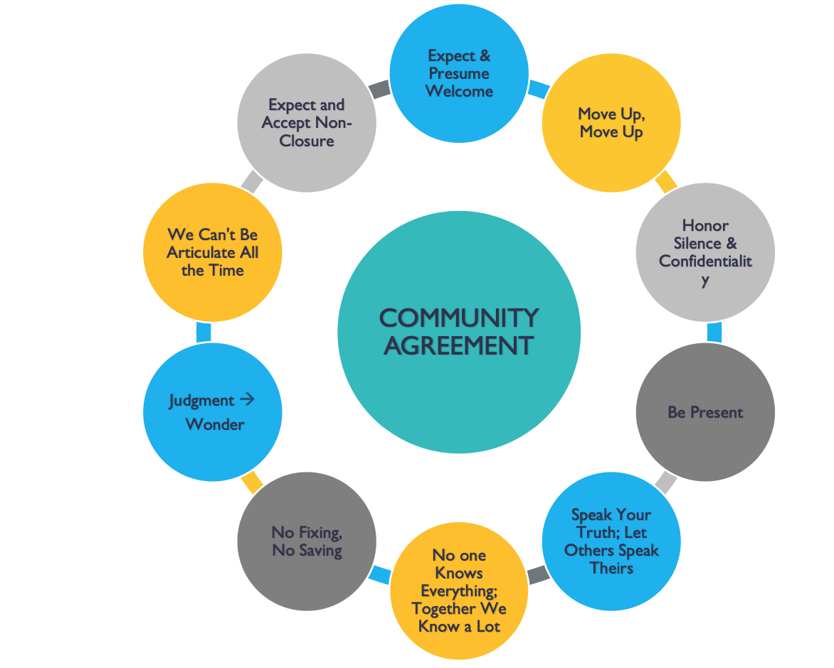
Initial Safe Space Agreements
Commitments…I ask that you commit to… {Requires unanimous agreement open to additions}
Making this a safe space
Having patience w/ yourself & each other
Speak from a place of authenticity and vulnerability
Being seen w/o your mask, so you may see yourself and allow others to see you.
Active listening and active participation
Willingness to be called upon
Sit with any discomfort that arises, writing out the stories that come up as a result of the discomfort.
Notes:
20 minute mark after break

Slide 19
Drafting a Definition Exercise
Proactive creation and reinforcement of policies, practices, attitudes, and actions that produce equitable power, access, opportunities, treatment, impacts, and outcomes for all. Racial justice work is not only about being “not racist” and instead requires the presence of deliberate systems and supports to achieve and sustain racial equity through proactive and preventative measures and sustained action.
Racial jus­tice is the sys­tem­at­ic fair treat­ment of peo­ple of all races that results in equi­table oppor­tu­ni­ties and out­comes for every­one. All peo­ple are able to achieve their full poten­tial in life, regard­less of race, eth­nic­i­ty or the com­mu­ni­ty in which they live.
Justice is the sys­tem­at­ic fair treat­ment of peo­ple of all races that results in the proactive creation and reinforcement of policies, practices, attitudes, and actions that produce equitable power, access, opportunities, treatment, impacts, and outcomes for all.
Notes:
5 + 8 for activity = 33 minute mark

Slide 20
Drafting a Statement Exercise
We are committed to becoming a fully inclusive, anti-racist multicultural organization whose heart is healing and equitable health care. We purposefully identify, address, and dismantle supremacist policies and practices, heal the damage they cause, and remove the barriers to achieving equity for our staff and patients.
HCAN is committed to building a culture that celebrates diversity and strives for equity. We are dedicated to combatting the public health impact of systemic inequities and racial injustice through advocacy, education, and training. Additionally, we stand in solidarity with LGBTQIA+ communities and are dedicated to the ongoing work of providing just, inclusive, and equitable care to all of our patients.
“A community health center can serve as an agent of social change, intervening not only in the social determinants of its population’s health but also launching a process of structural change that starts to liberate that population through community empowerment from repetitive cycles of poverty and political exclusion.”
is committed to building a culture whose heart is healing and equitable health care. We are dedicated to combatting the public health impact of systemic inequities and racial injustice through purposefully identifying, addressing, and dismantling supremacist policies and practices in our organization, & serving as an agent of social change, intervening not only in the social determinants of our patient population’s health but also launching a process of structural change that starts to liberate that population through community empowerment from repetitive cycles of poverty and political exclusion.
Notes:
2 + 10 for activity = 45 minute mark after break

Slide 21
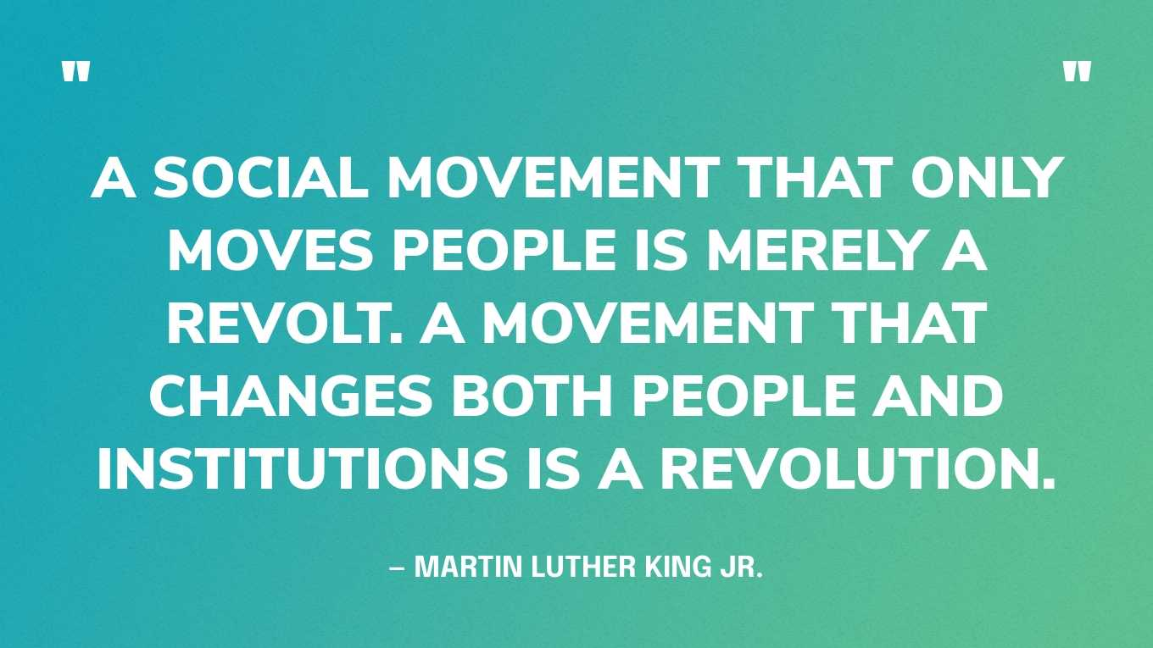
JEDI Approaches that Center Healing
Contributes to:
  Cultivating Self Knowing
  Acknowledging Intersectionality
  Being Trauma Responsive
  Being Anti-racist in Thought & Actions
  Person-First Language
  Healing Centered Restorative Engagement
  Psychological Safety
  Relational Leadership & Collaboration
Notes:
10 = 55 minute mark
Provide resources for utilizing each
Briefly explain:
Self Knowing
Benefit of seeing Intersectionality
Trauma responsive rather than informed means my actions, behaviors, patterns of engagement, thought process is informed by trauma informed principles
Person first language is all about see the human in front of you first rather than their situation/ present circumstance or narratives held
Healing Centered Restorative Engagement –
Psychological safety

Slide 22
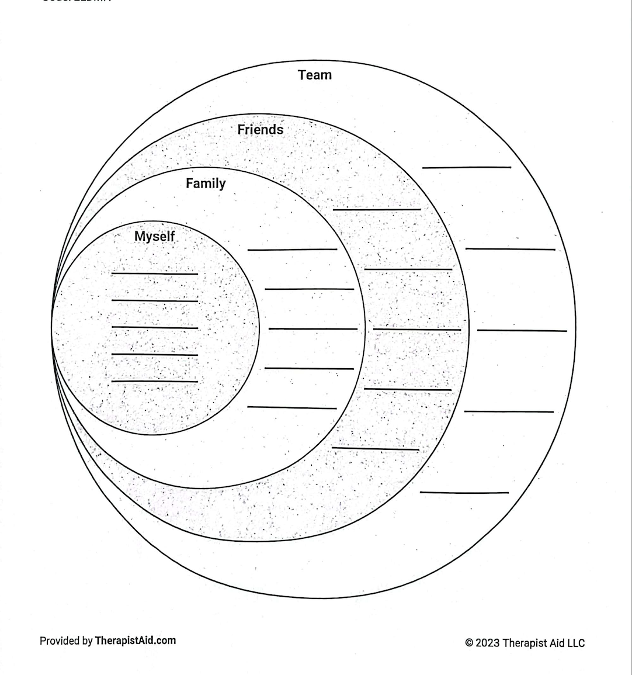
Values Worksheet
Notes:
Use for healing centered restorative engagement

Slide 23
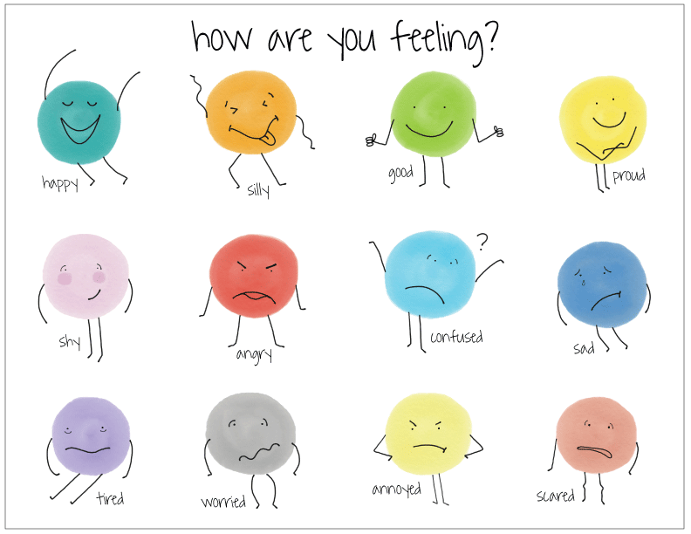

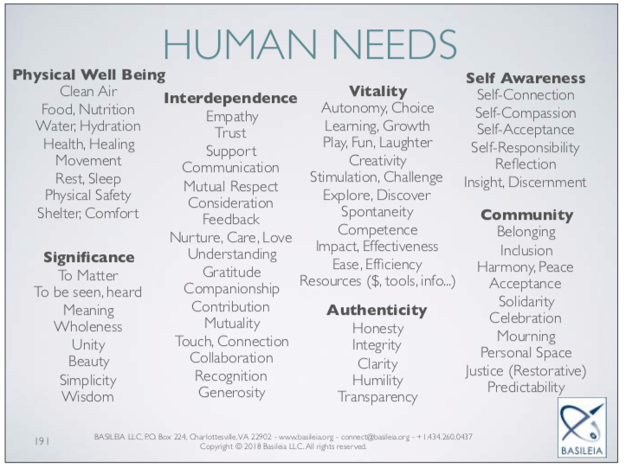

Empathetic
Communication
S.T.O.P.
&
KEEP
CALM
What Needs are feeding the Feelings
What is it that each are needing?
What would you like to request of the other in relation to these needs?"
Become Aware of Feelings
Verbalizing our feelings helps to foster connection & engage from a place of shared humanity
Pause & Observe
Without judgement or criticism
What narratives are coming up for you?
Disrupt negative & disempowering narratives
What is an Enriching Constructive Solution Oriented Request
Clear concrete action using positive language
Clearly state what is desired goal of request.
Notes:
None of this tools will mean anything without us being able to communicate with each other in a way that allows us to hear what is being said & process what is coming up for us as a result of what is said.
Just like with Trauma informed supervision, this is just to provide the foundational concept & will need to be a training all it’s own. And it’s a process that can help us walk our talk, embody cultural humility & support the healing centered restorative engagement process.
For those who are curious or are like this look familiar, it’s because it’s based on the NVC process.

Slide 24
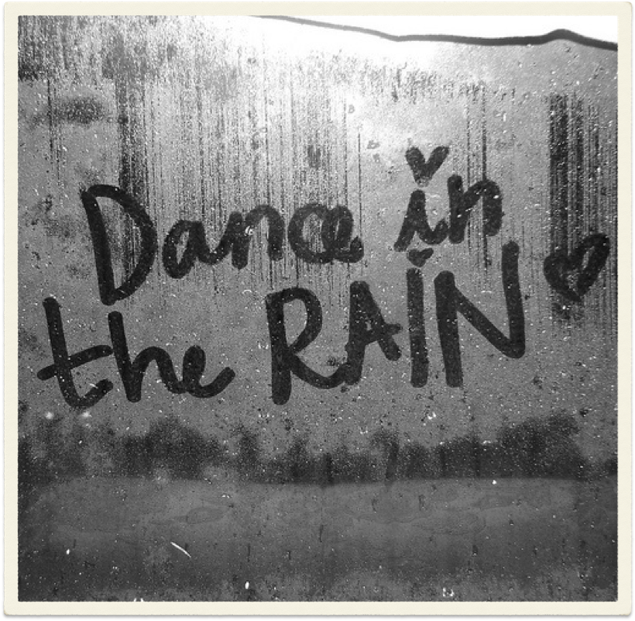
Mindfully Engaging
R.A.I.N.
  Recognize
    What you physically & emotionally feel
    What story plays in your mind
  Allow/Accept
    “Has something old, something borrowed, something bruised been activated” R. King
  Investigate
    What am I to learn & heal in this moment
  Nurture
    Care for the inner and outer harm dissonance caused
Notes:
This is mindfulness-based practice that I love you give as a tool for processing triggers.
This practice asks us to pause & take a breath
Then pay attention to our body,
what’s going on in are body’s physically in this moment
what emotions are coming up for us? What are we feeling
and what story are we telling ourselves in the moment as a result of whatever triggered us.
As we process we want to ask ourselves
has something been activated in this moment?
we are acknowledging & accepting the presence of whatever narrative come up during the recognize process
Next, we investigate
what is this moment trying to help me learn about myself or teach me
We end by providing care both for ourselves & any outer harm that may have resulted.
This doesn’t have to be done in the moment. More often than not it will occur after the fact.
Even when we have oops/ouch moments it doesn’t make us a “bad” person remember universally applies perfectionism is an oppression tool. Again, Oops/ouch moments will happen & they are opportunities for growth. Its important that we not get caught in shame, blame or guilt spirals. Forgive yourself, own your impact, & work with the other person to restore the relationship.

Slide 25
Direct Route Actions
JEDI is the lens leaders use in all messaging across the org.
Make anti-racism teaching as part of your department onboarding.
Educate your team & develop a shared language on what it means to embody anti-racism at your org.
Identify the intersectionality held by the population you serve & explore ways to ensure that these needs are also addressed
Incorporate interview questions with an EDI lens to your hiring practice for your department
Take the white supremacy norms & explore the ways they are manifested at your organization/department & create antidotes
Develop a department affinity or ally group. This will keep the conversation going & cultivate further learning.
Find ways to engage in the practice of shared leadership in your department
Look at department-specific policies & practices that you can address via an equity lens.
Look at ways leads in your department can incorporate EDI & restorative justice practices into their management style.
Name when “whiteness” org norms are playing out during a meeting, or policy/practice development
Incorporate the use of an equity lens for all policy/practices review & development
Educating leaders & staff on gatekeeping practices in your organization & how to disrupt it
Educating leaders & staff on what placating ‘whiteness” looks like in your organization & how to disrupt it
Educating staff on microaggressions & how to “call in” when they see these behaviors occurring.
Talking with staff to identify ways to cultivate psychological safety for marginalized groups in the organization
Diversify who’s at the leadership table through incorporating shared leadership practices
Identify "micro-affirmation" actions that can be immediately put in place.
Include JEDI concerns in your anonymous reporting practice
Utilize JEDI Champions in every time/department
Notes:
The reality is when it comes to organizational change it can move at the pace of molasses in winter!! Especially when there is resistance to seeing the ways we perpetuate the harms of whiteness despite our best intention not to or there are too many ingrained people with the “this is the way we have always done it” mentality or lack of support at each of the level of leadership
These are actions you can take when you are still waiting for your larger organization to catch up. The principle here is to embody the change you want to see even in the mist of challenge. And lets be honest there will ALWAYS be challenges to this work. Sometimes you will be able to do things collectively & other times you will need to move the pieces you can when you can & have those with opposing/reluctant mindset to catch-up later. What I have found is that through exposure to the positive impacts & external pressure from the world at large change does happen.

Slide 26
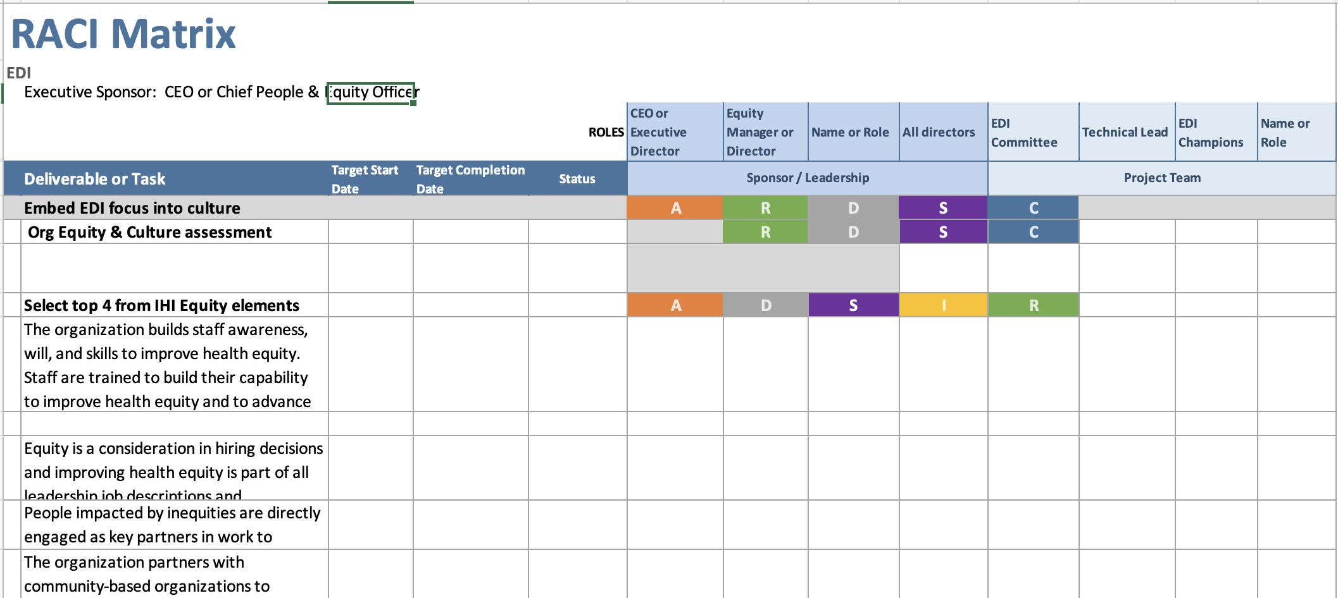
RACI Example
Notes:
(last slide + this slide) 6 minutes = 61 min mark

Slide 27
Indirect Route Actions
Health Equity via focusing on disparities rather than naming root of problem first
"How can we best support staff to meet the complex & challenging needs of the patients we serve?"
Focusing on the top clinical challenges of the clinic, show connection between the poor outcomes of these patients & the intersectionality of the patient population. (ie BP/ DM/ Vaccinations/ Maternal Child
Connect how things are compounded the more intersectionality is present. Including the influence of generational harms & legacy of medical mistrust.
Utilize narratives (ie patient personas) with the data, while demonstrating how political & social drivers contribute to the data & NOT solely personal choice (ie 20/80 ratio of health interventions).
Notes:
5 minutes = 66 minute mark
Have patient persona’s ready for each of the major groups. Use one’s from NACHC meeting & HHOT team
Need rural & ag worker examples.
The sum of us by Heather McGee & Dying of Whiteness will be good resources for the indirect group. As they speak of the harmful policies that harm us regardless of race. Also teaching the roots of medical mistrust can provide insight into why some patients make the choices they do when it comes to health recommendations

Slide 28
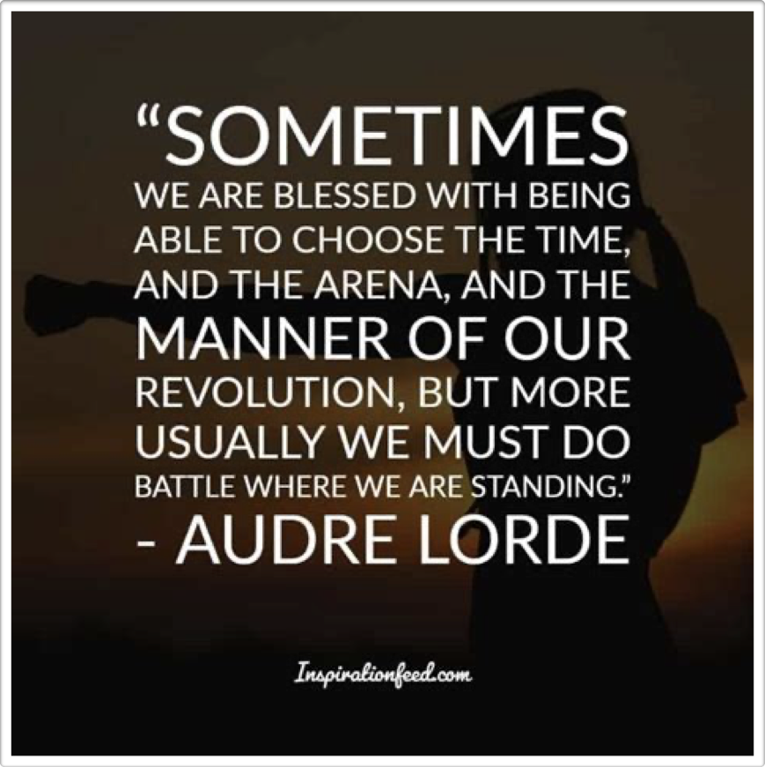
Next Steps, EDI in Action
How does the internalized & interpersonal stories we carry within us influence how we show up?
When you engage in your daily work whose story is being centered? Whose voice is being left out? Why?
How do you mitigate the centering of whiteness & the innate imbalance of power engaging in your daily work?
What do we want anti-racism in action to look like for our team?
What do we want anti-racism in action to look like for our job role?
Notes:
5 minute = 71 min mark
At this point in the journey I want you to focus on 2 things
1) what are the narratives that come up for you throughout the day. How do that contribute/condone/or are complicit to whiteness, bias, stereotypes, privilege
2) Talk with your teams & ask these questions

Slide 29
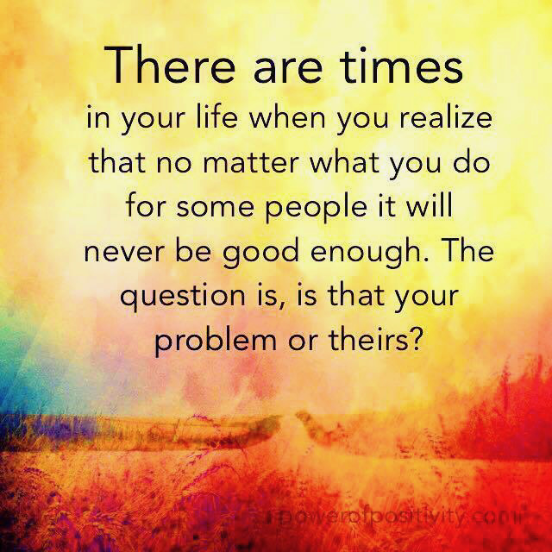
SELF CARE WORK

Slide 30
What Does Emotional Labor Look Like for You?
Ingesting JEDI content without a composting processes.
Navigating & dealing with resistance.

Slide 31
What Would Active Support Look Like?
From Yourself:
Identifying narratives that no longer serve me.
Prioritize myself!
Identifying my boundaries & being able to say No.
Calling our harm when its experienced.

Slide 32
What Would Active Support Look Like?
From Your Allies:
When they see marginalized set-up for failure/ harm/ increased burden or know something/someone is gonna be an issue NAME THAT *ISH!

Slide 33
What Would Active Support Look Like?
From Your Leadership:
Foundational cultural humility conversation of honoring & respecting what it means to be me {ie what I stand for, how my lived experiences have informed my patterns of behavior & method of engagement, especially with white or male leaders}.
Shared agreement on what it means to be in partnership.
Communication agreements {understanding what is the norm or logical has emotional impact for me as a historically marginalized person}
Commitment to transparency.
Psychological safety agreement so harms can be names when they occur.
NEVER throw me under the bus or placate me – AUTHENTICITY at all times!!!

Slide 34
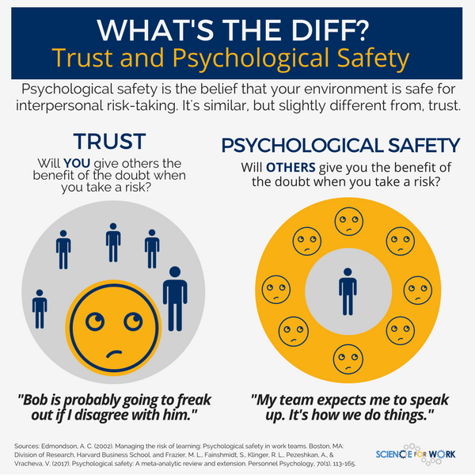
Psychological Safety
A shared belief that a group is safe for interpersonal risk-taking.
I can ask questions & admit mistakes or knowledge gaps.
I can offer my perspective & ideas freely regardless of hierarchy.
I can raise concerns or name conflicts without fear of reprisal.
I feel seen, heard & valued.
Notes:
Psychological Safety: Again this applies to addressing internal dynamics with the department/org & can be a resource shared for engaging with patients
Psychological safety means as a learner which we all are, I can ask questions & admit mistakes or knowledge gaps/
As a contributor I can offer my perspective & ideas freely regardless of hierarchy/
As a Challenger I can raise concerns or conflicts without fear of reprisal/
As a member of the team I feel seen, heard & valued
Psychological safety doesn’t just happen we actually must sit down with one another & create this container as we all have different styles & needs when it comes to communication.
Psychological safety requires us to:
embrace our discomfort/
own our intentions & impacts/
disagree with civility/
separate ideas from people {ie I’m not saying you’re a bad person, I’m saying that I struggle with your method of engagement}/
identify & agree upon what it means to be respectful {this is not about hierarchy, its about seeing our shared humanity regardless of hierarchy & agreeing to being called in when we default into “whiteness norms”}
I would also say that a baseline level of trust is needed & if harm has been experienced in the past a restorative practice

Slide 35
What Would Demonstrate Psychological Safety to You?
Taking an unprompted stand for me, whether I’m present or not.
Having difficult conversations with me that helps us to develop a foundation for partnerships.
Interest in understanding my approach to my work so that you can better support me.
Being honest with me first.
Allowing me to be authentically myself without repercussion.

Slide 36
What Does Nurturing Yourself Look Like?
Work hour boundaries
Interpersonal boundaries
Shadow work/reflection
Yoga, Meditation, Spiritual practices
Nature
Joy activities {photography, jewelry making, kayaking}
Soul Tribe support

Slide 37
What Would You Want to Have in a JEDI Monthly Support Group Space?
What structure/ format?
What topics/ focus?
What resources?

Slide 38
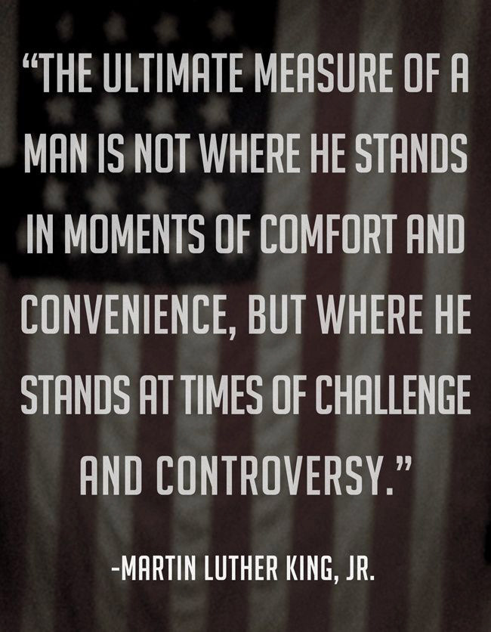
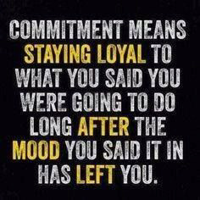
Questions?
Kevonya Elzia, MA, BS, RN
Director of Justice Equity Diversity Inclusion
Kelzia@NHCHC.org

Slide 39

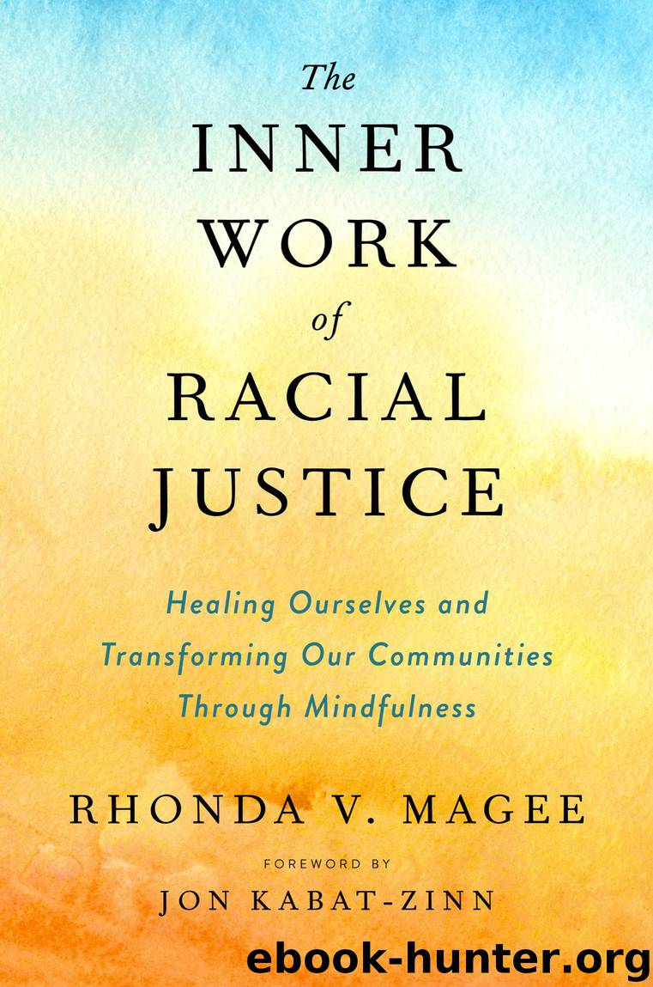




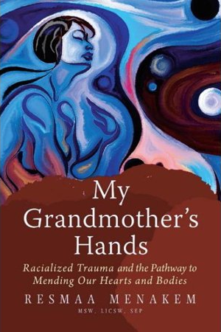



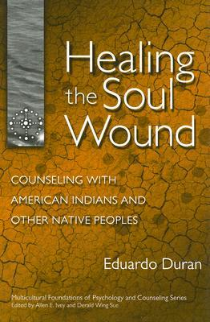







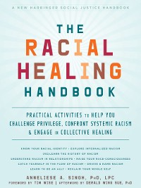

Slide 40



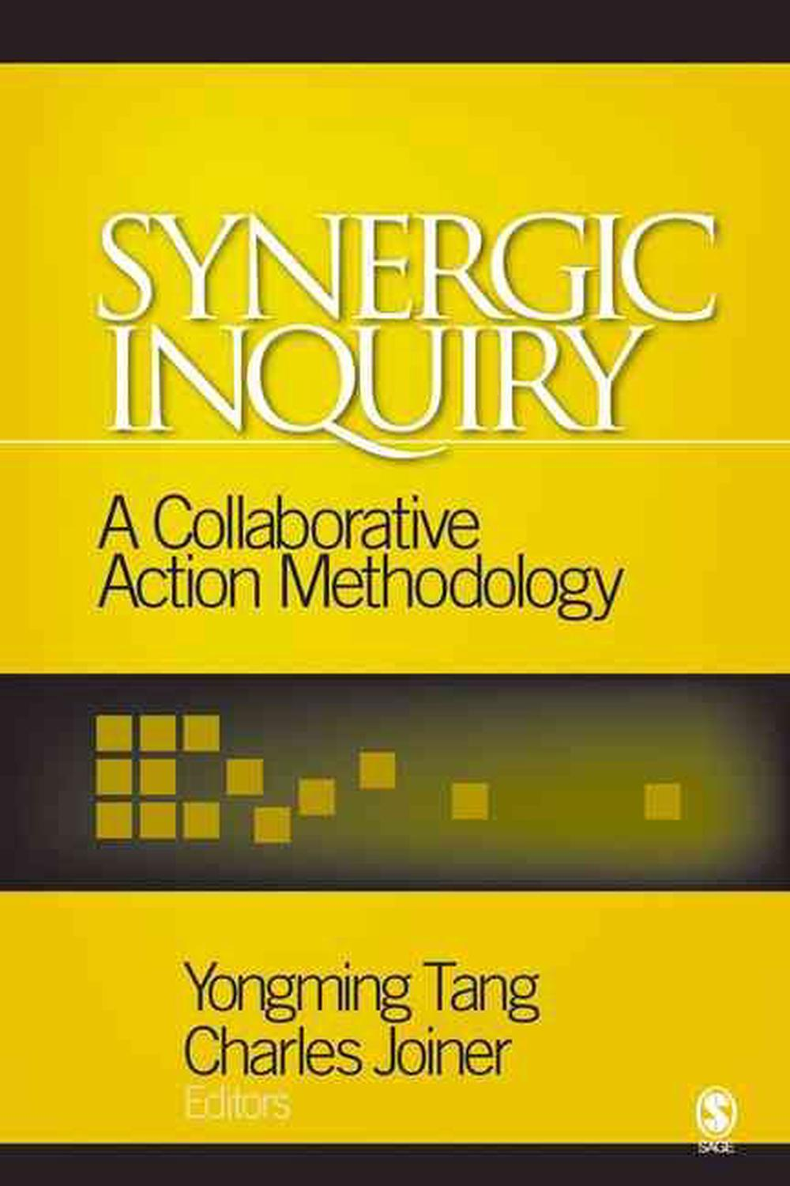
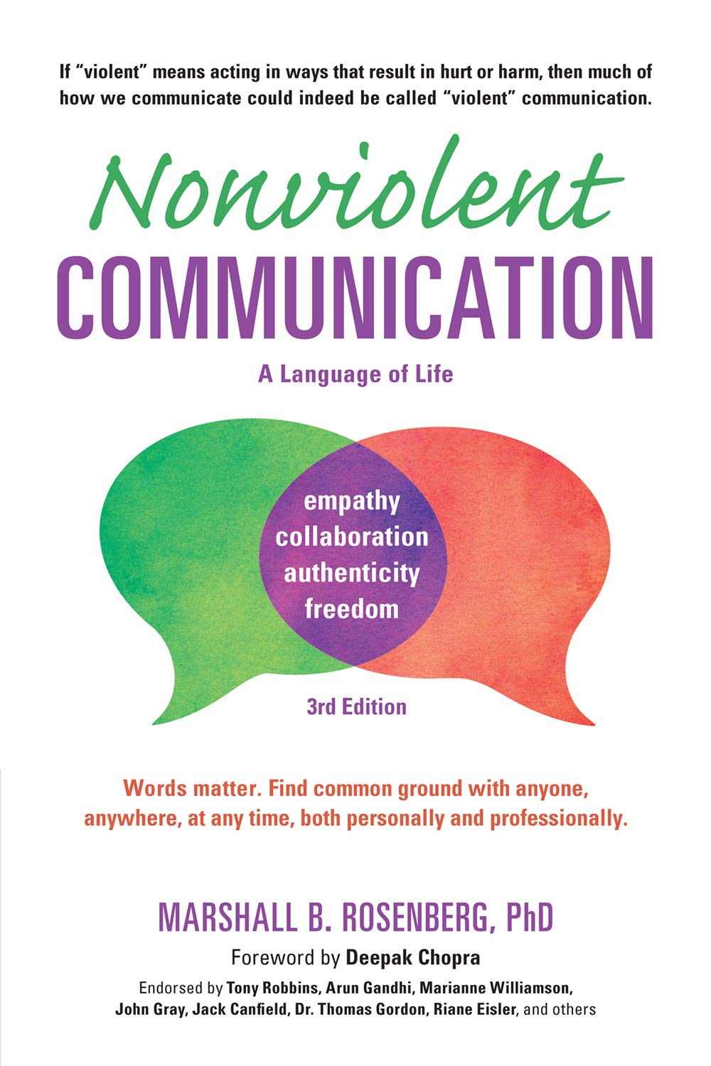



Slide 42

EQUITY TOOLS

Slide 43
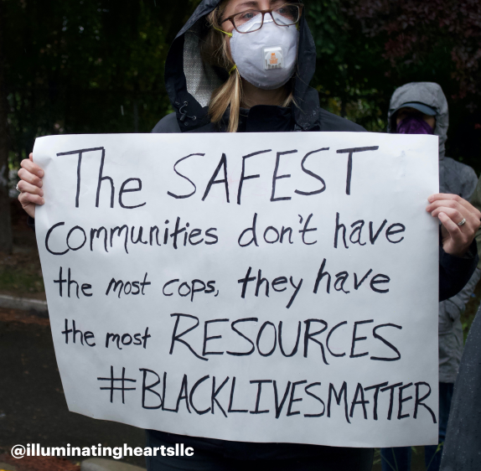
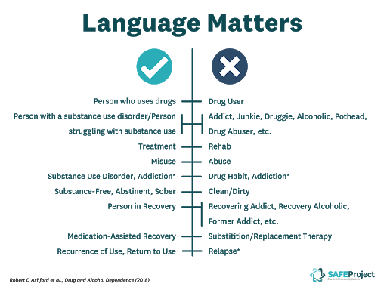
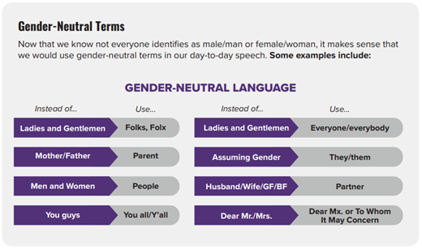
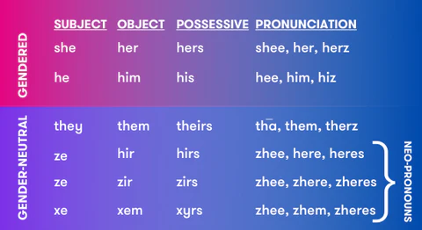
Equity Tools
Anti-Racism
Standardize use of Pronouns
Person First Language
Is about supporting antiracist policies & practices through actions or expressing an antiracist ideas. When I am embodying anti-racism it includes all the intersecting ways that racism can present itself
Using the right pronouns to refer to a person can be one of the easiest ways to show them respect and help them to affirm themselves. It is also one of the best ways to promote an inclusive atmosphere within your organization.. Pronouns ≠ Gender.
Person first language emphasizes the person before the disability, for example “person who is blind” or “people with spinal cord injuries.” Identity first language puts the disability first in the description, e.g., “disabled” or “autistic."
Notes:
Antiracism - Is about supporting antiracist policies & practices through actions or expressing an antiracist ideas. When I am embodying anti-racism it includes all the intersecting ways that racism can present itself
Person First Language – as we do trainings we should default to person first language. When engaging in 1:1 conversations as with other things it’s up to the person how they wish to identify & they should not be corrected. Its important for us to default to person first language because we want to acknowledge that people are more than the the disease or circumstances that they currently are navigating. We want to decrease stigma & not support stereotyping.
Standardize use of Pronouns: Using the right pronouns to refer to a person can be one of the easiest ways to show them respect and help them to affirm themselves. It is also one of the best ways to promote an inclusive atmosphere within your organisation. Pronouns ≠ Gender. (Remember that you can't tell someone's gender identity or pronoun use just by looking at them. If you don't know someone's pronouns but you still want to refer to them in the third person, you can use they/them pronouns until you know. Example: you are trying to point out an attendees who asked for A/V help at the conference to another staff member but you don't know their pronouns, you could say: "that person with the yellow sweater said they are having trouble with their mic."). Gender-neutral pronouns are also a polite and easy way to refer to someone until you know what pronouns they use. (There are a range of pronouns that people may use, some are more common than others. Here is a list of some of the most common you may hear when meeting new people [show graphic].) Neo-pronouns are any set of singular third person pronouns that are not officially recognized in the language they are used in, typically created with the intent of being a gender-neutral pronoun set. There are lots of reasons as to why it’s important to use the correct pronouns for a person. Using the right pronouns to refer to a person can be one of the easiest ways to build rapport, show them respect, and help them to affirm themselves. On the flipside, using the wrong pronouns to refer to someone can actually be quite harmful even if it is accidental or unintentional.
“Misgendering” is a term used to describe accidentally or intentionally using incorrect pronouns about or towards a person. It can happen as an accident, and that's okay. The important thing to remember is that it’s okay to make mistakes but not to make a big deal out of it. Apologise and rectify your mistake and then move on. A good way to prevent this from occurring too often is to practice using someone’s pronouns mentally before using them out loud in conversation. (I like to practice by saying positive things about that person to myself e.g. "I love working with Kevonya, she is so lovely to work with.) (If someone mentions that they use several pronouns (e.g. she/they, they/she), it usually means either are fine. Sometimes people list the pronoun they prefer first in the list, but that isn't true for everyone.)
Person first source: https://askearn.org/page/people-first-language

Slide 44

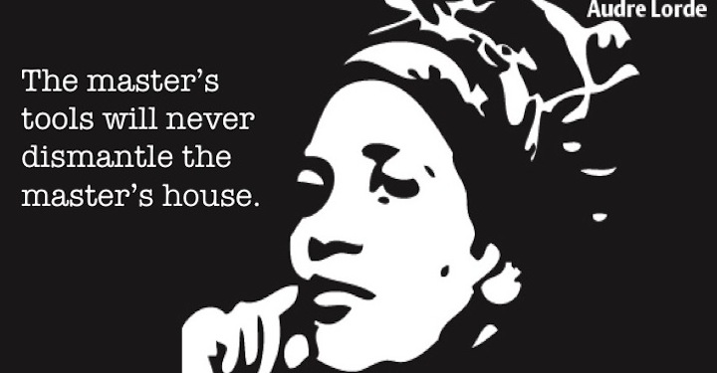
Agent of Change Equity Tools

Slide 45
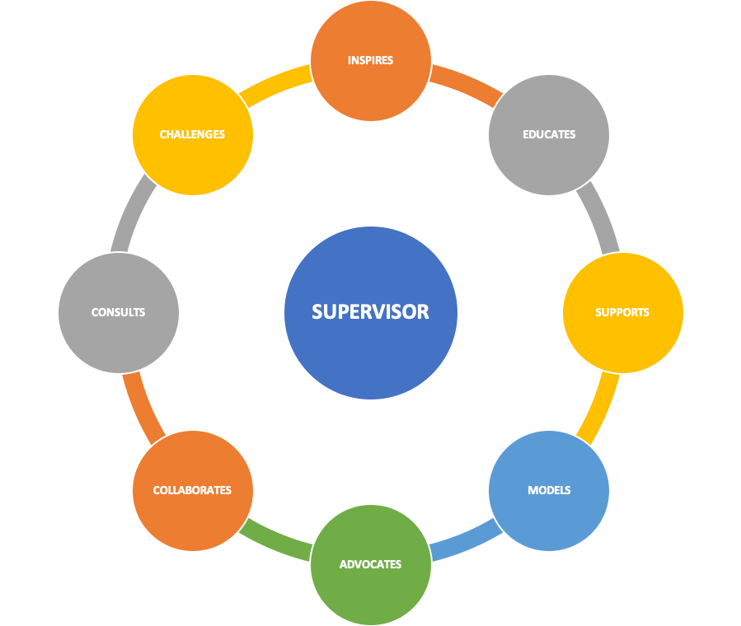
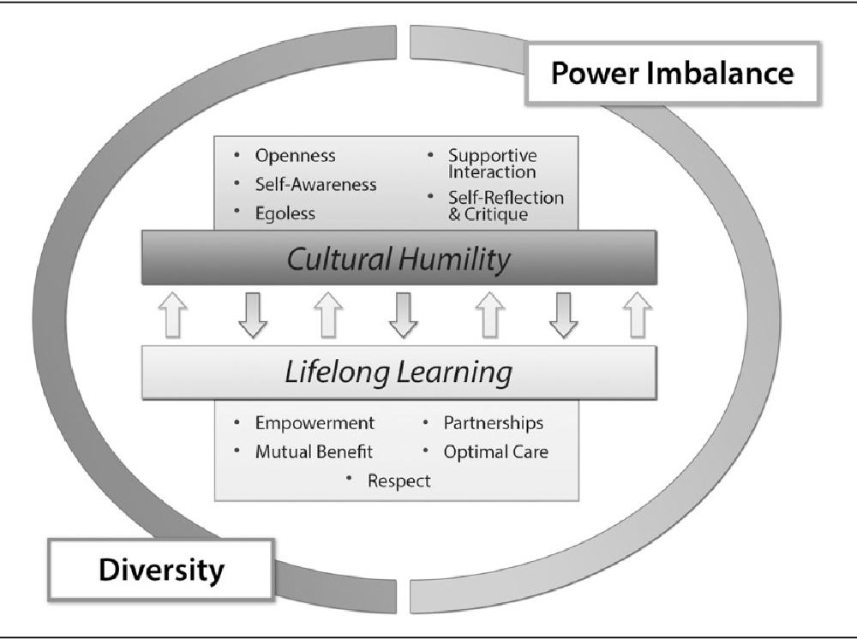
Equity Tools
Cultural Humility
Psychological Safety
Trauma Informed Sup
is about cultivating an open attitude or open mind, and new skills in yourself, while at the same time learning about and honoring other people’s cultures.
a shared belief that a group is safe for interpersonal risk-taking
Combines knowledge about trauma & supervision, focusing on the characteristics of the interrelationship between cultural humility, the mission of the org, the nature of doing social justice & human rights work and the context in which we are doing said work.
Notes:
Cultural Humility : is the ability to learn from and relate respectfully with people of your own culture as well as those from other cultures. It is not about trying to change other to become more like you. It is about cultivating an open attitude or open mind, and new skills in yourself, while at the same time learning about and honoring other people’s cultures. For us internally this means recognizing that we each bring different personal & cultural experiences into our work. We likely have different expectations of what work is, how we define a healthy work environment, how we feel fulfilled by the work we do, & a different definition of what define work ethic, especially across generations & marginalized identities. Cultural humility is acknowledging that my lived experiences are apart of me & inform how I show up in the world & influence how I respond to things. And because we carry different experiences & narratives within us there will be oops/ouch moments. When these occur the feelings that may result & the well intentions are both valid AND still require a restorative process to be in place to help address when these moments of tensions happen so we can continue to work together without giving each other side eye which can undermine a healthy/supportive/equitable work culture.
This means as we work & collaborate together on teams & across teams we need to normalize incorporating this into our planning conversations. Our leaders needs to incorporate this into how they lead & support teams.
Two teammates had me doing a lil happy dance when I saw it by explicitly naming work differences in their email signatures. They name that their work hours might differ from those who they are communicating with & encourage the respondent not to feel pressured to answer back during the respondent’s off hours.
Psychological Safety: Again this applies to addressing internal dynamics with the department/org & can be a resource shared for engaging with patients
Psychological safety means as a learner which we all are, I can ask questions & admit mistakes or knowledge gaps/
As a contributor I can offer my perspective & ideas freely regardless of hierarchy/
As a Challenger I can raise concerns or conflicts without fear of reprisal/
As a member of the team I feel seen, heard & valued
Psychological safety doesn’t just happen we actually must sit down with one another & create this container as we all have different styles & needs when it comes to communication.
Psychological safety requires us to:
embrace our discomfort/
own our intentions & impacts/
disagree with civility/
separate ideas from people {ie I’m not saying you’re a bad person, I’m saying that I struggle with your method of engagement}/
identify & agree upon what it means to be respectful {this is not about hierarchy, its about seeing our shared humanity regardless of hierarchy & agreeing to being called in when we default into “whiteness norms”}
I would also say that a baseline level of trust is needed & if harm has been experienced in the past a restorative practice
Cultural humility & psychological safety gives us a foundation to engage in trauma informed supervision.
Combines knowledge about trauma & supervision, focusing on the characteristics of the interrelationship between cultural humility, the mission of the org, the nature of doing social justice & human rights work and the context in which we are doing said work {ie swimming in the waters of oppression}.
Trauma informed supervision
Emphasizes supporting staff members
Encourages self-care
Is relationship & motivational interviewing based
Values honest communication & transparency
Is strengths-based in both attitude & language.
As TIARA & I work on organizational trainings this will be one that we will be looking for all who supervise to attend. It’s my understanding that its currently an optional option right now through C4 but only one person on our management team and 2 program managers has attended thus far. If we are to really make being trauma informed apart of our culture its important that we walk our talk. And as being trauma informed is something we externally encourage to other organizations we all should be versed in its principles.
Trauma informed supervision image source: https://cetc.org.au/the-role-of-supervision-in-the-trauma-informed-journey/
Cultural humility image source: Foronda, C.L., Baptiste, D., Reinholdt, M.M., & Ousman, K. (2016). Cultural Humility. Journal of Transcultural Nursing, 27, 210 - 217. web address: https://www.semanticscholar.org/paper/Cultural-Humility-Foronda-Baptiste/f5d79fd49d35fca706b5c38a827481db7018177c#citing-papers

Slide 46
Equity Tools
Recognizing
Repairing Relationships
Reflection
Nurture & Building
Discover Strengths
Inclusion
Empowerment
Purposefulness
Ethical Behaviors
Process Orientation
Relational Leadership
Healing Centered Restorative Engagement
Asks us to look at how can what’s right be used to support the healing & restoration of the person or community from what happened. This can be used to address internal organizational issues and when engaging with patients directly There are five components to healing-centered restorative engagement.
The relational leadership model emphasizes the relationships among people when leading an organization. Relational leadership values inclusion, empowerment, purposefulness, ethical behaviors, and process orientation.
Notes:
Healing Centered Restorative Engagement: asks us to look at how can what’s right be used to support the healing & restoration of the person or community from what happened. This can be used to address internal organizational issues and when engaging with patients directly There are five components to healing-centered restorative engagement:
Recognizing – what is causing harm in the moment/situation
is it miscommunication; is there an unspoken expectation/ need that is not being address; was this an agreed upon expectation or is it from socialized/dominant culture
Discovering Strength {already present} - how can what's right be used to: heal, restore connection, understanding, empower the person who is being marginalized in this moment
Repairing Relationships – Who has been hurt? • What are their needs? • Who has the obligation to address the needs, to put right the harms, to restore relationships? (As opposed to: What rules were broken? Who did it? What do they deserve?) This is not about punishing it's about, reestablishing a two way street of trust/connection, owning our impact when it doesn't match our intent, its about collaborating with patients to help identify health goals that make sense to them & where they feel seen/heard, meeting patients & families where they are. The same is true if the issue is between two staff members regardless of place within the organization.
Reflection – this should be done independently & as a team if it’s an internal issue we are addressing. Reflection is an important part of growth so we can learn. Pause & Breathe, get out of reaction/crisis mindset, what happened today, I feel like there is a story/understanding I'm missing that contributed to today's events. What went well, what could have gone better, what should we continue doing, what should we look at doing differently,
Nurturing & Building – what will help support both of us to have a meaningful connection {what so you need & what do I need}, what do we need as a team, do we need to set adjust our norms of engagement/communication, what is our shared understanding of being a team, what is our shared understanding of what a supportive leader is, what an engaged teammate is, what is our unique & shared understanding of our roles on the team, what are our complementary strengths as a team or leads, what is our shared understanding of communication norms, what are each of our responsibility in communicating & working together as a team, understanding of norms around how we engage with each other.
Relational Leadership https://youtu.be/kswcW9e3tXc
The relational leadership model emphasizes the relationships among people when leading an organization. It’s a relational process of people together attempting to accomplish change or make a difference to benefit the common good. It acknowledges the diverse talents of group members and trust the process to bring good thinking to the socially responsible changes group members agree they want to work toward. Acknowledging that relationships are the key to leadership effectiveness. This philosophy values being ethical and inclusive.
This is my dream standard for the organization I work for.
Inclusion: Being inclusive means that the leader truly believes that everyone can make a difference and that the leader can actively listen to everyone in the group.
Empowerment: Empowering others is an extremely important quality when it comes to a leader’s success. To empower others, a leader needs to give them the ability to be involved as well as the feeling of being involved in group decision-making. A leader using the relational leadership style needs to have a true concern for the growth and development of others and the tools to encourage that growth.
Purposefulness: A relational leader knows exactly for what they are working The leader can not only identify the group’s goals and have a vision of the outcome, but fully involve others in the vision-building process.
Ethical Behaviors: Practicing ethical behaviors is slightly vague, but it means that moral values and standards drive the leader. These values should be used to make ethical decisions and to model the behaviors that the rest of the group needs to follow. And should be in alignment with the overall mission & vision of the organization. An example of this is the use of community health workers, within our current medical model this position within community health isn’t financially supported and yet ethically we know it’s the right thing to add into our clinics for the betterment of patient care.
Process Orientation: This focuses on how the group decides to function as a team, including how everyone stays together, communicates, solves problems, and achieves communal goals. For the leader to be process-oriented, they need to believe that the process is as important as the outcome and they need to encourage collaboration and reflection throughout the process.

Slide 47
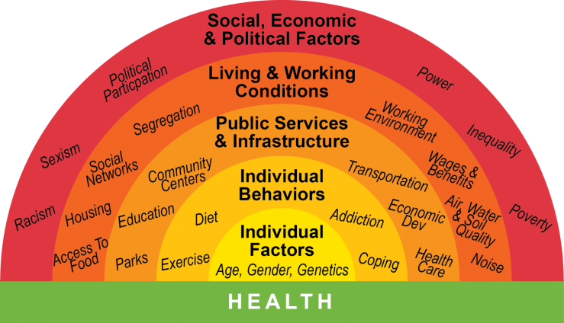
Levers of Health/Vital Conditions
Notes:
When engaging in our work it’s important that we pause and ask ourselves:
Before/When engaging in care with a patient ask yourself:
Do I hold any bias for best practices around this topic or population?
Am I being mindful of the social, economic, political factors at play for this population?
Am I being mindful of the living & working conditions at play for this population?
What is the lived experience of the community this person is a member of vs what is their personal lived experience?
What systems of oppression are in play that are contributing to the health needs/disparities of this patient & their community?
What marginalizing/disempowering/ or victim-blaming narratives do I hold/carry for this community?
All of this impacts the care you provide & the person’s ability to hear, understand, & act on health/well-being recommendations.
When engaging in our work it’s important that we pause and ask ourselves:
Do I hold any bias for best practices around this topic or population?
Am I being mindful of the social, economic, political factors at play for this population?
Am I being mindful of the living & working conditions at play for this population?
What is the lived experience of the community this person is a member of vs what is their personal lived experience?
What systems of oppression are in play that are contributing to the health needs/disparities of this patient & their community?
What marginalizing/disempowering/ or victim-blaming narratives do I hold/carry for this community?
All of this impacts the care you provide & the person’s ability to hear, understand, & act on health/well-being recommendations.

