Slide 1
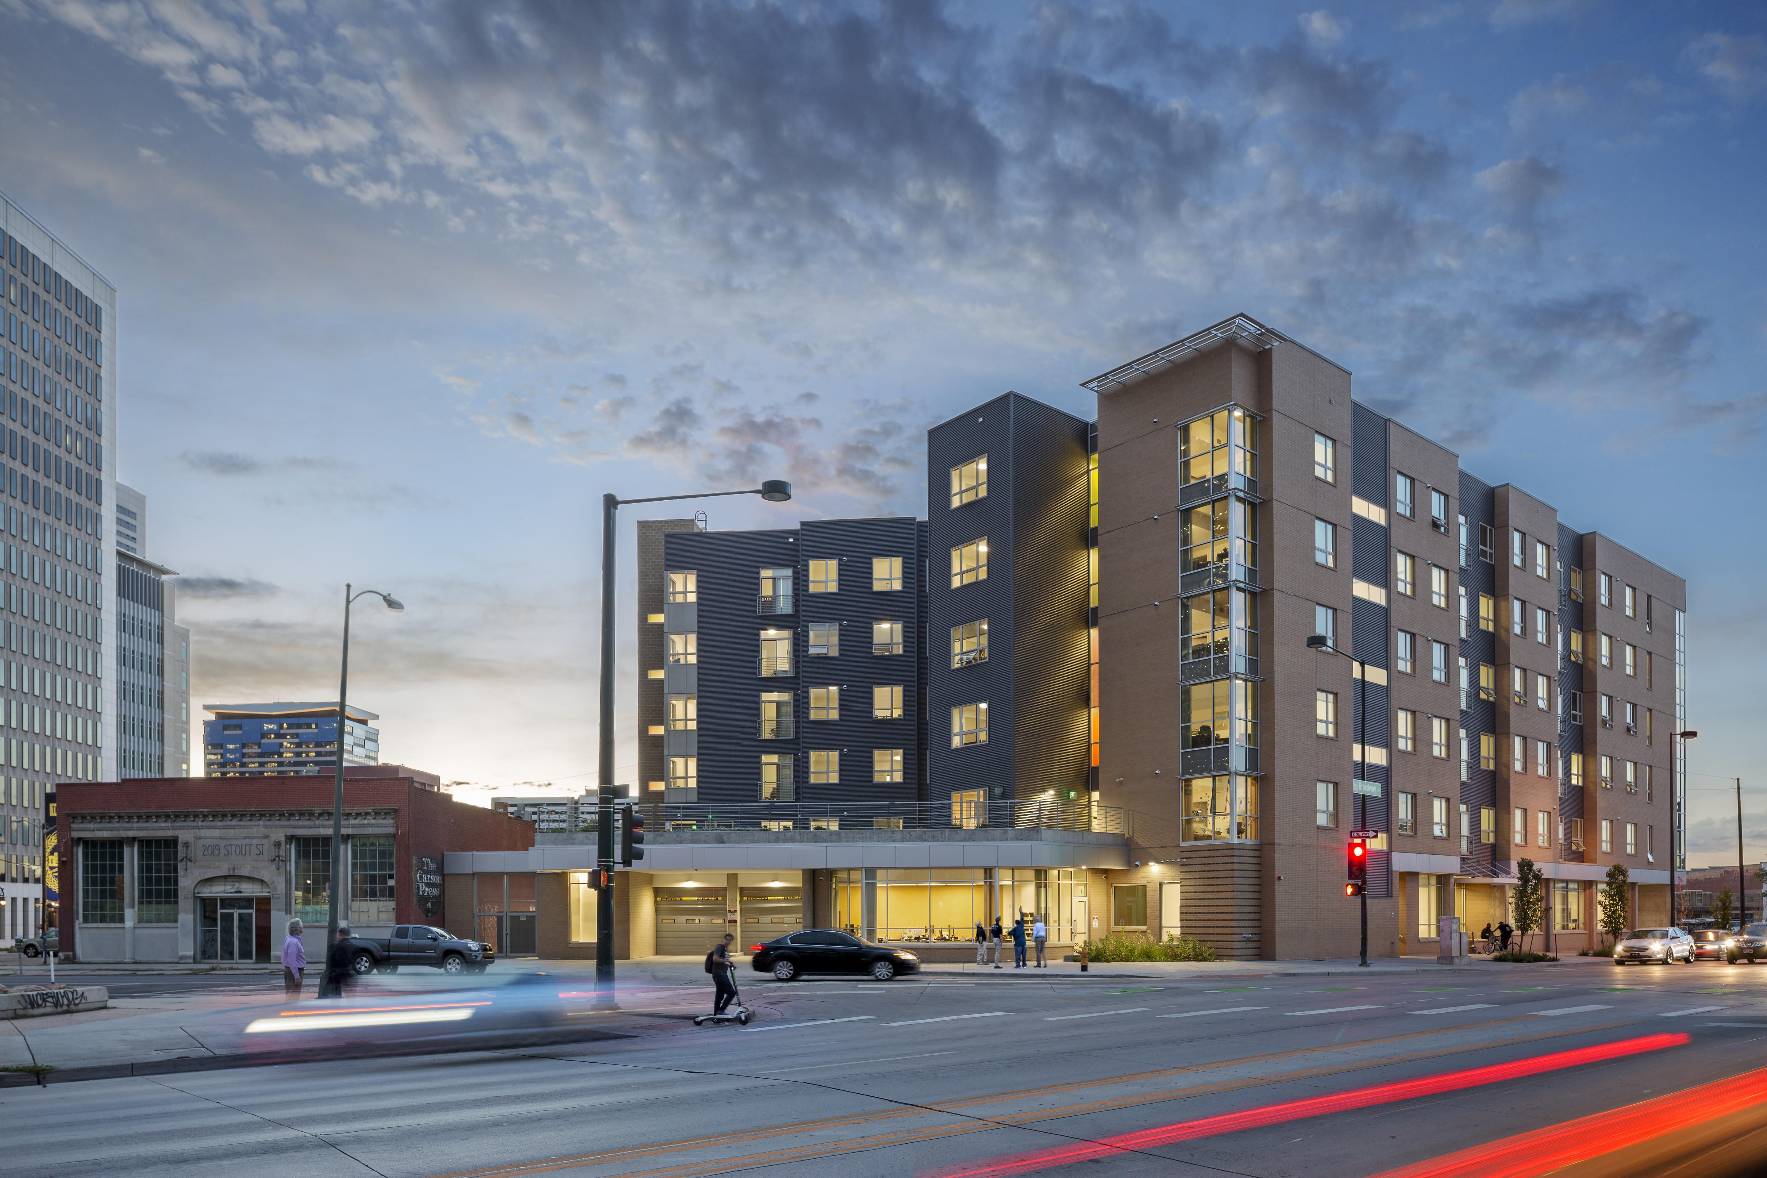
HOW TO USE REPORTS & DATA (LIKE SIB) TO SUPPORT ADVOCACY

Slide 2
COLORADO COALITION FOR THE HOMELESS
Cathy Alderman Chief Communications and Public Policy Officer
CAlderman@coloradocoalition.org

Slide 3
OUR MISSION
The Mission of the Colorado Coalition for the Homeless is to work collaboratively toward the prevention of homelessness and the creation of lasting solutions for families, children, and individuals who are experiencing or at-risk of homelessness throughout Colorado. CCH advocates for and provides a continuum of housing and a variety of services to improve the health, well-being and stability of those it serves.

Slide 4
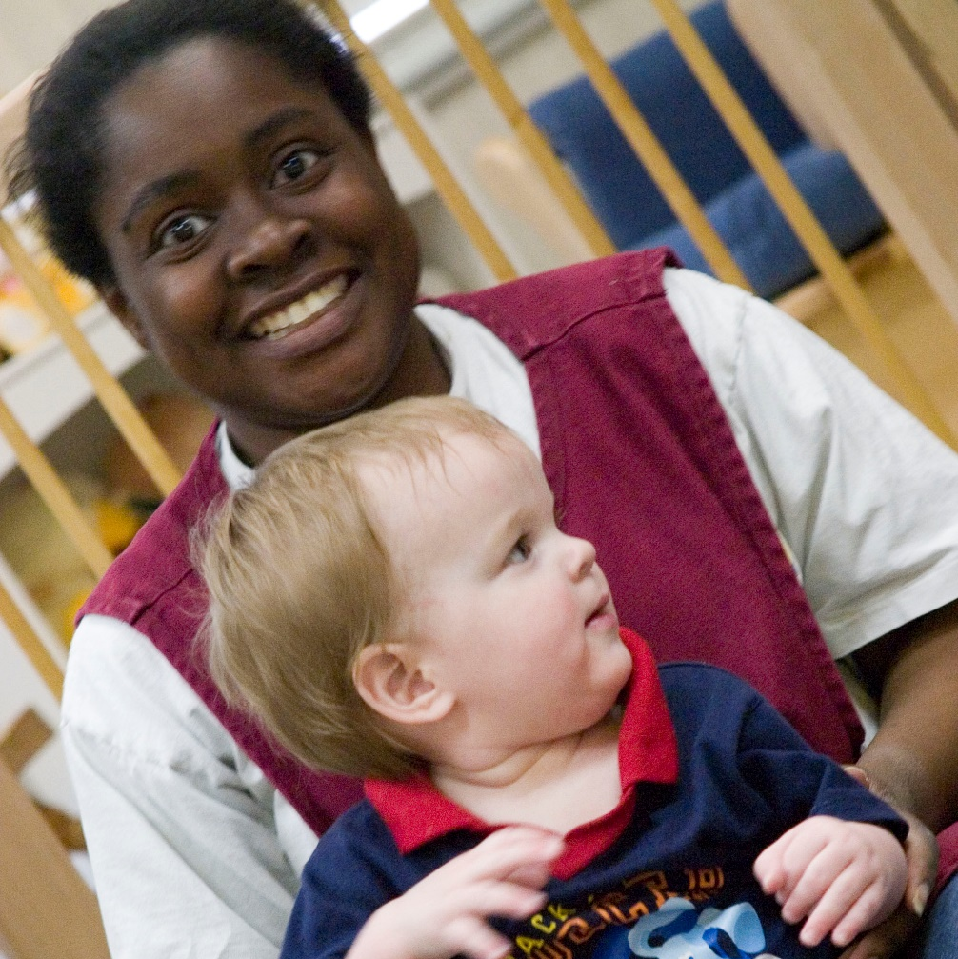
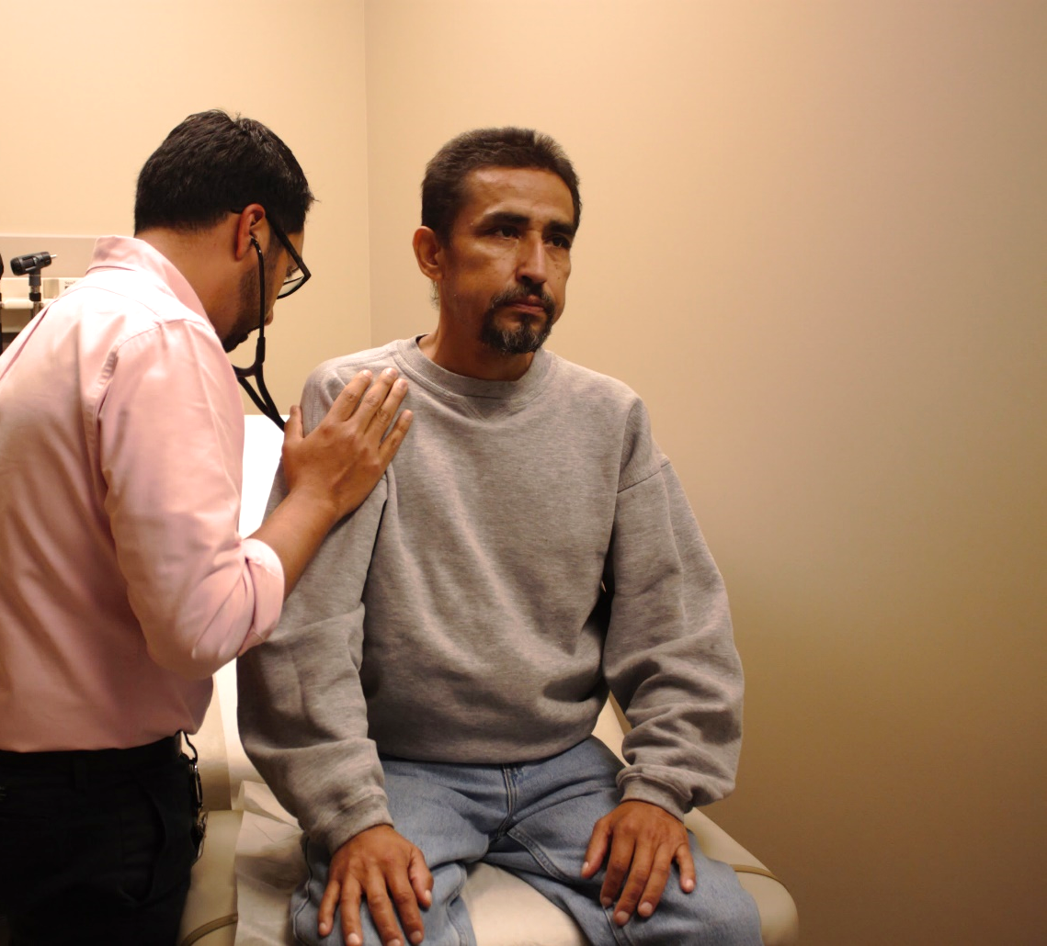
COLORADO COALITION FOR THE HOMELESS
Healthcare
15,000 served yearly
Housing
4,300 served yearly
Supportive Services
20,000 served yearly
Advocacy & Education
Notes:
HEALTHCARE:
Stout Street Health Center and 5 satellite locations, including Health Outreach Program (HOP), 48th Avenue Shelter. We also do telemedicine and street medicine.
Helped house people during COVID – 5,000 in PA/AR sites
HOUSING:
Our first property was in 1996, and we now have 20. We innovate regularly and respond to evolving community needs. For instance Fusion Studios was us updating a hotel rather than building from scratch which made it much faster. We also have efforts like the Renaissance veterans apartments at Fitzsimons that are for particular populations.
SUPPORT SERVICES:
Community Resources
Outreach
Project to Assist in the Transition from Homelessness (PATH)
Family Support Services
Case Management Program
Housing Assistance
Vocational Programs
Recovery Services
Rural support
We also help through Advocacy efforts!

Slide 5
CCH’s EDUCATION & ADVOCACY GOALS AND PRIORITIES
Shape public policy and advocate for social and racial equity and systems change alongside the people we support at the local, state, and federal levels.
Build strategic relationships and create meaningful engagement opportunities throughout the state to influence policy in the areas of housing, healthcare, and homelessness.
Influence public perception and awareness about homelessness and other systemic issues to shape the public narrative around homelessness at local, state, and federal levels.
Continue to grow a robust internal communications strategy to create stronger, consistent connections across the organization.

Slide 6
CCH POLICY PRIORITIES
Homelessness
Housing investments
Housing protections
Access to healthcare
Public health
Economic security
Criminal legal reform

Slide 7
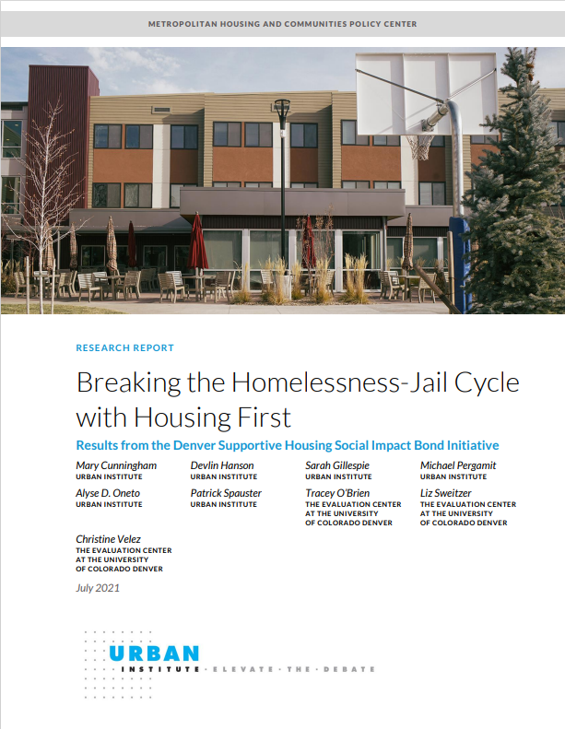
WHAT KIND OF ADVOCACY?
With Elected Officials and Public:
Advocacy = Communication with Public Officials to Impact Policy AND Communication/Education to the Public to Inform/Influence Public Perception
Why the data matters?
Some people are persuaded by personal stories and impacts
Some people are persuaded by data especially data that shows:
Impact of interventions for the people
Financial impact of the intervention
A combination is usually a winning case because it appeals to everyone
.
https://urbn.is/3AV7mgh
Notes:
They're our neighbors, they just happen to be unhoused.

Slide 8
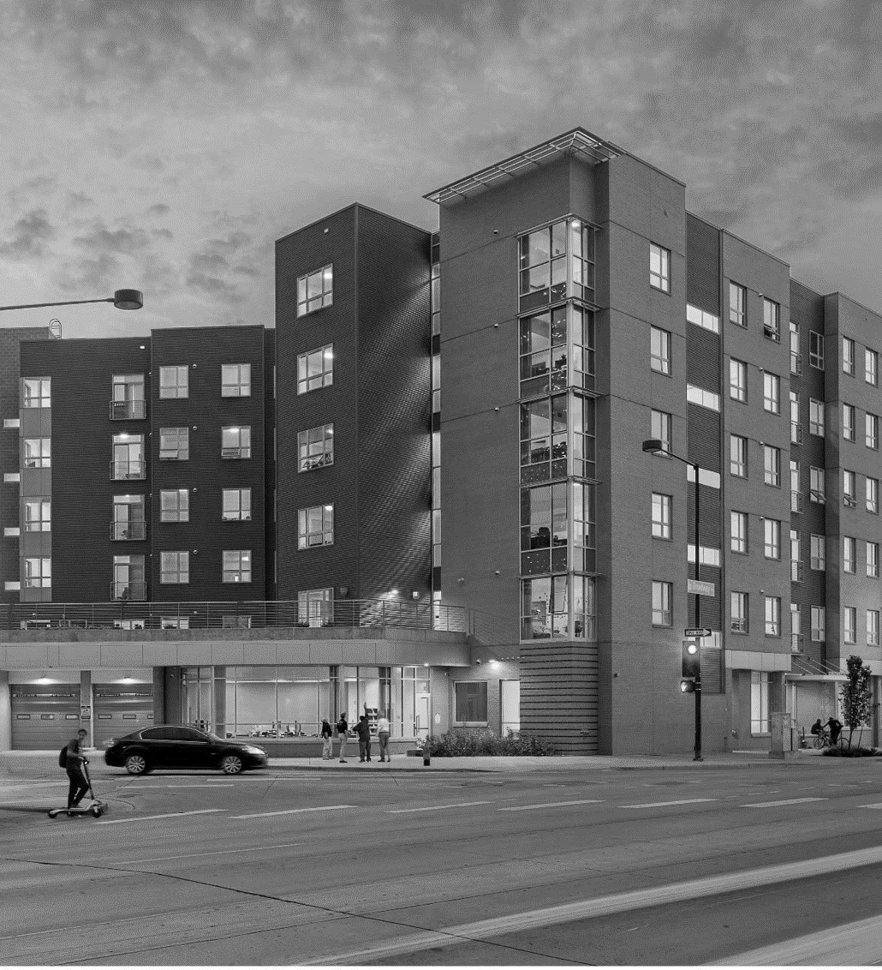
SUPPORTIVE HOUSING WORKS: SOCIAL IMPACT BOND
Supportive housing for chronically homeless individuals who frequently use emergency resources.
Services provided at half the cost per individual, compared to incarceration, detox, medical care and shelter.
80%
Retention
50% - 70%
Reduction in Arrests
25% - 33%
Fewer ER Visits

Slide 10
HOW WE USED SIB DATA AND STORIES
With elected officials – Make the case for effective investments and policy
Affordable Housing Transformational Task Force Subpanel Work
Final Report
Drive narrative around legislation
With the public – to build understanding and support
Report Launch event and Webinar Series
Strategic Investment Report
Report release event
Media Engagement
Presentations at conferences

Slide 11
HOUSING INVESTMENT LEGISLATION 2022
HB22-1304: State Grants Investments Local Affordable Housing - $178M for two grant programs
SB22-159: Revolving Loan Fund Invest Affordable Housing - $150M for loans
HB22-1051: Modify Affordable Housing Tax Credit - Extends $10m annual credit to December 2031
HB22-1282: Innovative Housing Incentive Program - $40M for innovative manufacturing
SB22-146: Middle Income Access Program Expansion - $25M for existing CHFA program
SB22-160: Loan Program Resident-Owned Communities - $35M for loans
HB22-1117: Use of Local Lodging Tax Revenue – specifically for housing
SB22-232: Creation of Middle-Income Housing Authority

Slide 12
HOMELESSNESS LEGISLATION
HB22-1377: Grant Program Providing Responses to Homelessness
$105M for local homelessness projects
HB22-1378: Denver-metro Regional Navigation Campus Grant
$50M grant to local government for creation/operation
SB22-211: Repurpose the Ridge View Campus
$45M for campus transition
HB22-1083: Homeless Contribution Income Tax Credit

Slide 13
SHAPING THE PUBLIC NARRATIVE/MEDIA WITH REPORTS/DATA (HEADLINES MATTER)
“Denver’s Homeless Program Called a Remarkable Success”
“Denver’s Creative Approach to Homelessness Sees Returns”
“Denver Permanent Supportive Housing Program Saved Millions”
“Innovations in Financing Supportive Housing”
“Housing First Approach Breaks Down Barriers To Treating Chronic Homelessness”
“Denver Social Impact Bond Expands”

Slide 14
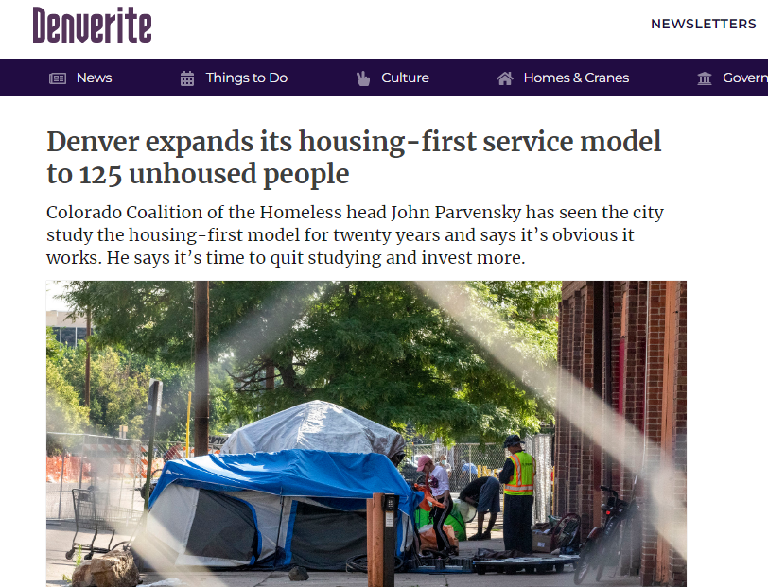
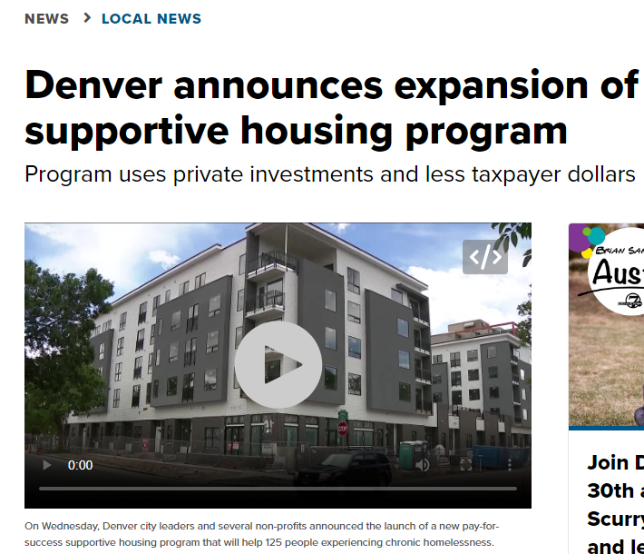
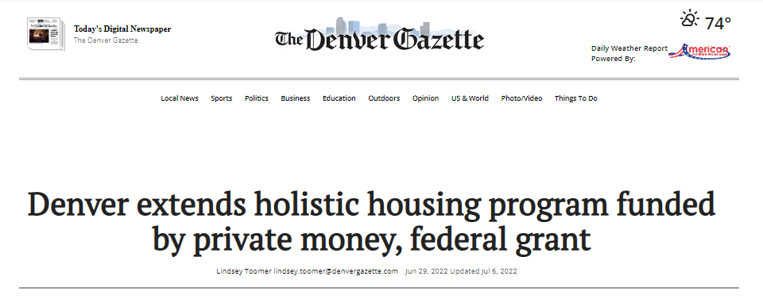
CONTINUED PRESS COVERAGE
From May 2022 to May 2023 (1 year after final report), there were 120 media hits RE: SIB and SIPPRA
Media reached of over 252M
Notes:
They're our neighbors, they just happen to be unhoused.

Slide 15
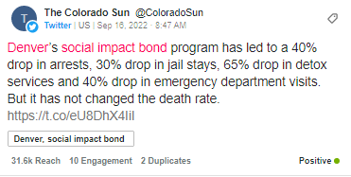
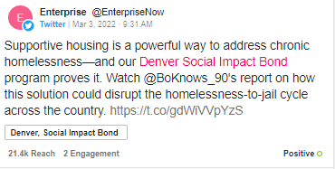
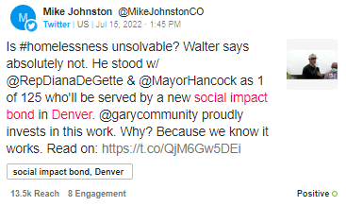
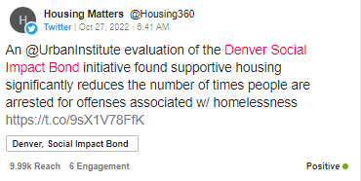
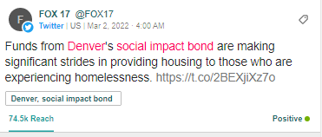
SOCIAL MEDIA COVERAGE
Notes:
They're our neighbors, they just happen to be unhoused.

Slide 16
SIB MODEL WAS REFERENCED IN PROPOSITION 123
. . . . OTHER HOMELESSNESS RELATED ACTIVITIES THE DIVISION DETERMINES CONTRIBUTE TO THE RESOLUTION OF OR PREVENTION OF HOMELESSNESS, INCLUDING HOUSING PROGRAMS PAID FOR BY NON-PROFIT ORGANIZATIONS, LOCAL GOVERNMENTS OR PRIVATE ENTITIES ON A PAY FOR SUCCESS BASIS, MEANING AN ORGANIZATION, LOCAL GOVERNMENT OR PRIVATE ENTITY WOULD RECEIVE FINANCIAL SUPPORT FROM THE PROGRAM UPON ACHIEVING OBJECTIVES CONTRACTUALLY AGREED UPON WITH THE DIVISION.
“Colorado voters approve Proposition 123, dedicating $300 million annually to affordable housing”

Slide 17
After three years, 77% remained housed and the city of Denver realized substantial savings. Overall, it costs taxpayers half as much to provide housing and supportive services than to let people experiencing homelessness remain unhoused. In addition to its devastating impact on those who experience homelessness, it comes at a great cost to communities and taxpayers. SIB demonstrates that strategic investments in housing and services for those with the lowest incomes and greatest need are a win for everyone.
FINAL REPORT
“
“
Notes:
They're our neighbors, they just happen to be unhoused.

Slide 18
LESSONS LEARNED
Don’t be afraid of data – Just don’t use too much
Balance personal stories and data use
Use outcomes to shape policy by showing effectiveness of targeted investments
Consistency with language can change the narrative
Public education is as important as outreach to elected officials

Slide 19
Questions?
Notes:
Shannan introduce, both answer questions

Slide 20
Cathy Alderman
CAlderman@coloradocoalition.org
VISIT COLORADOCOALITION.ORG
TO LEARN MORE
@COCOALITION

