Slide 1
Living on the Edge of the Edge: Multiple Palliative Care Models for People Experiencing Homelessness
Notes:
We are hoping for circular milieu. We hope you sit with folks you do not know because we will be interactive. Tanya

Slide 2
Shannon Ducharme, HW Melanie Bien, LCSW Tanya Majumder MD San Francisco Department of Public Health, Street Medicine and Shelter Health Shannon.Ducharme @sfsph.org melanie.bien@sfdph.org and tanya.majumder@sfdph.org
Creating a Model for Palliative Care for People Experiencing Homelessness in San Francisco
Creating a Model for Palliative Care for People Experiencing Homelessness in San Francisco
Notes:
Intros Tanya, Shannon, melanie
1 minute

Slide 3
Grounding
The work we do requires presence and attunement. That begins with providers. Take a moment with us to prepare for our time by checking in with yourself in this somatic grounding exercise
Notes:
Melanie
3-5 minutes

Slide 4
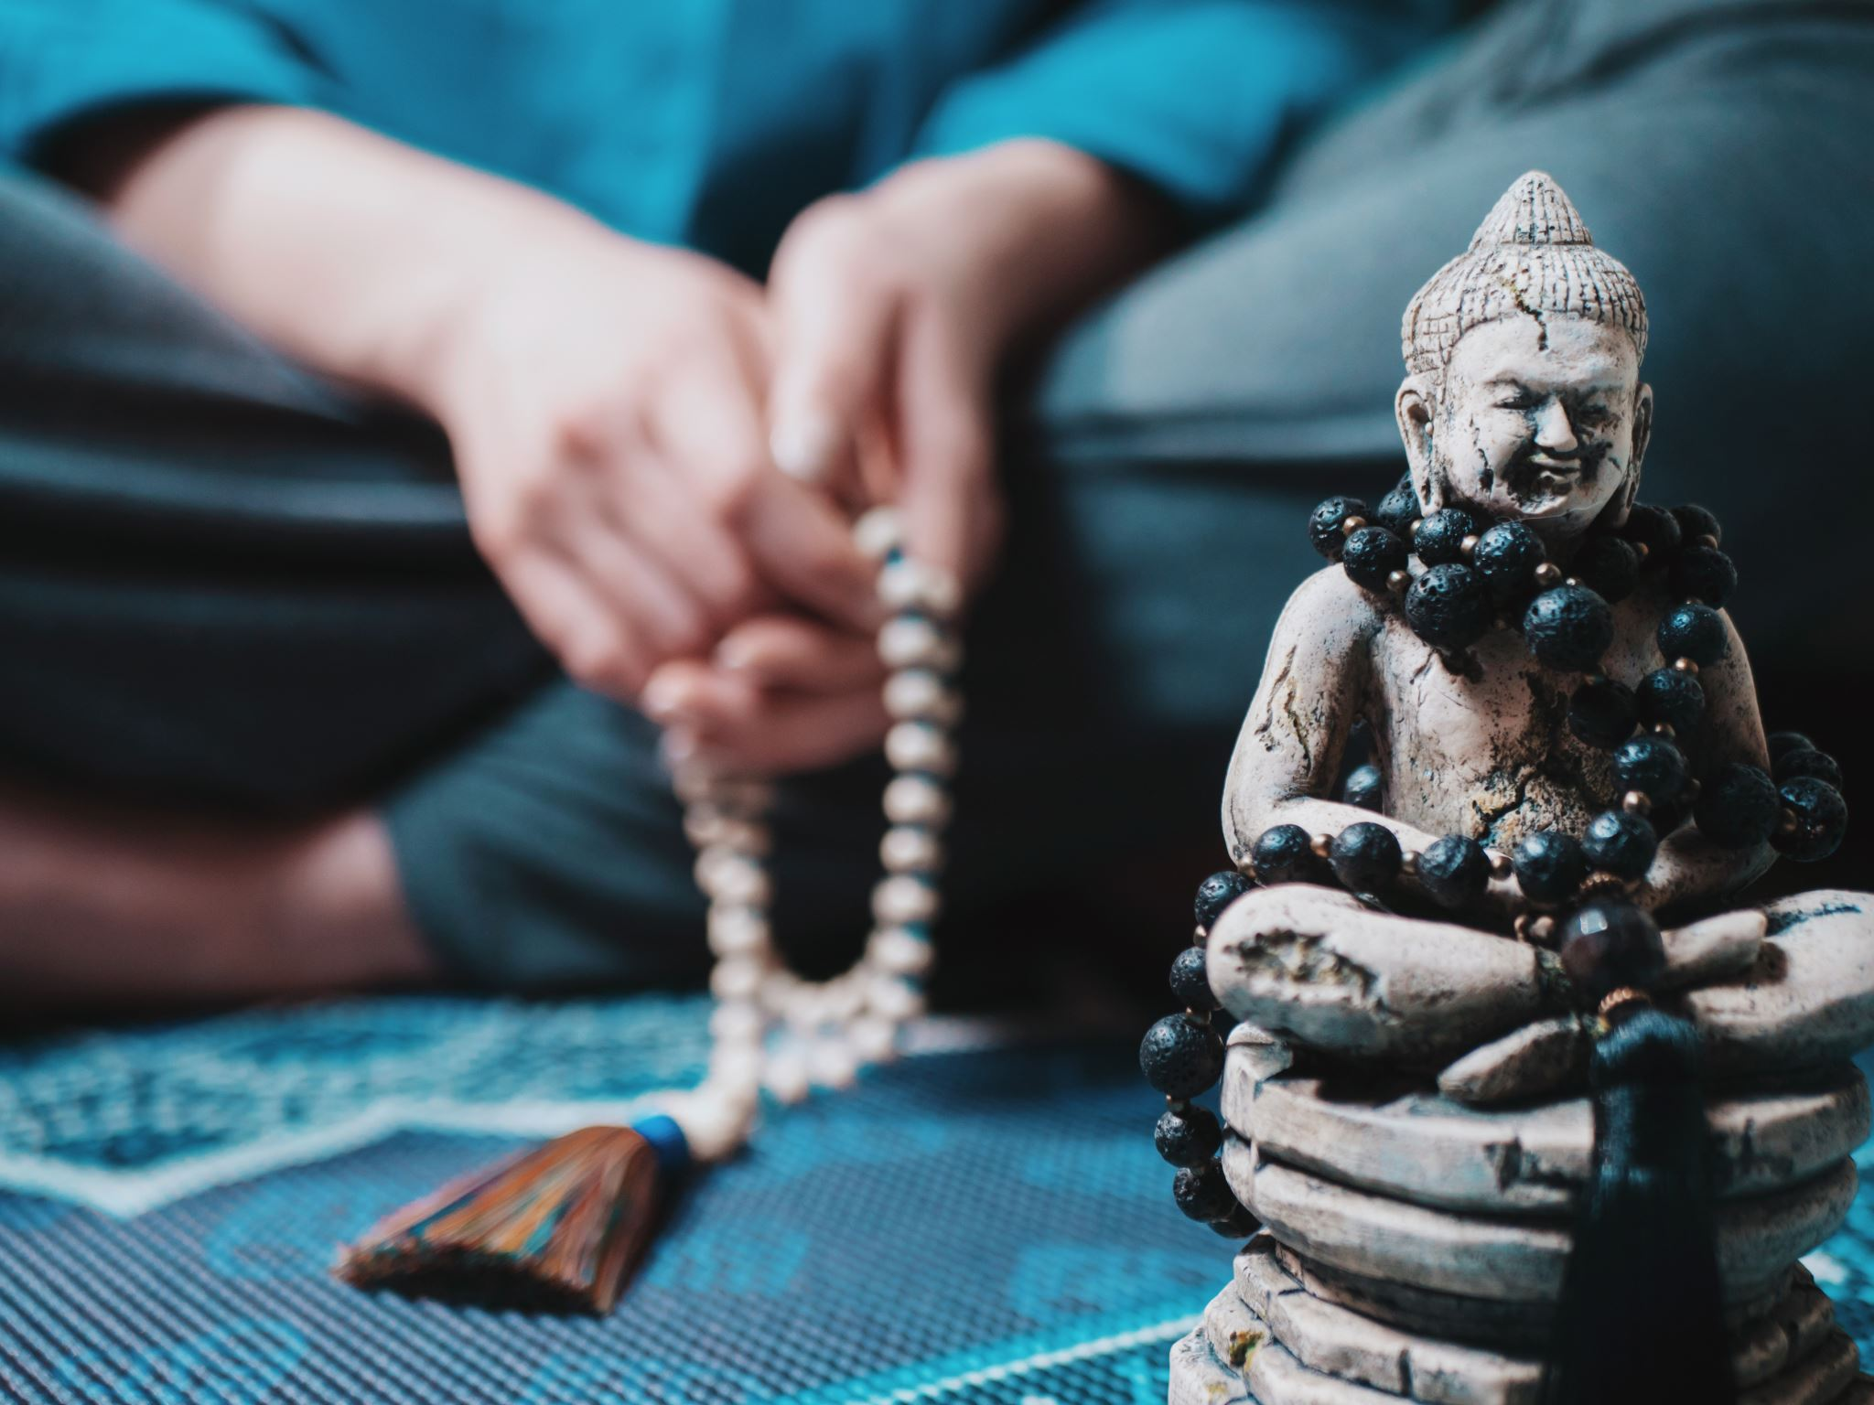
Our Mission Statement
Our Mission is to create a sacred space to hold the complexity of living and dying at the end of life for people experiencing homelessness.
Notes:
Tanya Our team has always done palliative care work with PEH. But we did not formulate an organized way to speak to what we do. Our team was created out of a case to support our patients but also our team who were siloed, and managing a lot of distress on their own.

Slide 5
Our team
We are a team of peers, health workers, nurses, social workers, and providers committed to providing low barrier, open access care to people experiencing homelessness in San Francisco.
Notes:
Shannon

Slide 6
Street Medicine Model
Outreach and Engagement
Clinical Care Coordination
Trauma-Informed Patient Centered Care
Inquiry
Closure
Notes:
Not linear. Dynamic. Will highlight a few of these given time constraints and group interests Melanie
Melanie

Slide 7
Outreach and Engagement
Notes:
Shannon

Slide 8
Skills and competencies
Outreach Skills and Partnership
Presence and creating safety for patients
Flexibility
Notes:
State of being, holding space for the patients, holding space for yourself, being and not doing, sharing space..PEH are often involved in many community organizations and we need to partner with them.

Slide 9
Clinical care Coordination
Notes:
Tanya

Slide 10
Skills and competencies
Teamwork
Communication
Discernment
Notes:
Teamwork comes up in multiple aspects of our model. Teamwork within our team is new in some ways. Tanya. Discernment: Figuring out what’s important and what’s not important and who is it important to

Slide 11
Trauma Informed Patient Centered Care
Notes:
melanie Pillars of Trauma Informed Care is our special sauce collaboration choice Melanie

Slide 12
Skills and competencies
Empathetic Listening
Deep look at harm reduction
Self reflection
The Deep End: creative boundaries that mirror need
Notes:
Melanie empathetic listening is hearing what your pt is saying without trying to problem solve!!! Deep look at harm reduction: What is harm reduction for you and the individual you are working with. What actions are needed to facilitate care?
Self reflection: What is happening inside me in relation to the pt? How is it informing pt care? The Deep End: Doing things that you might not regularly do for someone who is not dying.

Slide 13
Inquiry and Advocacy
Inquiry
Notes:
Shannon how we ask questions

Slide 14
Skills and competencies
Attuned Listening
Minding the Straddle
Courage
Notes:
Shannon, deep listening. Courage to ask the hard questions. Attuned listening to voice, body, and actions..the straddle..trusting instincts

Slide 15
Closure
Notes:
Melanie

Slide 16
Skills and competencies
Spaciousness
Humility
Self-care
Notes:
Melanie death notification process and memorials

Slide 17
Tailoring this talk to what’s most important to you
Everything you want to know about palliative care for PEH
What are your questions?
Small group exercise: Talk to people at your table and share a pressing question or share a story that you have been holding
Notes:
Tanya Few guiding questions: Could be around challenging cases you are holding or a particular aspect of this work that you are curious about? Honor the wisdom in the room. Our answers will also serve as a way to share some of the cases we work with.
5-7 minutes

Slide 18
Zappa
43 year old man, sleeping in Golden Gate Park, diagnosed with Stage II testicular cancer
Connected to Street Medicine Palliative Care through trusted HW and during meetings would mostly focus on the HW and his dog Zappa
Interested in connecting to cancer treatment but needed creative collaborations with urology and oncology and support from Street Medicine Palliative Care to get his cancer treated
Got chemotherapy while sleeping in a bus on the street and self-managing his pain with methamphetamines
Notes:
Themes: Rough sleeper, community partners and engaging trusted relationships, care coordination and creating flexibility for our patients within the hospital to allow patients to get care. Bending hospital boundaries. Wanted to and with support could. What is the different lens of street medicine palliative care?

Slide 19
Red
20 year old man sleeping in a boxcar
Initially presented to care with chest pain, blurred vision, and lightheadedness for a few weeks and diagnosed with a Stage IIIb yolk sac tumor.
Required multiple trips to the emergency room with significant HW support to get him to stay in the hospital and get the work-up he needed
Insurance status required a hospital transfer and coordinating with new hospital partners who don’t traditionally work with people experiencing homelessness
HYA partners helped to support him with treats and encouragement during his months in the hospital, particularly since he did not have access to his preferred substances (nicotine, alcohol marijuana)
Losing his hair was hard for him
Family (grandmother and sister) became involved in his care while he was hospitalized and he ended up going back with them to Oregon for in between care and support. Street Medicine Palliative Care team needed to do a lot of work bridging his street family, his biological family, and his health care team to make sure he got the care he needed.
Now cancer-free!
Notes:
Transitional age youth, rough sleeper, no engagement with medical care prior to this, going into the deep end, interfacing with family that was not involved before that and bridge his street family with his biological family, role of street families, generational trauma, care coordination, how do you make sure that patients get access to all the resources available to them (nonprofits, insurance)

Slide 20
Donna
37 year old woman diagnosed with decompensated cirrhosis after presenting with scleral icterus
Generational trauma: My mom never stopped drinking and she died and I stopped drinking so I shouldn’t die of this disease
Identified her eldest cousin as her DPOA. Street Medicine Palliative Care spent many hours on the phone with the DPOA to help clarify Donatile’s health and goals
At the end of life, she was intubated with multi-organ failure for several weeks while the cousin made sure the family was on board with not escalating care. Street Medicine Palliative Care participated in family meetings and provided ongoing support to DPOA
Notes:
Generational trauma, coordination with DPOA, not all ends are beautiful

Slide 21
Jerry
Living in Golden Gate Park since the 1990s and not engaged in medical care
Presented with increasing difficulty swallowing and diagnosed with esophageal cancer
Stayed in the hospital for several months to complete chemoradiation
Had a tracheo-esophageal fistula and so was not able to eat and required a feeding tube and oxygen. Initial plan was for him to discharge to the street at his request.
“I can’t stay outside”: Returned to the hospital soon after being discharged but continued to struggle with the demands of being in the hospital (many new people every day, being constantly poked and prodded, etc)
“I have to go on this journey on my own”- thinking about self determination through the social work lens
Street Medicine Palliative Care team focused on care coordination between inpatient and outpatient supports and translation between the inpatient teams and the patient with deep listening to the patient
Notes:
Rough sleeper recognizing that he is too vulnerable to be outside, managing DME for people experiencing homelessness (tube feeds, oxygen), translation between patient and medical teams with deep listening to the patient, self-determination in the lens of social work, race and equity and the medical system, palliative care coordination, trauma of health care

Slide 22
L’il Mama
48 year old woman who was a visible and controversial presence in the Haight-Ashbury neighborhood and was well known to many community organizations
Presented to the hospital with increased difficulty swallowing and found to have a Stage III SCC of the left lung with no curative options
Street Medicine Palliative Care focused on care coordination with many agencies, symptom management, and connection with hospice when she was ready
Dignity vs. autonomy: Struggle at the end of life to honor her wishes to die in her hotel room vs. making sure she was well cared for
Hospice and HYA able to bring son to her bedside at inpatient hospice to spend time with her in the days before she passed away
Notes:
Care coordination with multiple teams and partners but no lead (diverse team), visible and controversial figure on the street, politics, good outcome, reconnection with family, ethically tough call (how do we honor our desire for all our patients to have dignity with our patients’ wishes for autonomy?), managing our distress thresholds, palliative care in the time of COVID, collaborating with hospice agencies, how does our team work? What is palliative care? Closure practices

Slide 23
Robert
55 year old man with a history of TBI and strokes causing expressive aphasia. Able to dissent and assent but not clearly consent
Diagnosed with Stage III lung cancer and had left AMA from the ICU multiple times. Stated through words and actions that he did not want to go to the hospital or get chemotherapy
Not able to clearly consent to hospice so Street Medicine Palliative Care alongside SIP team managed his needs until he required hospital care.
Highest priority for him based on his actions was getting and using crack cocaine
Never gave us explicit permission during his life to contact his family, but after he passed family requested to speak to us and was concerned about whether he received equitable care at the end of his life due to his race
Held closure ceremony with employees of the SIP hotel where he worked
Notes:
Race and equity, substance use affecting medical care, serious mental health/concern for lack of capacity, privacy vs. including family systems, closure activities

Slide 24
Prophet
39 year old man who had a SIP room but was staying outside in a tent
Girlfriend had housing but was staying in sanctioned encampment separate from him and was not allowed into his SIP room
Diagnosed with Stage IV colon cancer and then was not able to follow-up
Street Medicine Palliative Care attempted to meet him multiple times at his encampment before meeting him in the hospital
Initial engagement with Street Medicine Palliative Care happened through social work concerns (housing, SSI, benefits)
Outreached to partner as well and made it clear in our documentation that she was the DPOA and not the patient’s legal wife. When he had a severe medical complication leading to his death, we made sure that his rightful DPOA was the one making health care decisions for him
Notes:
Safety, DPOA that isn’t otherwise clear and guidance around to manage that, engagement through social work concerns

Slide 25
Billie
Long time patient of Street Medicine with OUD, borderline personality disorder, and chronic osteomyelitis of L hip and L shoulder who was diagnosed with renal failure from AA amyloidosis
Initially wanted hospice but then decided to undergo dialysis. Went to dialysis for a month consistently
Treated pain from chronic osteomyelitis at the end of life with full agonist opioids with the expectation of frequent follow-ups and no fentanyl use
Both the patient and the Street Medicine Palliative Care team communicated closely with his mom during the last months of his life after Lee reconnected with his mom during the last months of his life
He ended up passing away of a likely overdose after not presenting to care for a few weeks
Primary wish at the end of his life was to be in new permanent housing
Held a closure memorial with our team
Notes:
Opioids and OUD, personality disorder, wants treatment but can’t access it, communicating with family during illness, coming off hospice, managing patient boundaries and unreasonable requests, Overdose vs. end stage death, newly housed/dying wish is to be housed, closure memorial

Slide 26
Goals of Care conversations: What is most important is your ongoing guide
Goals of Care conversations can start with an emergency contact
Ok to dance around the periphery. You have time.
Verbal and non-verbal communication around care is welcomed and valuable (ex. Patient states they want care but never show up)
Name the straddle
Build a relationship. Your relationship and rapport is key
Courage means reflecting to the patient honestly and transparently about what you see
Interpretation is advocacy
Notes:
Melanie Goals of care is part of inquiry

Slide 27
Palliative Care. Homelessness. Substance Use. Making end of life care opiates work for people who use substances
Keep in mind that it can work
It requires flexibility, an open mind, checking bias, and a lot of communication
It is a dynamic process
It requires meaningful and trusting relationships with patients and hospice care providers
Notes:
Shannon People who use drugs deserve end of life care and deserve to have pain managed

