Slide 1
Points of Contact to Points of Care: Creating an Effective Hospital-Based System of Healthcare for People Experiencing Homelessness

Slide 2
Our Presenters Today

Slide 3
As researchers, we are witnesses.

Slide 4
Our Goal Today
We want to build a street team that connects the ED, hospital, and street
What is the communication that needs to happen between places? What roles must be present to facilitate this communication?
We will build the system and then test it with 3 different cases.

Slide 5
Background
Unstable housing and homelessness can exacerbate adverse and inequitable health outcomes ​
This population has a greater risk of chronic disease burden, infectious disease, injury, and disability
No universal method exists to identify those at risk of or currently experiencing homelessness
Some screening tools are being developed, but minimal studies have: ​
Described those at risk of ​or currently experiencing​ homelessness presenting ​to an urban ED​
Assessed long-term trends ​amongst all individuals who ​present to an acute care center​

Slide 6
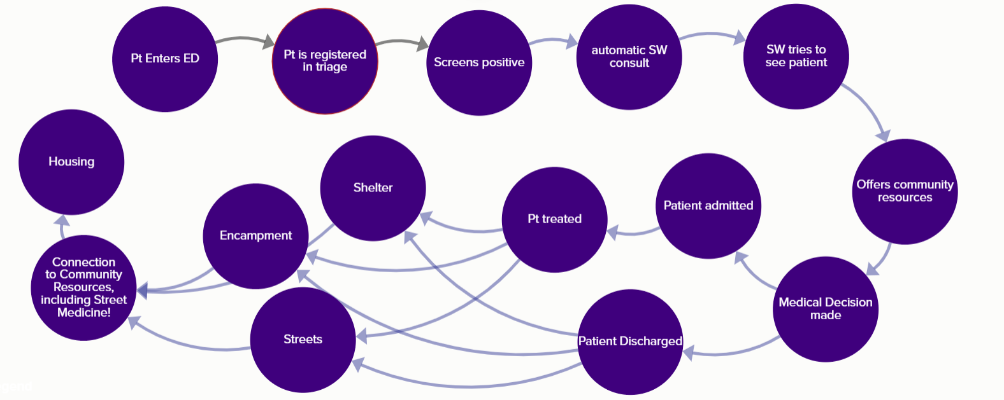
Our system

Slide 7
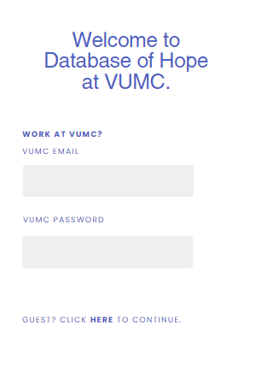
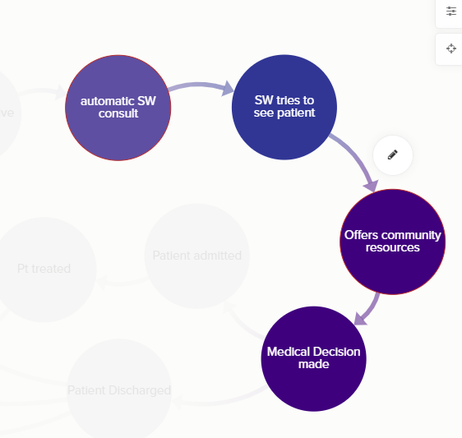

Slide 8
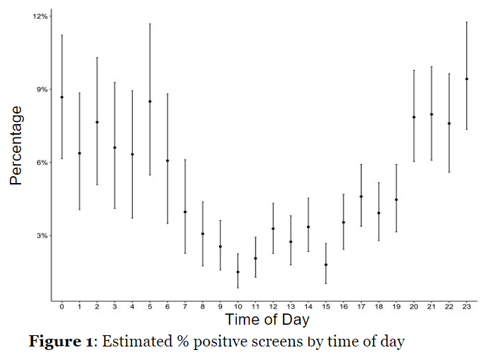

Slide 9
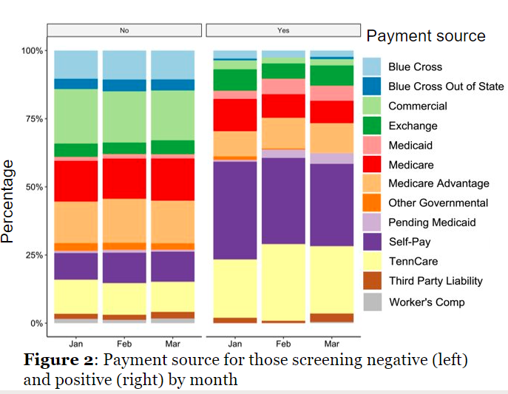

Slide 10
Results
From Jan 1-Mar 29 2023, 790 (4.5%) of 17,515 patients who presented to the VUMC ED screened positive for current homelessness or future housing instability (1,822 [10.2%] were not screened)​
The median age was 45 years (IQR 35-54) , 556 (70%) were male, 491 (64%) identified as White, and 255 (33%) as Black​
The most common chief complaints were trauma (n = 98, 13%) and suicidal ideation (n = 87, 11%)​
Social Work (SW) chart assessed and/or saw 597 (78.6%) of positive screens​
The highest proportion of people who screened positive presented between 8pm and 6am​
More people who screened positive were self-pay (33% vs 11%) or covered by TennCare (24% vs 12%)​

Slide 11
Qualitative Evaluation
Interviewed registration staff, social workers, healthcare providers
SW wanted 1 coordinated place for resources
Registration staff reported patients found the word “stable” confusing

Slide 12
Let’s design a system
What we have:
Mandatory screening criteria that occurs in registration/triage point of the ED
Academic medical center
Nashville

Slide 13
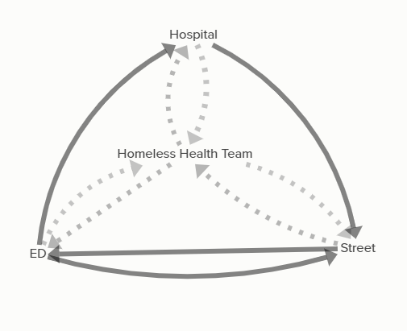
Dark lines- pt flow
Dashed - tasks between each part of the diagram
Street team- this is both the in-reach and out-reach teams

Slide 14
What tasks need to happen here?
Responses:

Slide 15
What tasks need to happen here?
Responses:

Slide 16
What tasks need to happen here?
Responses:

Slide 17
What tasks need to happen here?
Responses:

Slide 18
What tasks need to happen here?
Responses:

Slide 19
What tasks need to happen here?
Responses:

Slide 20
Test Case #1
Person w/ diabetes, elevated sugar, weren’t able to keep their medicines (got stolen, no refrigerator, lost supplies), post-op and have a wound to care for, don’t have a place to go (what would the roles be to get someone safely back on the street and cared for)
Need check up on supplies
Need check up on sugars
Gets admitted

Slide 21
Test Case #2
Addicted to alcohol, got into altercation, rib fractures, facial fractures, level 2 trauma, doesn’t have a place to go (where does he go when he’s done, how do we keep him safe, connect him to resources), won’t need a respite care
Gets admitted

Slide 22
Test Case #3
It’s raining, pt comes in with schizophrenia and suicidal ideation, in despair because of their living situation (in a tent, don’t have stuff, lost job, don’t have ID)

Slide 23
As researchers, we are witnesses.

Slide 24
Thank you!
Questions? Comments?
sophia.druffner@gmail.com
469-608-9476

