Slide 1
Affirming Expansive Gender Identities 2023 National Health Care for the Homeless Conference & Policy Symposium
britt walsh (they/he), LICSW, LCSW-C,LCSW, CPH
Director of Gender Affirming Care
Notes:
Good afternoon everyone, my name is britt walsh. I use they and he pronouns, and I’m here to talk about gender with you all, specifically, gender expansive and trans identities.

Slide 2
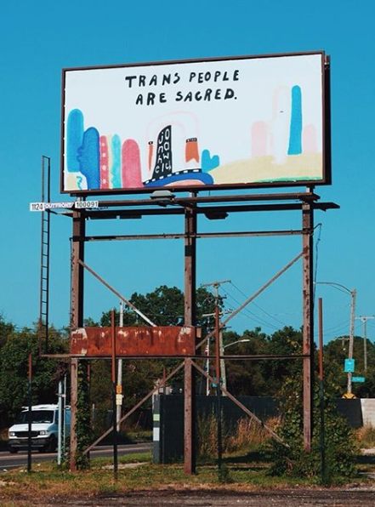
Agenda
Personal Reflection + Context
Definitions + Key Concepts
Myths + Disparities
Gender-Affirming Care

Slide 3
Hi, I’m britt!
Who are you?
What identities and experiences do you bring?
What questions do you have? What assumptions have you made?
Notes:
It feels important to set the context of my own lived experience (and to simultaneously encourage each of you to dothe same). I am a white, non-binary trans and queer 30-something from Michigan, with ancestral connection to Appalachia, Ireland, Finland, and Wales. I earn my income as the Director of Gender Affirming Care at WWH, and as a licensed, clinical social worker trained with an emphasis in community practice. My home is on unceded Piscataway land known as Baltimore MD. I commit to learning with and from you all this evening.
Though we won’t be spending much time on intros, I’d like each of you to consider *who* you are today.
What are the identities (seen and unseen) and experiences you bring with you, you carry some days or all days; those that helped shape you?
And after a few moments of that- I’d like you to consider what commitments you’ve made in showing up today. Are you with me in your willingness to be uncomfortable, to be surprised, to learn 1 new thing about yourself and 1 new thing about others?
And lastly, I’d love to know what questions you have coming in? Feel free to pop them in the chat or send them to me directly, or simply write them down and I’ll do my best to get to them. If you feel stuck or hesitant to say yes to those commitments or come up with any questions, make note of that too.

Slide 4
Shaping our Time: Cultural Humility
Lifelong learning And Critical self-reflection
Recognizing and Challenging power imbalances in pursuit of respectful partnerships
Institutional Accountability
Image description: A photo of two trans women hugging; they are both dressed in formal wear and smiling at a camera off to their left. One woman is Black with long highlighted hair, the other is a brown woman with dark black hair. , There are other people in formal wear in the background behind them.
Notes:
I also want to offer, for anyone who hasn’t heard of this framework– a lens for each of us to sit with in our time together, known as cultural humility.
For some of us who have been in this work or maybe attended some institutional education around “helping professions” we may have been taught this idea of Cultural Competency. Has anyone heard of that before? It can sound similar to Cultural Humility, and yet I want to point out what feels unique to me about the Humility piece. I ask each of us to sit within this framework throughout our session today, and as you continue to do work with other humans.

Slide 5
What does it mean to have this conversation today?
●We don’t need to understand everything about what it’s like to be transgender in order to believe that every person deserves health care that is compassionate, age-appropriate, and individualized to our personal medical needs. Everyone, including transgender people, should be able to visit health care providers who can support them, without interference from power-hungry politicians who don’t have their best interests at heart.
●Every major U.S medical and mental health organization, including the American Medical Association, American Academy of Pediatrics, Federation of Pediatric Organizations, and American Psychological Association, supports access to gender-affirming support and care for transgender young people and adults.
Notes:
I also want to set us in the context of what is happening “out there”. THE STAKES ARE HIGH. It is long past time that each of us did some of the internal work to understand why we are uncomfortable with difference, specifically, gender or sexuality difference.
It is dangerous to continue to have outdated views about gender, because it essentially plays into the threats to each of our rights to bodily autonomy. This is about each of us being able to live in our bodies

Slide 6
gen·der noun
Notes:
For the next several slides I’m going to break down language and ideas about gender.

Slide 7
What were you taught about Gender?
ID: A blue rubber duck against a pink background, next to a pink rubber duck against a blue background. There are questions in yellow sticky notes around the ducks.
Boys don’t cry
Women and Girls work in the home and do the caretaking
Girls are timid and deferential
Men and Boys are physically stronger and bigger
Only boys excel in Math and Science
With that long hair, someone will think you’re a girl!
Notes:
All of us here have unique upbringings, experiences, and personal journeys that shaped how we understand ourselves and the world. For myself, I was raised in a white, Evangelical Christian community in SE< Michigan.. And it wasn’t until much later in my life that I had space and self-awareness to really unpack what I’d been taught about Gender, in order to understand my own gender. What were some of you taught about gender?
How old were you when someone

Slide 8
Definitions: Sex
A multidimensional construct based on a cluster of anatomical and physiological traits (sex traits)
Sex traits include external genitalia, secondary sex characteristics, gonads, chromosomes, and hormones
Characteristics of sex:
Usually defined at birth as female or male based on visual inspection of external genitalia
Sex traits are often assumed to be unambiguous, but they may not be, as in the experience of people with intersex traits or differences of sex development (DSD)
Some sex traits can change or be altered over time
Notes:
To clarify- lets actually define some things.

Slide 9
Definitions: Gender
A multidimensional construct that links:
Gender Identity: A core element of a person's individual sense of self
Gender Expression: How an individual signals their gender to others through behavior and appearance
Social and cultural expectations: Social status, characteristics, and behavior that are associated with sex traits
Characteristics of gender:
Often conceptualized as binary (male/female or man/woman) in Western cultures, but also includes categories outside this binary
Often assumed to be determined based on sex assigned at birth but may differ
Often used interchangeably with sex, though it is conceptually distinct
May be temporally and contextually fluid
Notes:
Each of us, I’m sure, has assigned new meaning to words after learning new context, so I am asking you to embrace that mindset now and let’s get on the same page with common words and concepts --
Gender – refers to the ways “masculinity and femininity” have been socially constructed and re-enforced by dominant culture through norms, scripts, and stereotypes. Gender is social constructed and maintained as a Binary (usually through classifications of Man or Woman), even though gender is experienced internally and expressed externally.
Sex Assigned at Birth – or someone’s Sex – or Birth Sex – this refers to the decision a medical professional made at a child’s birth based on, typically, external characteristics of genitals.
Gender Identity – how you feel inside and identify yourself; your internal experience of your own gender
Cisgender – an adjective to describe a person whose gender identity and SAAB are the same
Transgender – an adjective to describe a person whose gender identity and SAAB are different
Intersex- is an umbrella term to describe people who have chromosomes, hormonal profiles, or genitals that typically do not fit into binary medical and social constructions of male or female.
Agender – describes people who do not have a gender or are genderless; they may exist outside of the gender binary and/or may be trans
2Spirit – is an Indigenous term for Indigenous people to use in self-identifying with complex experiences and identities as well as cultural responsibilities, that can span gender identity, sexual orientation, or roles.
Genderqueer, genderfluid, gender expansive, non-binary – each of these words may describe a unique experience and have different individual meanings, however they are grouped together to demonstrate some of the language that is out there for gender outside of the normative “man or woman” – people may hold these experiences as well as also being trans or using man or woman
Gender Binary – is the system in which a society classigies all people into one of two categories, each with different norms and stereotypes
Misgendering – refers to the act of speaking about someone with language that is gendered inappropriately for them or by using the wrong pronouns
Misnaming and Deadnaming – refer to the act of speaking someone’s wrong name, often thought of as using an outdated name or one’s legal name instead of their Name
Transphobia – is the systemic and individual oppression of people whose gender identity and expression do not conform to cisgender identities. This includes a range of negative attitudes and feelings, such as prejudice, fear, discrimination, harassment, and bias towards trans and gender expansive people.
Transmisogny – is the intersection of transphobia and misogyny, directed at trans women, trans people, and gender non-conforming feminine people.
This is not intended to be an exhaustive list of important words, only a sampling of words that are important to hold onto as it relates to gender and affirming people’s experiences, or thinking about systemic oppression and our role in that.

Slide 10
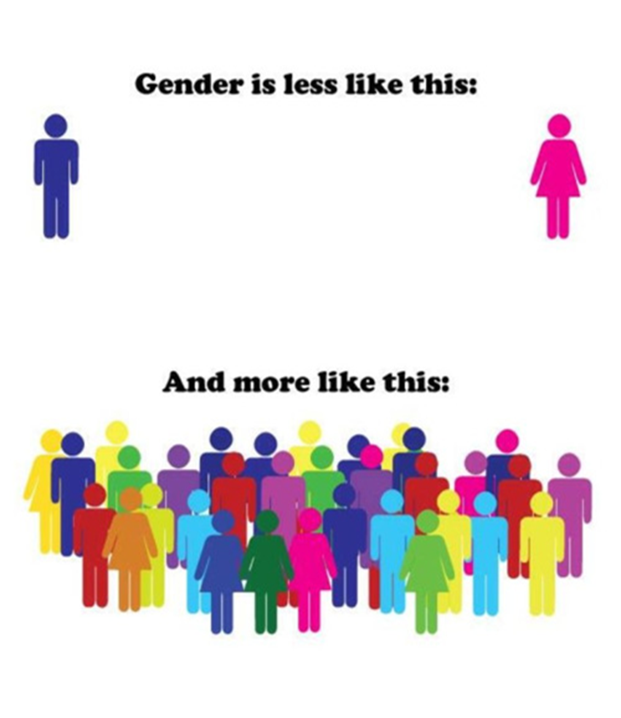
Notes:
In the spirit of throwing away outdated concepts– let’s do a deeper dive into Gender. What is it, “really” and what has that meant for many of us who were raised with ideas and expectations for our behaviors based on our gender.
Gender is LESS LIKE THIS (where do you often see the images at the top?) – BATHROOMS
And more like this (Describe the bottom)
So, let’s break it down a little – if you were raised to believe gender was Blue for Boys and Pink for Girls, raise your hand.
If you were raised with that, what else do you remember being taught?
Blue is for boys and men. People who are physically and emotionally strong, tough, breadwinners, hairy, tall, doctors, firefighters, dominant. Decision makers. Leaders.
Pink is for girls and women. People who are tender, soft, caring, emotional, moms and caretakers, homemakers, nurses and teachers. Submissive. Supportive. Cooks, cleaners. Child-raisers.
How many of you have followed along with these expectations of you (based on your gender)? Do you only wear clothing associated with your gender? Only hold jobs or perform tasks associated with your gender?
Can you remember a time in your life when you acted outside those norms or expectations of you? How did it go?
Who helped you to learn what behaviors were accepteable for you or expected of you based on your gender?
What was it like to explore expressions, behaviors, roles, norms, activities etc outside those put on your gender?
This picture depicts the Gender Binary at the top – the socially constructed system for how we act, relate, express or behave. Whatever sex was placed on your birth certificate, society assigned you some expectations for your gender right along with it. Sometimes our upbringings or socializations are so rigid in those binaries that people are stuck in place for a long time. My assumption is that each of us have taken steps to move outside of many of those norms and stereotypes… closer to what’s at the bottom. A diverse and variant, multitude of genders.

Slide 11
Definitions: Gender Identities
Transgender: A person whose current gender identity is different from the sex they were assigned at birth
Transgender experience: All people who can be classified as transgender, regardless of whether they identify as transgender
Transgender identity: People who identify as transgender
Cisgender: A person whose current gender identity corresponds to the sex they were assigned at birth
Nonbinary: An umbrella term for gender identities that lie outside the gender binary
Genderqueer: A person who does not follow gender norms
Agender: A person who does not identify with a gender
Two-Spirit: Placeholder term for specific gender and sexual orientation identities that are centered in Indigenous tribal worldviews, practices, and knowledges

Slide 12
Definitions: Sexual Orientation
A multidimensional construct encompassing emotional, romantic, and sexual attraction, identity, and behavior
Identity: A person's core internal sense of their sexuality
Attraction: A multidimensional concept that includes the gender(s) to which a person is attracted and the strength of this attraction, including whether a person feels attraction at all
Behavior: A multidimensional concept that includes the gender(s) of sexual partners, specific sexual activities, and frequency of activity
Characteristics of sexual orientation:
Often defined based on the gender(s) of a person's desired or actual partners relative to their own gender, but is not the same as gender identity: a transgender person can have any sexual orientation, including straight/heterosexual
The three dimensions of sexuality—attraction, identity, and behavior—may not correspond to the same orientation

Slide 13
Definitions: Sexual Orientation Identities
Straight or heterosexual: Sexually oriented toward people of a different, usually binary, gender
Gay: Sexually oriented toward people of the same, usually binary, gender (Note: the term “homosexual” is often considered offensive and outdated)
Lesbian: Women who are sexually oriented toward other women
Bisexual: Sexually oriented toward both men and women or toward all genders
Queer: An umbrella term for belonging to the LGBTQI+ community; also used to refer to a person who is sexually oriented toward people of more than one gender
Pansexual: Sexually oriented toward people of any gender
Questioning: Uncertain about sexual orientation identity
Two-Spirit: Placeholder term for specific gender and sexual orientation identities that are centered in Indigenous tribal worldviews, practices, and knowledges
Same-Gender-Loving: Nonheterosexual sexual orientation identity used by some in African American communities as a resistance to Eurocentric language for sexuality

Slide 14
Words to Avoid
Transsexual or Transvestite
Transgenders; Transgendered; a transgender
Gender Identity Disorder
Sex change; “The Surgery”; gender reassignment
Biological/genetic male, biological female
Born a girl/boy or man/woman
Female-bodied/male-bodied
What’s your real name ? What gender were you born as?
What’s your “Preferred” name/ pronouns?
CAUTION: Gendered Language
Notes:
There are also words for each of us to unlearn, or rather, to forget, to put away, to never repeat. Merriam Webster adds new words to the dictionary often, and in turn some words no longer carry meaning. We find different language for various experiences.
REVIEW LIST
If any of you hears this language from a trans person, speaking about their own experience (or community), I beg you not to correct them. However, if youre not speaking about your own experience, I would encourage you to avoid these words/phrases.
Transsexual or Transvestite
Transgenders, Transgendered, the Trans
FtM or MtF (if you’re in a clinical setting, try AMAB or AFAB, or use a “parts inventory”)
Biological male/female, born a girl/boy; female-bodied /male-bodied
Again, language shifts all the time and a golden rule here (depending on your setting) is to follow the cues of the people using language for their lived experience, and to take feedback if you are using outdated language.
Any questions here?

Slide 15
Words to Use
A transgender person
Gender dysphoria (in clinical contexts as relevant)
Gender affirmation
Gender-affirming care
Gender transition (though be aware of nonbinary identities)
My name is ____. What name should I use for you?
My pronouns are ____. What pronouns should I use for you?

Slide 16
Gender Expansive + Trans Experiences: Myths + Disparities
Notes:
I hope you’ll keep thinking about these gender galaxies and how it would serve us (the royal us of society ) to remain open to experiences unlike our own. I’ll spend the next bit of time sharing more about transness, and experiences of trans people.
While many transgender people say they knew they were trans as soon as they knew what “boys” and “girls” were, for many others, living openly as their affirmed gender was a *journey*. For some, understanding their gender identity is a complex process that lasts into their teens, adulthood, or even old age. Many people have a general feeling of being “different” but don’t connect that feeling to our gender until we are exposed to new language or find role models in whom we can see ourselves reflected. While early childhood is one common time for kids to name their gender, people can come to understand their gender at any age. Sometimes a trans or gender expansive person will come out as gay, lesbian, or bisexual before recognizing that it is their gender, not their sexuality, that they are struggling with. Stigma, lack of knowledge and fear of rejection by family and peers can keep trans people from sharing our gender, period, let alone early in life. Research indicates that there is a significant gap between a child’s understanding that their gender doesn’t conform to expectations and when they communicate with others (namely parents) about it. In one study, the average age of self-realization for the child that they were trans or non-binary was 7.9 years old, but the average age when they disclosed their understanding of their gender was 15.5 years old.
I’m going to do my part to debunk some myths, share some stories, and keep us thinking about gender galaxies.

Slide 17
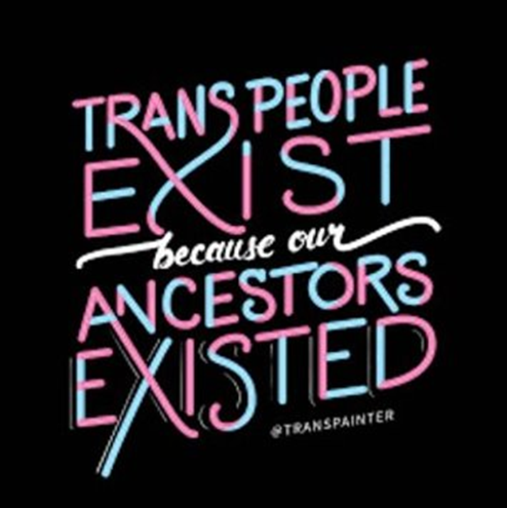
Transgender People have ALWAYS Existed
Ancient Greek, Roman, South Asian, Indigenous, African, and many more cultures have celebrated and embraced gender diversity long before now
There are infinite ways to experience gender, including not at all.
Notes:
First of all – being trans isn’t new. I’m not meeting with you all to share breaking news, right? Being trans isn’t a fad or trend, either. To say that diminishes the long long history of trans experience documented EONS ago and the especially critical role Black Trans women played in fighting for LGBTQ rights at Stonewall. If you look at ancient Greek, Roman, South Asian, Indigenous, African, and many more cultures have celebrated and embraced gender diversity long before now. Many people will ask “why are we hearing about it ALL of a SUDDEN” , or why is there so much more now? and that is a question that comes up with other social realities– i.e. racial violence, threats to bodily autonomy; fascism– many of us are already aware that our access to news, the ways we elevate people’s experiences, and the ways we document stories are all shifting and changing. At the same time, some of us have language that we didn’t have before, to express experiences. Maybe we have greater perceived safety to share or be free.
There are infinite ways to experience gender, including not at all. Some of us finally have language to express what we experience.
Our current gender binary has been socially constructed and upheld by many norms, stereotypes, and institutions like capitalism and white supremacy…. It’s each of our roles to interrogate, investigate, explore, and stay curious.

Slide 18
Myth-Busting: Gender and Transness
Myth 1: Being trans is a mental illness
Myth 2: All trans people hate their bodies
Myth 3: Children are too young to know their gender
Myth 4: Regret and “detransition” are common
Myth 5: Trans people using facilities of their gender identity is dangerous
Notes:
I do recommend reading about and absorbing media by trans people, because most of us have had little or no education about gender– I certainly did not. And there’s a lot of misconceptions out there, and a lot of harmful mistruths informing people’s views of trans folks. We’re going to address common myths many of us hold about gender, kids, and trans people – (could someone read the myth and I’ll follow up with the debunking it)
Being trans is NOT a mental health disorder. There is nothing inherent to being trans that makes a person more likely to experience poor mental health. However , trans people are some of the most socially and medically marginalized groups around the world and with the impact of oppressive systems and harm, trans folks do experience higher rates of depression or suicidality.
For some trans people, the discomfort they feel in their bodies is insurmountable. In these cases, people may pursue hormones or surgery to feel more comfortable intheir bodies. Not all trans people hate their bodies, however, and not all trans people will access hormones or surgery.
According to the American Academy of Pediatrics, by age 4 most children have a stable sense of their gender identity. We don’t question when cisgender children know their gender at a young age, so why do we question trans or nonbinary children at the same age?
Very few trans people regret gender affirming hormones and surgery, and one longitudinal study indicated a regret rate of less than .5percent. Along with this very low rate of regret or de-transition, access to GAC improves mental health and quality of life in several studies. People have higher regret rates for knee surgery (6-30%) than they do accessing gender affirming care.
There is no evidence to suggest that allowing individuals access to the facilities that align with their gender identity increases incidence of violence. It ostracizes transgender people if we credit the misperception that they are a threat. Worse, it takes focus away from the work we can do to keep everyone safe.

Slide 19
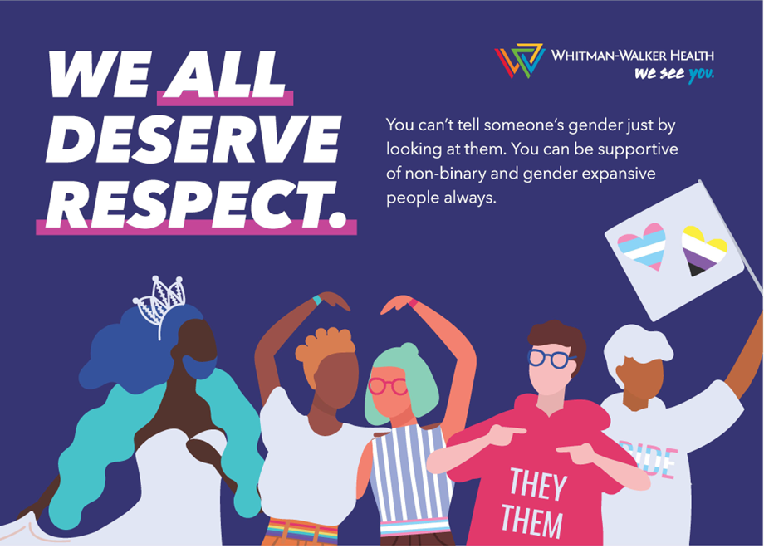
Someone may feel discomfort/anxiety with personal body parts, language or experiences that are gender-coded
Trans people may experience discomfort that is about other people’s perceptions – i.e. social dysphoria-- not from their own self.
Someone may explore different genders for alignment, euphoria, comfort. Exploration means many things!
Not all people who explore gender are trans
Notes:
Just like each of us is unique in our identities and experiences, so are trans people. We won’t know someone’s gender identity just by looking at them, and Trans folks come with our own slew of intersecting identities that make some in our community more disenfranchised than others.
Someone may feel discomfort/anxiety with words, personal body parts, or expectations that are gender-coded
Someone may explore genders different from the one assigned at birth to try out words, experiences, or parts for alignment, euphoria, comfort. Exploration means many things!
Many trans people experience discomfort that is environment specific – i.e. social dysphoria-- because of other people’s perceptions
Not all people who explore gender are trans

Slide 20
Transgender Health Disparities & The 2015 U.S. Transgender Survey
Largest survey to date examining the lives of transgender people in the U.S.
Conducted in the summer of 2015 by the National Center for Transgender Equality
Anonymous, online survey for transgender adults, available in English and Spanish
Almost 28,000 respondents
Examined the educational, employment, family life, health, housing, and criminal justice experience of transgender individuals
Full survey report: https://www.ustranssurvey.org/reports
Notes:
I do recommend reading about and absorbing media by trans people, because most of us have had little or no education about gender– I certainly did not. And there’s a lot of misconceptions out there, and a lot of harmful mistruths informing people’s views of trans folks. We’re going to address common myths many of us hold about gender, kids, and trans people – (could someone read the myth and I’ll follow up with the debunking it)
Being trans is NOT a mental health disorder. There is nothing inherent to being trans that makes a person more likely to experience poor mental health. However , trans people are some of the most socially and medically marginalized groups around the world and with the impact of oppressive systems and harm, trans folks do experience higher rates of depression or suicidality.
For some trans people, the discomfort they feel in their bodies is insurmountable. In these cases, people may pursue hormones or surgery to feel more comfortable intheir bodies. Not all trans people hate their bodies, however, and not all trans people will access hormones or surgery.
According to the American Academy of Pediatrics, by age 4 most children have a stable sense of their gender identity. We don’t question when cisgender children know their gender at a young age, so why do we question trans or nonbinary children at the same age?
Very few trans people regret gender affirming hormones and surgery, and one longitudinal study indicated a regret rate of less than .5percent. Along with this very low rate of regret or de-transition, access to GAC improves mental health and quality of life in several studies. People have higher regret rates for knee surgery (6-30%) than they do accessing gender affirming care.
There is no evidence to suggest that allowing individuals access to the facilities that align with their gender identity increases incidence of violence. It ostracizes transgender people if we credit the misperception that they are a threat. Worse, it takes focus away from the work we can do to keep everyone safe.

Slide 21
Transgender Health Disparities & The 2015 U.S. Transgender Survey
Severe Economic Hardship and Instability
1/3 of respondents living in poverty; unemployment 15% (3x natl average); 30% experienced homelessness
Harassment and Violence
46% experienced verbal harassment in last year; 1 in 10 physically attached; 47% sexually assaulted in their lifetime
Health Insurance and Health Care
33% of those who saw a provider in the last year had at least 1 negative experience
Psychological Distress and Suicidality
40% attempted suicide in their life time; 7% attempted in the past year
HIV
Transgender people are 5x more likely to be living with HIV compared to cis people; DC has estimated 25% HIV prevalence among all trans people
Notes:
I do recommend reading about and absorbing media by trans people, because most of us have had little or no education about gender– I certainly did not. And there’s a lot of misconceptions out there, and a lot of harmful mistruths informing people’s views of trans folks. We’re going to address common myths many of us hold about gender, kids, and trans people – (could someone read the myth and I’ll follow up with the debunking it)
Being trans is NOT a mental health disorder. There is nothing inherent to being trans that makes a person more likely to experience poor mental health. However , trans people are some of the most socially and medically marginalized groups around the world and with the impact of oppressive systems and harm, trans folks do experience higher rates of depression or suicidality.
For some trans people, the discomfort they feel in their bodies is insurmountable. In these cases, people may pursue hormones or surgery to feel more comfortable intheir bodies. Not all trans people hate their bodies, however, and not all trans people will access hormones or surgery.
According to the American Academy of Pediatrics, by age 4 most children have a stable sense of their gender identity. We don’t question when cisgender children know their gender at a young age, so why do we question trans or nonbinary children at the same age?
Very few trans people regret gender affirming hormones and surgery, and one longitudinal study indicated a regret rate of less than .5percent. Along with this very low rate of regret or de-transition, access to GAC improves mental health and quality of life in several studies. People have higher regret rates for knee surgery (6-30%) than they do accessing gender affirming care.
There is no evidence to suggest that allowing individuals access to the facilities that align with their gender identity increases incidence of violence. It ostracizes transgender people if we credit the misperception that they are a threat. Worse, it takes focus away from the work we can do to keep everyone safe.

Slide 22
Providing Gender-Affirming Care
Notes:
We’ve already covered some general unlearning of gender norms, and debunking myths. What comes next in holding space for people unlike ourselves, or trans people specifically? How are we co-conspirators in this collective work of building something new?
I believe the work each of us has to do looks a little different and starts with ourselves. Getting to know more about who we are, and what values and ideas we hold.. And why. There’s the interrogation and exploration piece.
When we are able to be present with ourselves, then we are more able to be present and really see someone else. Being present with someone means we aren’t assuming we know who they are and what they are about, but it’s about seeing them for who they tell us they are and believing their struggles (and strengths). This is the work of co-conspirators. This is the work of our liberation. And hey, as a community practice social worker– that’s at the core of my lifemodel.
We will mess up because humans are all imperfect, and maybe we’ll also remember that humans hold galaxies and we can try again and do better.

Slide 23
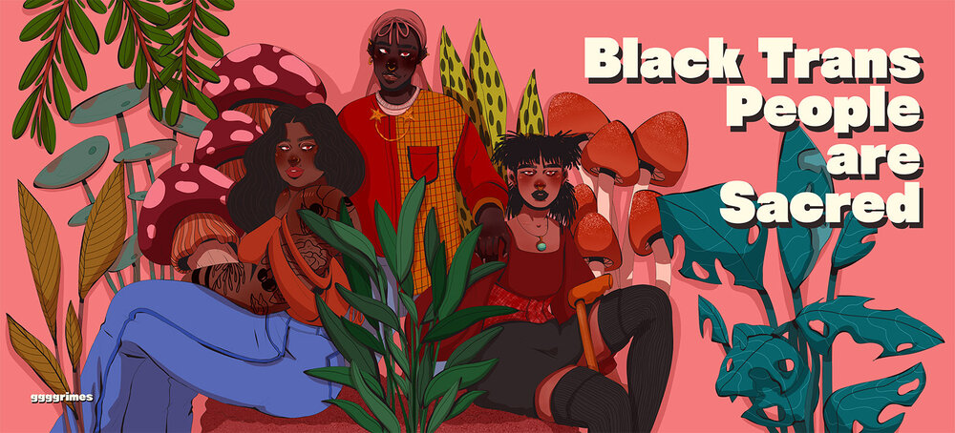
Beyond (and even Before) Clinical Care
Share your pronouns consistently. Do not force someone to share theirs.
Correct people who misgender or mis-name people, in the moment.
Thank someone who corrects you; Apologize
Don’t ask trans people questions because you’re curious– seek out reputable sources to continue your own learning and unlearning.
Advocate for policies and practices that are gender inclusive for clients, patients, staff
Avoid Assumptions; Be accountable
ID: Art with a bright pink background that reads “Black Trans People are Sacred” and the art has 3 Black people staged in a triangular shape, two sitting and one standing with botanical imagery around them. All 3 look ahead with serious expressions on their faces.
Notes:
Before I go into some literal details of gender affirming care, I want to remind us all about what it means to show up for trans people in our places of work specifically
https://outandequal.org/whats-your-pronoun-strategies-for-inclusion/

Slide 24
What kind of Gender Affirmation?
Social
Trying a different Expression, different Name and/or Pronouns
Coming out to friends/family/work
Physical /Medical
GAHT; Surgery; Hair Removal or Transplant; Voice/Speech Therapy
Binding; Tucking; Packing; Prosthetics
Legal
Name and/or Gender Marker change
Birth Cert, Passport, DL/ID, records etc
Notes:
Any one of you, in your professional role, studies, or personal life, may find yourself in a position of being an accomplice towards someones pursuit of Gender Affirmation

Slide 25
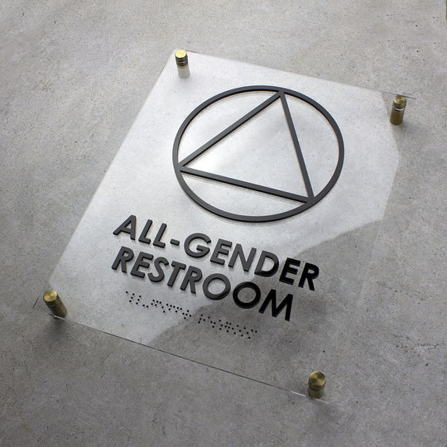
Create an Inclusive Environment
Provide cultural humility training for ALL staff, including routine re-training
Focus on Care
Don’t disclose a person’s status
Consider opportunities at each patient touch point
Registration or intake forms; gender neutral restrooms; educational materials that are gender inclusive; ads incorporate various genders; channels of feedback and demonstrated accountability
Notes:
Provide cultural humility training for all staff
Use the correct name and pronouns; if you don’t know, just ask politely
Learn to say “I’m sorry,” move on, and fix the problem the next time
Create respectful partnerships by recognizing and challenging power imbalances
Create institutional accountability by establishing effective policies to allow for reporting and addressing discriminatory behavior
Focus on care
Don’t indulge in questions out of curiosity
It is inappropriate to ask about a trans person’s genitals or how they have sex if it isn’t related to their care
A trans person is not always a “learning opportunity”
Don’t disclose a person’s status unless it is related to their care
Safety issue for many patients

Slide 26
Standards of Care, Guidelines, Resources
WPATH Standards of Care
Informs most insurance/payor guidelines for surgical coverage
SOC8 includes guidelines for non-binary transition
TransLine
Endocrine Society
UCSF Center of Excellence
Dr. William Powers
Trans Training Institute
Gender Health Training Institute
The National SOGIE Center
Notes:
What can gender affirming care entail?
Primary care
Gender affirming hormone therapy
Therapy or psychiatric care
Permanent hair removal
Surgery
Speech therapy/voice training
Support for legal name and gender marker change
No set path; each person can seek specific interventions to affirm their gender identity (Coleman et al., 2012)
Who can prescribe GAHT?
Primary care physicians, endocrinologists, ob-gyns, APRNs, PAs
Using medications commonly used for other indications
And if yo uthink you’re going to be providing GAC, check out some guidelines
WPATH - informed consent guidelines and criteria for hormone therapy
- every other year scientific symposium, Global Education Initiative classes
-USPATH
Transline - hormones guidelines, “ask an expert” service
Center of Excellence for Transgender Health @ University of Califorinia in San Francisco
Comprehensive care guidelines
Pelvic pain and persistent menses in transgender men
Free silicone and other filler use
Details about cancer screening
Endocrine guidelines – I don’t use them
William Powers - I include this because so many patients ask about it. Physician with many novel ideas, practices off guidelines, ?questionable
ALSO -- Philly Trans Wellness Conference

Slide 27
DSM Criteria for Gender Dysphoria
A marked incongruence between one’s experienced/expressed gender and assigned gender, of at least 6 months duration, as manifested by 2 or more of the following and associated with clinically significant distress or impairment in social, occupational, or other important areas of functioning:
A marked incongruence between one’s experienced/expressed gender and primary and or secondary sex characteristics
A strong desire to be rid of one’s primary and/or secondary sex characteristics because of a marked incongruence with one’s experienced/expressed gender
A strong desire for the primary and/or secondary sex characteristics of the other or alternative gender
A strong desire to be of the other gender (or alternative gender than that assigned at birth)
A strong desire to be treated as the other (alternative) gender
A strong conviction that one has the typical feelings and reactions of the other (alternative) gender
Notes:
Useful to read and know
Use in conjunction with endocrine disorder dx for better insurance covergage
Often your clients (seeking orchiectomy or GA-surgeries)

Slide 28
What kind of Gender Affirmation?
Social
Trying a different expression, different Name and/or Pronouns, Coming out to friends/family/work
Physical /Medical
GAHT; Surgery; Hair Removal or Transplant; Voice/Speech Therapy
Binding; Tucking; Packing; Prosthetics
Legal
Name and/or Gender Marker change
Birth Cert, Passport, DL/ID, records etc
Notes:
What does Gender-Affirming Care Entail
No set pathway
Psychological assessment → hormone therapy → genital surgery
Care should be individualized and age-appropriate
Current standard is to allow each person to seek only those interventions which they need to affirm their gender identity
WPATH Standards provide an overview of medically necessary services and procedures but are not binding on physicians and other providers
It CAN Entail-
Social transition, especially for youth
Counseling or psychotherapy
Puberty-delay medications
Hormone therapy
Facial hair removal
Surgeries
Vocal therapy
Legal name and gender change

Slide 29
Gender-Affirming Surgeries
Many trans people need various surgical procedures as part of gender affirmation
Surgery is by no means an end goal for all transgender people
Surgeries are medically necessary and life-saving for many trans people
Decisions about surgeries should be made on an individualized basis between patients and their providers
Notes:
Many trans people need various surgical procedures as part of gender affirmation
Surgery is by no means an end goal for all transgender people
Surgeries are medically necessary and live-saving for many trans people
Decisions about surgeries should be made on an individualized basis between patients and their providers

Slide 30
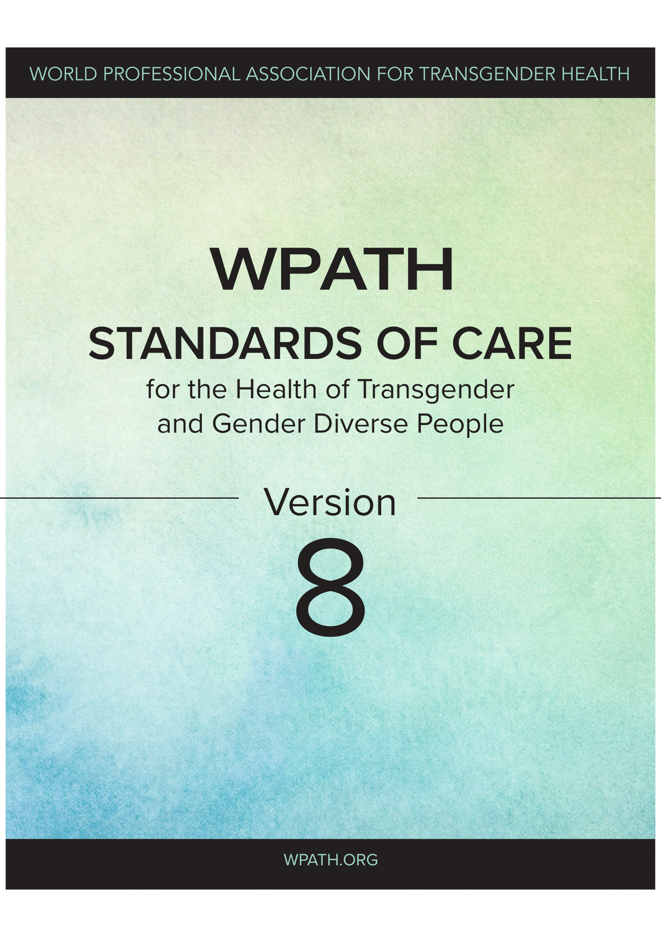
Criteria for Surgery according to WPATH
Gender incongruence is marked and sustained;
Meets diagnostic criteria for gender incongruence prior to gender-affirming surgical intervention in regions where a diagnosis is necessary to access health care;
Demonstrates capacity to consent for the specific gender-affirming surgical intervention;
Understands the effect of gender-affirming surgical intervention on reproduction and they have explored reproductive options;
Other possible causes of apparent gender incongruence have been identified and excluded;
Mental health and physical conditions that could negatively impact the outcome of gender-affirming surgical intervention have been assessed, with risks and benefits have been discussed;
Stable on their gender affirming hormonal treatment regime (which may include at least 6 months of hormone treatment or a longer period if required to achieve the desired surgical result, unless hormone therapy is either not desired or is medically contraindicated).*
Notes:
What can gender affirming care entail?
Primary care
Gender affirming hormone therapy
Therapy or psychiatric care
Permanent hair removal
Surgery
Speech therapy/voice training
Support for legal name and gender marker change
No set path; each person can seek specific interventions to affirm their gender identity (Coleman et al., 2012)
Who can prescribe GAHT?
Primary care physicians, endocrinologists, ob-gyns, APRNs, PAs
Using medications commonly used for other indications
And if yo uthink you’re going to be providing GAC, check out some guidelines
WPATH - informed consent guidelines and criteria for hormone therapy
- every other year scientific symposium, Global Education Initiative classes
-USPATH
Transline - hormones guidelines, “ask an expert” service
Center of Excellence for Transgender Health @ University of Califorinia in San Francisco
Comprehensive care guidelines
Pelvic pain and persistent menses in transgender men
Free silicone and other filler use
Details about cancer screening
Endocrine guidelines – I don’t use them
William Powers - I include this because so many patients ask about it. Physician with many novel ideas, practices off guidelines, ?questionable
ALSO -- Philly Trans Wellness Conference

Slide 31
Gender Affirmation is LIFE Saving
Remain Open (including to feedback)
Learn, unlearn, ask for support
Talk with your people, your families; model for your colleagues
Know better, do better**
Notes:
what *I want* my cis friends or family or coworkers to be doing, it’s a giant Unlearning of cultural norms and expectations. To me that means, I want more people to get curious. To get more uncomfortable. I want people to spend some time questioning more of their day to day reality. Not because our experiences aren’t reall, but because our experiences are shaped by our identities, our access to resources, our proximity to power, wealth, decision making authority etc. And I think when people who benefit from dominant cultural narratives or systems reflect on that and begin to see what it’s afforded us, it can create opportunity to unlearn norms that are harmful, to elevate the lived experiences of people historically and systematically oppressed, and do more or different work to work towards a more just society, for all of us.
The action steps I suggest are both personal or private. I also want to uplift that many of you are doing this work already, and ongoing– I assume as much, and I thank you for your energy and commitment to this. thank you in advance for being resources to one another and continuing a practice of doing labor so that trans people in your life don’t have to.
A BIG COLLECTIVE UNLEARNING
Ask yourself about your Gender— when did you know your gender? How or who helped you understand it? What’s it been like to act outside of your gender norms?
Imagine everyone is Trans and Non-Binary– what would your day be like if you moved through it believing more people were trans than not? What would your interactions look like if you assumed something other than normative or dominant experience?
Talk to the people close to you about these thought experiments and what you’re learning; encourage them to try it too
(READ PROMPTS)
I promise you, exploring your own gender does not make you trans. If you’re afraid of what you might learn– I encourage you to sit with that more and explore that feeling too.
I encourage more of you to imagine transness as the norm, imagine everyone is trans and non-binary. I shared last month that 26% of newm edical patients last year were with us for gender expansive care. I think all of us should be more prepared, or expect to need to be affirming of people unlike yourselves. I have found this one personally valuable to help me break out of assumptions around other dominant identities or norms I may have held… and learn about myself
And lastly here, I encourage you all to invite the people closest to you in your life into these discussions with you– start off with cis people. If you’re inclined, use these prompts in a team meeting (without forcing answers)
If this exercise feels meaningful for you with regards to gender, I’d encourage you to try it for other dominant cultural identities you hold– especially for fellow white folx, for abled people, for neurotypical people and so on. This is where I believe the practice of unlearning gender norms is tied to becoming more inclusive or open as a human. This practice of unlearning, and getting uncomfortable, it’s what connects us to one another.

