Slide 1
Coffee Chat: Updated CDC COVID-19 Guidance & Winter Planning for the HCH Community
December 20, 2022
Courtney Pladsen, DNP, FNP-BC, RN
Katie League, LCSW-C
Emily Mosites, PhD, MPH
Research | Training & Technical Assistance | Policy & Advocacy | Consumer Voices

Slide 2
Welcome!
Agenda
Check in
COVID Manual
Updated CDC COVID guidance
Discussion

Slide 3
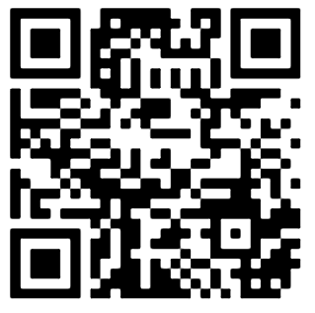
Mentimeter Poll
Link: https://www.menti.com/al1ty7ftmcx2
Notes:
Invite your community partners

Slide 4
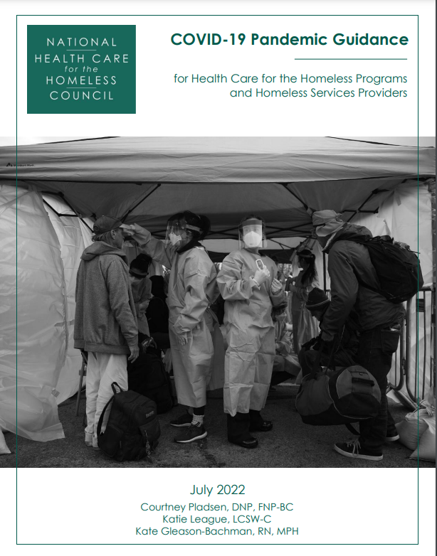
COVID Manual:
Guidance for the HCH community

Slide 6
Homeless Persons Memorial Day
The National Health Care for the Homeless Council, National Coalition for the Homeless, National Alliance to End Homelessness, and the National Consumer Advisory Board invite you to join us in honoring those who have died while experiencing homelessness by tuning in to our streaming Homeless Persons’ Memorial Day ceremony on Dec. 21. We will hear from speakers with lived experience and honor those in the community we have lost. 📆 Wednesday, Dec 21, 2022 3:30 p.m. EST / 2:30 p.m. CST / 1:30 p.m. MST / 12:30 p.m. PST
Notes:
https://nhchc.org/consumers/events/homeless-persons-memorial-day/

