Slide 1
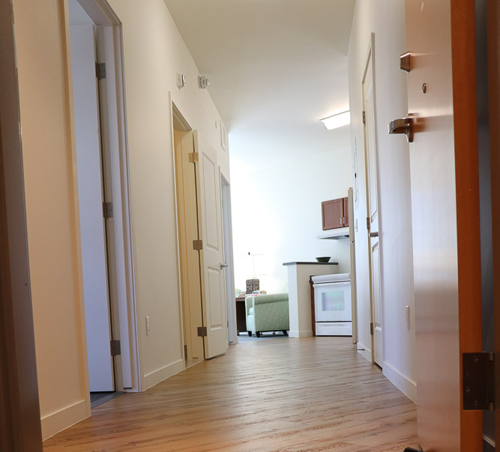
Denver’s Social Impact Bond: Solutions for Better Health Outcomes for Chronic Homelessness
NHCHC conference
May 2022
Notes:
Reports were released on July 15th
Types of Reports:
Final Report: implementation, outcomes, and impact
Payment Report: success payments
Health Care Outcomes Report: health care impact
Cost Analysis Report: costs and cost offsets

Slide 2
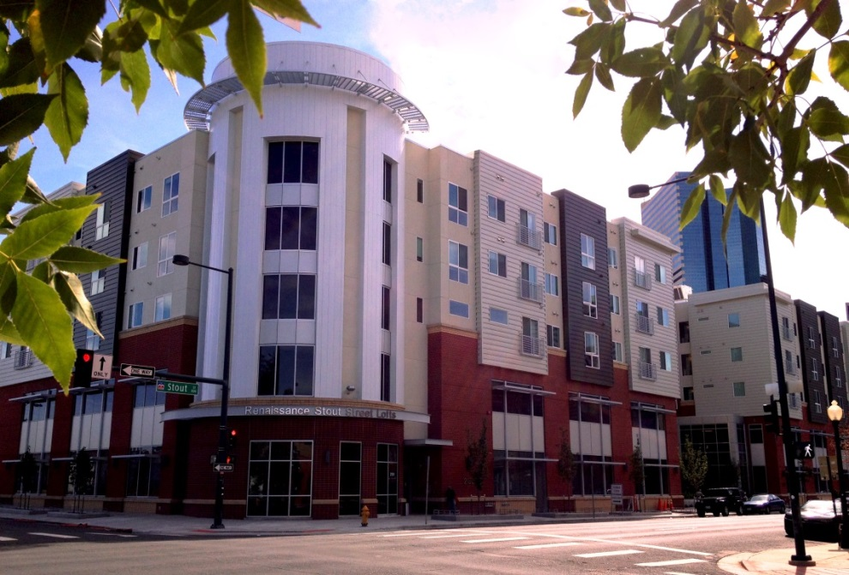
Speaker Introductions
Colorado Coalition for the Homeless
Lisa Thompson, DNP, PMHNP-BC Chief Operating Officer
Carrie Craig, LCSW VP of Supportive Housing
Walter Boyd SIB Program Participant

Slide 3
Today’s Agenda
CO Coalition for the Homeless overview
Pay for Success & Denver SIB Project Overview
Evaluation Design/Program Services Overview
Q & A
Key Findings and what’s next

Slide 4
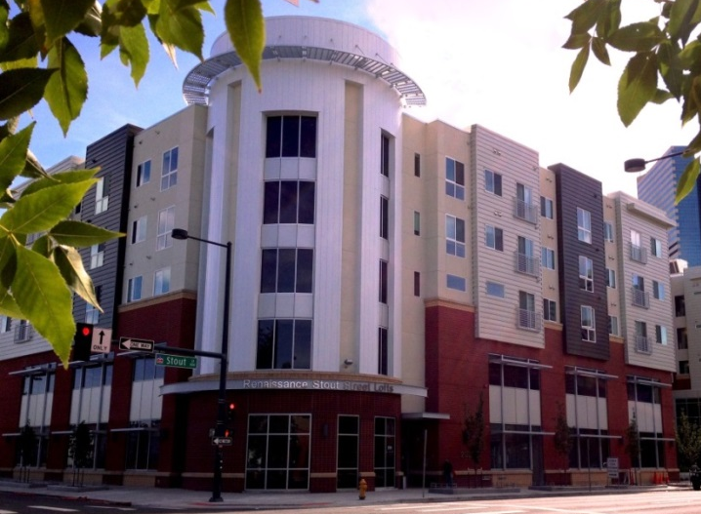
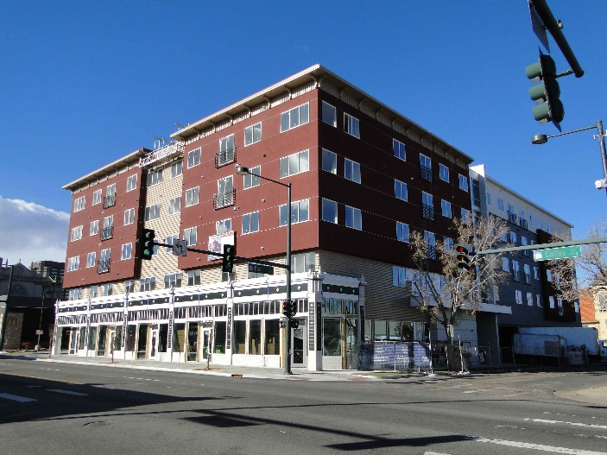
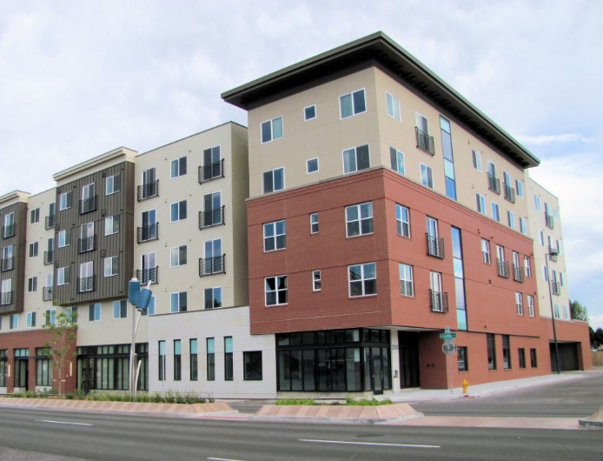
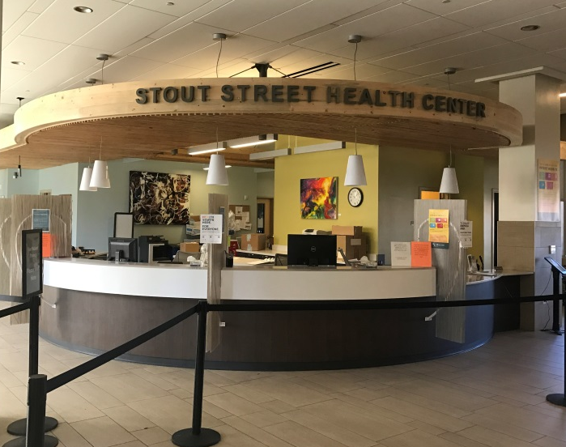
Colorado Coalition for the Homeless
Providing Lasting Solutions to Homelessness Since 1995
Integrated Health Care
Permanent Housing
Supportive Services
Housing Development
Community Partnerships
Education & Advocacy
Notes:
CCH- largest homeless service provider in the state of Colorado providing Integrated Healthcare, permanent housing a wide array of supportive services to families and individuals throughout the state.
We are also have an active Housing Development and a property management branch of our organization and are in involved in multiple community Partnerships working to solve the issues of homeless. In addition, we are are involved in education and advocacy issues at the local, state and national levels.

Slide 5
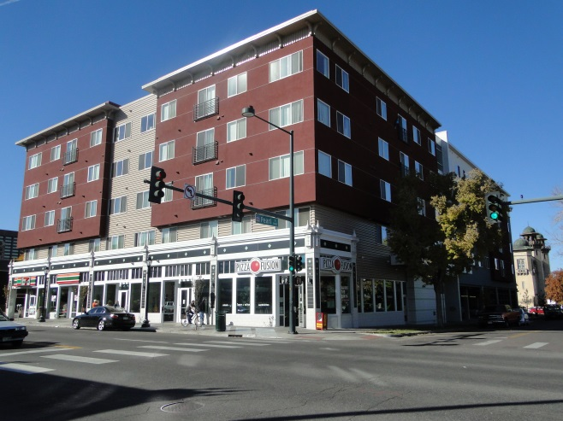
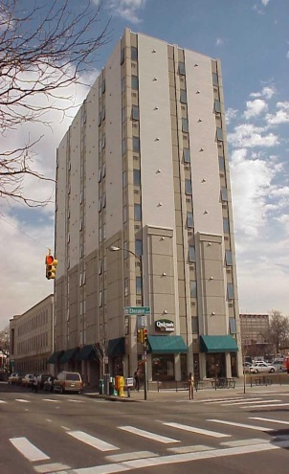
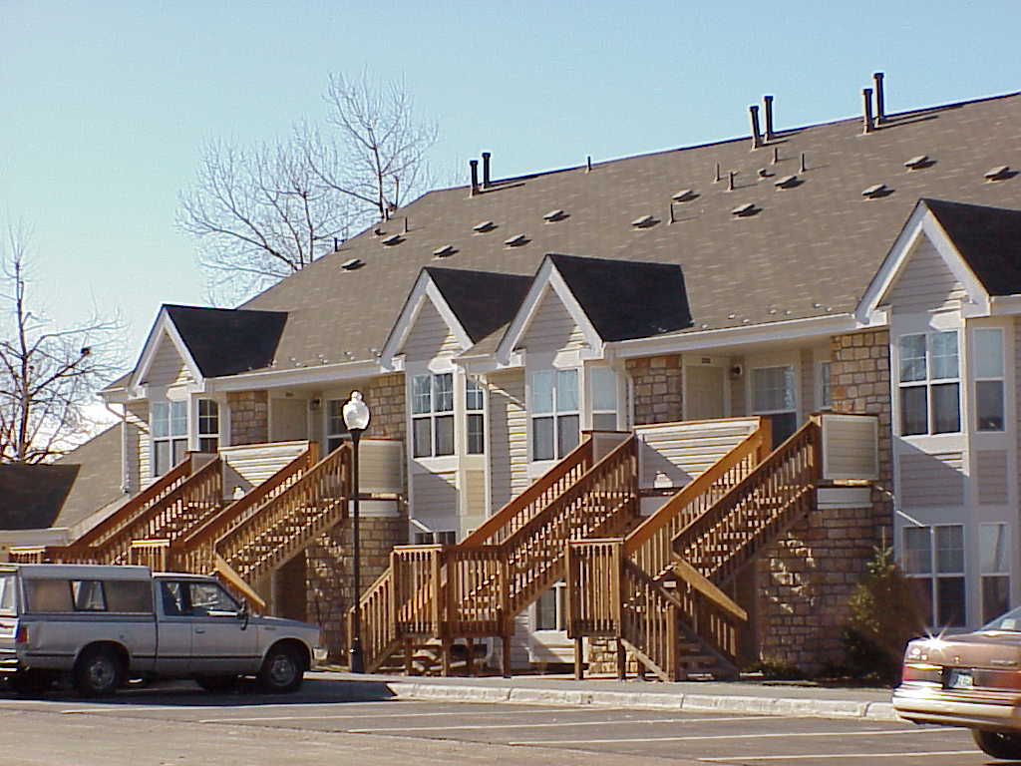
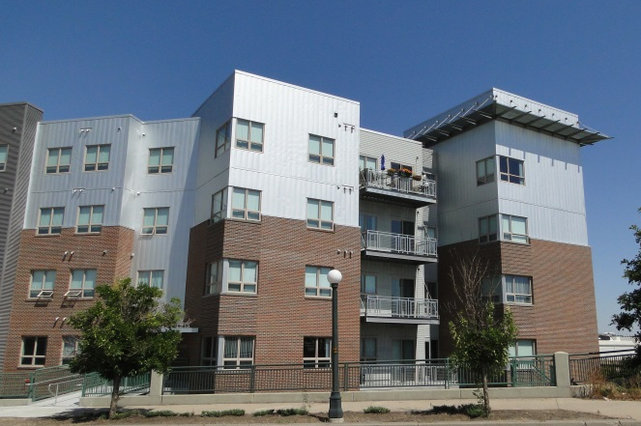
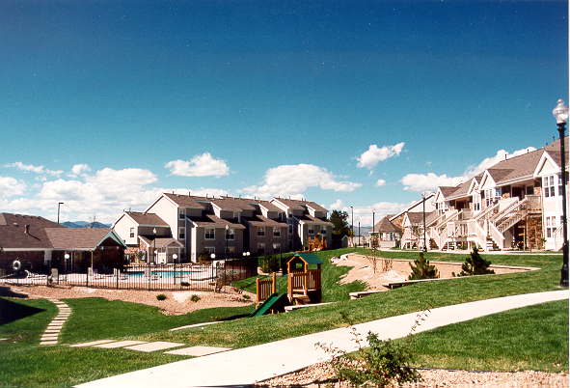
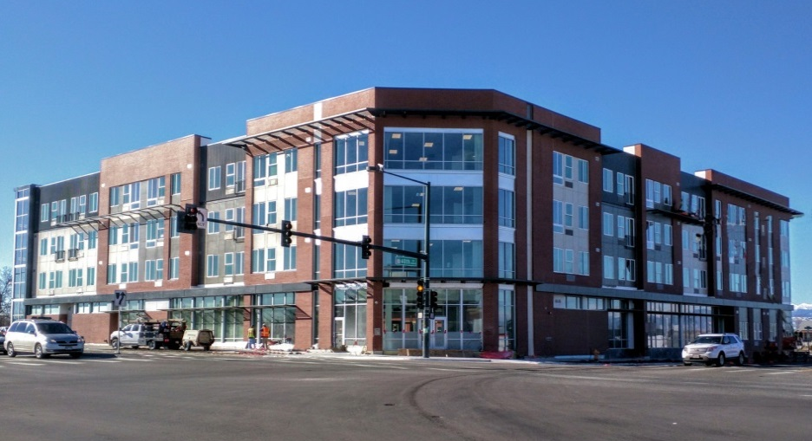
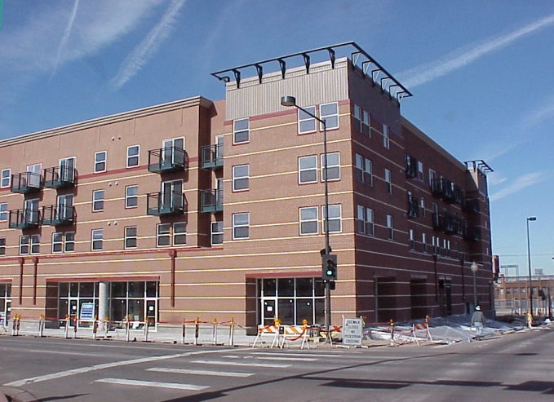
Colorado Coalition for the Homeless
Integrated Health and Behavioral Health Care
20 Residential Properties
Addressing Social Determinants of Health – Housing
Denver Social Impact Bond targeting chronically homeless persons who are high utilizers of jail
1,711 Units in past 15 years
100 Units in development
Notes:
HOUSING:
Our first property was in 1996, and we now have 20. We innovate regularly and respond to evolving community needs. For instance Fusion Studios was us updating a hotel rather than building from scratch which made it much faster. We also have efforts like the Renaissance veterans apartments at Fitzsimons that are for particular populations.
SUPPORT SERVICES:
Community Resources
Outreach
Project to Assist in the Transition from Homelessness (PATH)
Family Support Services
Case Management Program
Housing Assistance
Vocational Programs
Recovery Services
Rural support
We also help through Advocacy efforts!

Slide 6
Stout Street Health Center
Federally Qualified Health Center
Integrated Health Care to more than 15,000 unique patients annually
Medical
Mental Health
Addiction Treatment
Dental
Vision
Pharmacy
Peer Support
Case Management Services
Stout Street Lofts -- 78 Supportive Housing Lofts on upper three floors
Notes:
HEALTHCARE:
Stout Street Health Center and 4 satellite locations, including Health Outreach Program (HOP), 48th Avenue Shelter West End, Ft. Lyon. We also do telemedicine and street medicine.
Helped house people during COVID – 5,000 in PA/AR sites
Part of CCH as original RWJF Grantee since 1984
New SSHC opened 2014. One-Stop Shopping
Primary care, Psychiatric and Behavioral Health Services, as well as Vision, Dental and Case Management.

Slide 7
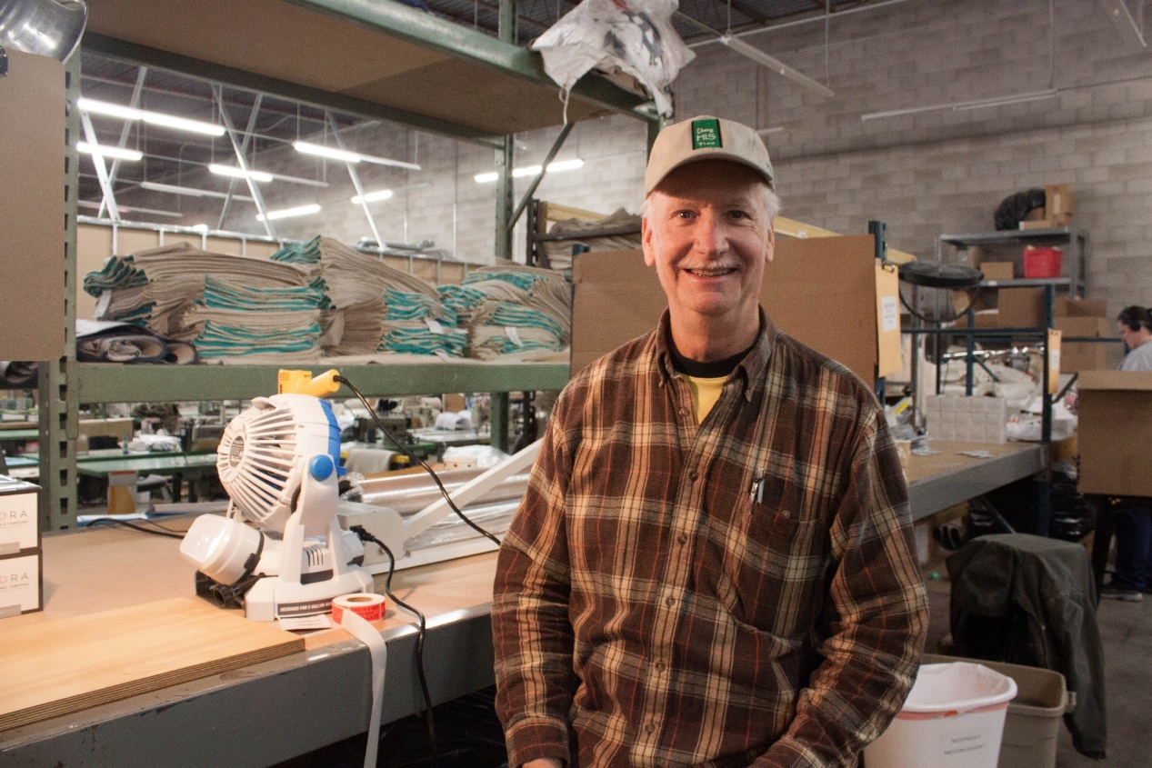
Additional Services Addressing Social Determinates of Health
Community Resources
Outreach & Engagement
Family Support Services
Child Care Center
Peer Support Services
Case Management
Housing Assistance
Vocational Programs
Residential Recovery Programs
Rural Community support
Notes:
Family Support Services provides services to families with at least one child under 18, or dependents with disabilities
Community Resources helps homeless adults without children meet their short-term needs and to transition individuals, with more intensive needs, into other services

Slide 8
Denver SIB: The Basics
Denver SIB – The BASICS
Goal | Addresses the underlying causes of homelessness, including mental illness and substance abuse, while also reducing costs in the criminal justice and emergency health systems in the City of Denver by providing housing and supportive case management services to individuals experiencing homelessness.
Project Dates | 2016-2020
Target Population | 250 individuals who frequently use the city’s emergency services in Denver, including police, jail, the courts and emergency rooms. (250 of which cost $7 million per year)
Outcomes Funding | $8.6 initial investment across 8 investors; $11.4M max repayment
Outcome Payor | City of Denver
PFS Funding Use | Services, limited housing related costs
Service Model | Modified Assertive Community Treatment (ACT); 2 providers
Evaluation | Randomized Control Trial led by Urban Institute, paid for by City of Denver (outside PFS transaction)
Success metrics | Stable housing + jail day reduction
Notes:
Basic Background information:
Goal was to reduce Criminal Justice and emergency health system costs in the City by providing Housing and Supportive Services to 250 individuals who were identified as the highest utilizers of the Denver Jail systems
Project Planning began in 2014, program launch 2016 – 2021
8 investors were identified to provide 8.6 million in initial investment. Based on outcomes, the City would pay back the investors a return on their investment.
CCH was one of 2 service providers- MHCD. Primarily provided Assertive Community Treatment
Used a Randomized control trial done by Urban Institute.
Primary Metrics were Stable Housing and Jail day reduction- later research done on Healthcare utilization reductions, but this was not part of success payments

Slide 9
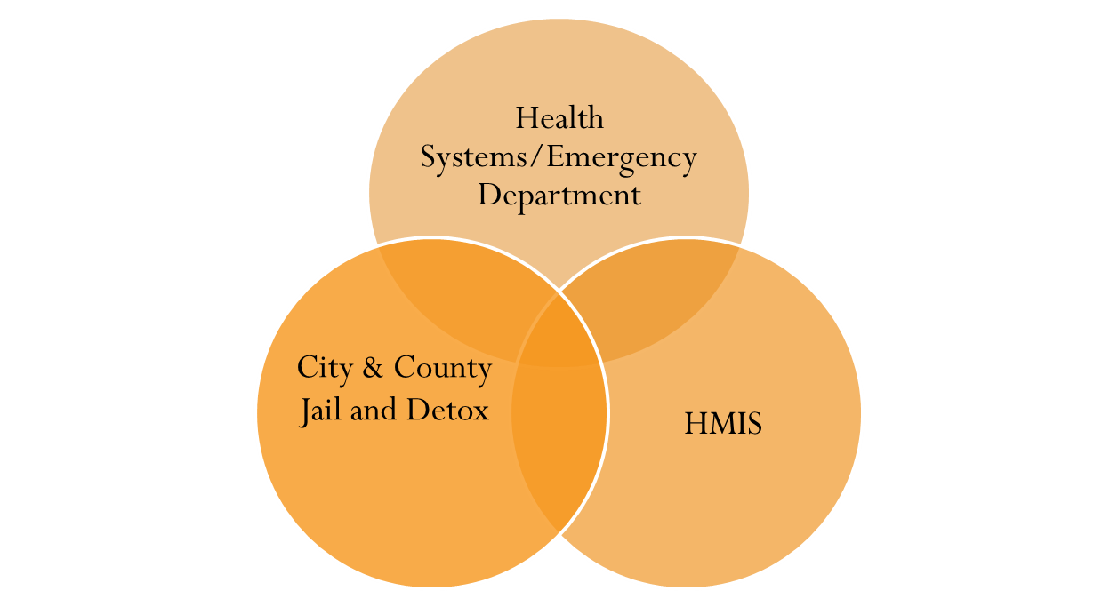
Why this group?
DATA SYSTEMS & MATCHING
Each year, 250 chronically homeless individuals account for:
14,000 days in jail
2,200 visits to detox
1,500 arrests
500 emergency room visits
Each year, the average cost to taxpayers per individual is $29,000 annually, resulting from jail days, police encounters, court costs, detox, ER and other medical visits.
Each year, the City spends approximately $7 million on 250 individuals to cover the expenses above.
Notes:
Based on prior analysis data that looked at jail and detox data as well as emergency services utilization data it was found that - 250 individuals accounted for significant jail, detox and arrest visits and were costing taxpayers over 29,000 per year and this was costing the City a significant amount of money. Reducing these unnecessary costs was ultimately the goal of the project, and as CCH believes regardless of costs savings, providing housing to people experiencing homelessness is the right thing to do.

Slide 10
Main Project Partners
City of Denver
Corporation of Supportive Housing
Enterprise Community Partners
Colorado Coalition for the Homeless
Mental Health Center of Denver
Urban Institute
Private Investors
Colorado Division of Housing
Denver Housing Authority
Colorado Access

Slide 11
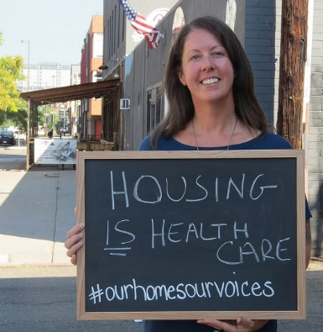
Housing is Health Care
Notes:
This slide means Carrie is up

Slide 12
In-Depth Look at the Social Impact Bond Program

Slide 13
Denver SIB Target Population
Front-end frequent users that drive up public service costs and cycle in and out of jail, detox, and emergency medical services.
The project targets individuals who have at least 8 arrests over three years and identified as transient (having no address or providing the address of a shelter) at the time of arrest.
Arrest data from 2012-2014 made the original sample size approximately 1,400 individuals.
List refresh adds an additional participants each year– the full list is now approximately 3900
Notes:
Goal of the project was to break the cycle of people cycling in and out of the jail to the streets and to utilizing emergency health sericces.
The project targets individuals who have at least 8 arrests over three years and identified as transient (having no address or providing the address of a shelter) at the time of arrest.
Initial list of eligible participants was based on arrest data between 2012-2014- original sample size was 1400 individuals, list was regularly refreshed

Slide 14
Social Impact Bond (SIB) ACT Teams
Two specialized ACT teams working with 175 of highest utilizers of Denver Jail System
Coordination with Denver Jail, Corporation for Supportive Housing, Enterprise Group, Investors, MHCD, City of Denver, DPD
Unique Funding Stream
Pay For Success model
Notes:
As part of this project, CCH served 175 of the total 250 target clients- while MHCD served the remaining 75. - We established 2 Modified Assertive Community Treatment team that worked very closely with the Denver Jail and other project partners. Early on in the project we set up weekly “operations calls” facilitated by CSH in which we reviewed how the project roll out was going and addressed any adjustments that were needed.
As Annie described one of the critical and unique aspects of this project to other grant funded PSH projects was the randomized control trial aspect as well the unique and flexible funding stream. Rather than invoiced based funding with specific with specific requirements on reporting, We received the Funding upfront, made it more successful, less barriers related to regular reporting requirements.
The pay for success nature of the project was also encouraging as given the noticeable success the project was having, ½ way through we worked with City of Denver to expand project to serve an additional 75 more clients

Slide 15
Assertive Community Treatment (ACT)
75% of services provided occur in the community.
Team approach—staff work with all/most clients.
Support an individual's ability to live successfully in the community based on client-centered goals.
Harm Reduction—reducing the overall negative consequences associated with substance use.

Slide 16
Housing First +Assertive Community Treatment (ACT)
Interdisciplinary Team of professionals who provide intensive wrap around treatment including:
Case Management
Initial and ongoing assessment
Nursing care
Benefits Acquisition
Psychiatric treatment & Medications
Substance treatment Services
Peer Mentoring and Support
Long-term ongoing care
Notes:
Using Low Barrier housing model + providing these Intensive services by a team of staff allowed for greater success.

Slide 17
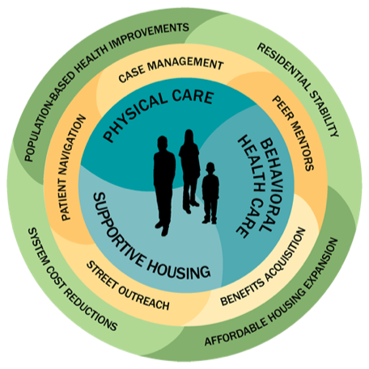
Housing Intake & Placement + Assertive Community Treatment (ACT) Team Finding the Flow- Homeless to Home
HIPS
Initial Outreach and Engagement
Eligibility Assessment
Housing subsidy paperwork
Vital Documents
Health Insurance
Goal setting
Housing Navigation & Placement
Transfer to ACT Long Term Services
SIB ACT TEAM
Case Management
Mental Health Care
Substance treatment Services
Nursing care
Psychiatric Treatment & Medications
Educational and Vocational Services
Benefits Acquisition
Peer Mentoring and Support
Long-term ongoing care
Notes:
Because of the nature of our organization and the already existing services we have set up in the community, we were able to leverage some of the expertise already being provided by other departments.
These two teams work together, it took an entire community in addition to many teams within CCH
Working with other homeless service providers
Outreach done together
How it works now…

Slide 18
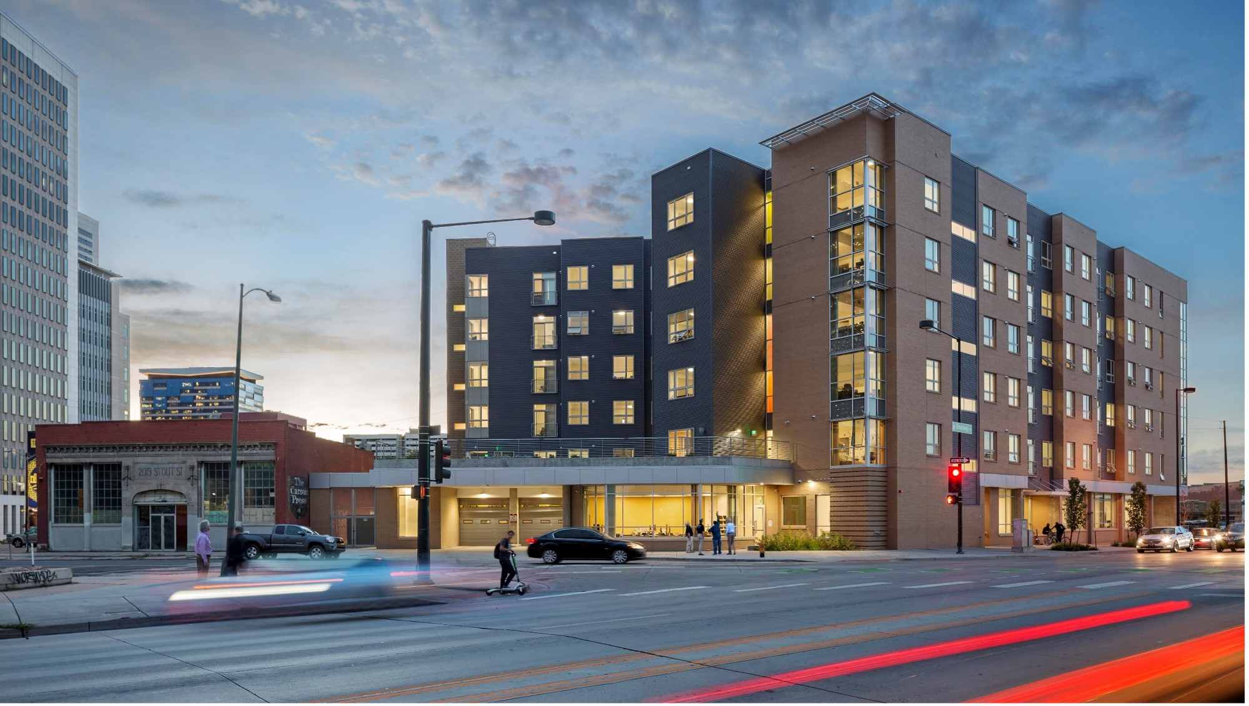
Renaissance Downtown Lofts
Supportive Housing – 100 units
Dedicated to SIB Program
Resident Services Coordinator
Clinical groups and support onsite
Activities and community engagement for residents
Resident Council governing body
Good Neighbor Incentive Program
Housing Retention Committee (eviction prevention)
Notes:
Discuss:
Supportive housing includes support services
RDL is in an ideal location close to public transportation, services, and the SSHC.
100 units for participants of SIB includes one and two bedroom units.
In addition to a property manager, and case managers, RDL has a Resident Services Coordinator, an Eviction Prevention Committee and a variety of activities and groups for residents to participate in.
computer skills class, cooking classes, and social outings. Groups include wellness, addiction recovery, budgeting skills and more.
Robust Service Program:
What we did before the building open: pizza parties, picnic, to get to know people, groups, establishing policies, what people wanted to see in the building ahead of time, resident council and town hall meetings to make sure that people’s voices are heard,
Good neighbor incentive Program- contingency management program, providing people rewards for awesome behavior, guy that called the ambulance because a neighbor was down in the hallway,
Whats in the closet- supplies for their apartment, tokens for group attendance, passing inspections, facilitating groups. Tokens for attending resident council meetings, officer positions in resident council.
We fund through flex funding, donations
Housng Retention process, now rolled out to 8 different properties

Slide 19
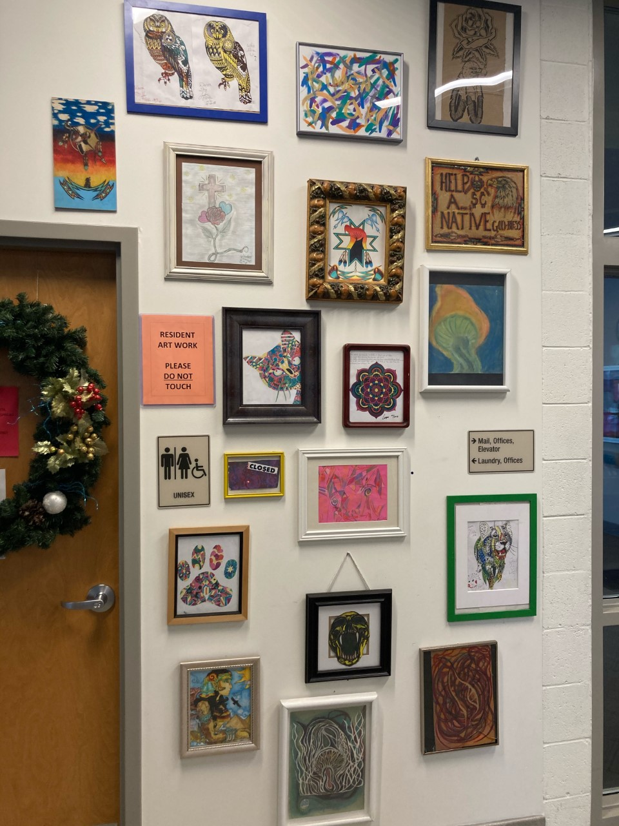
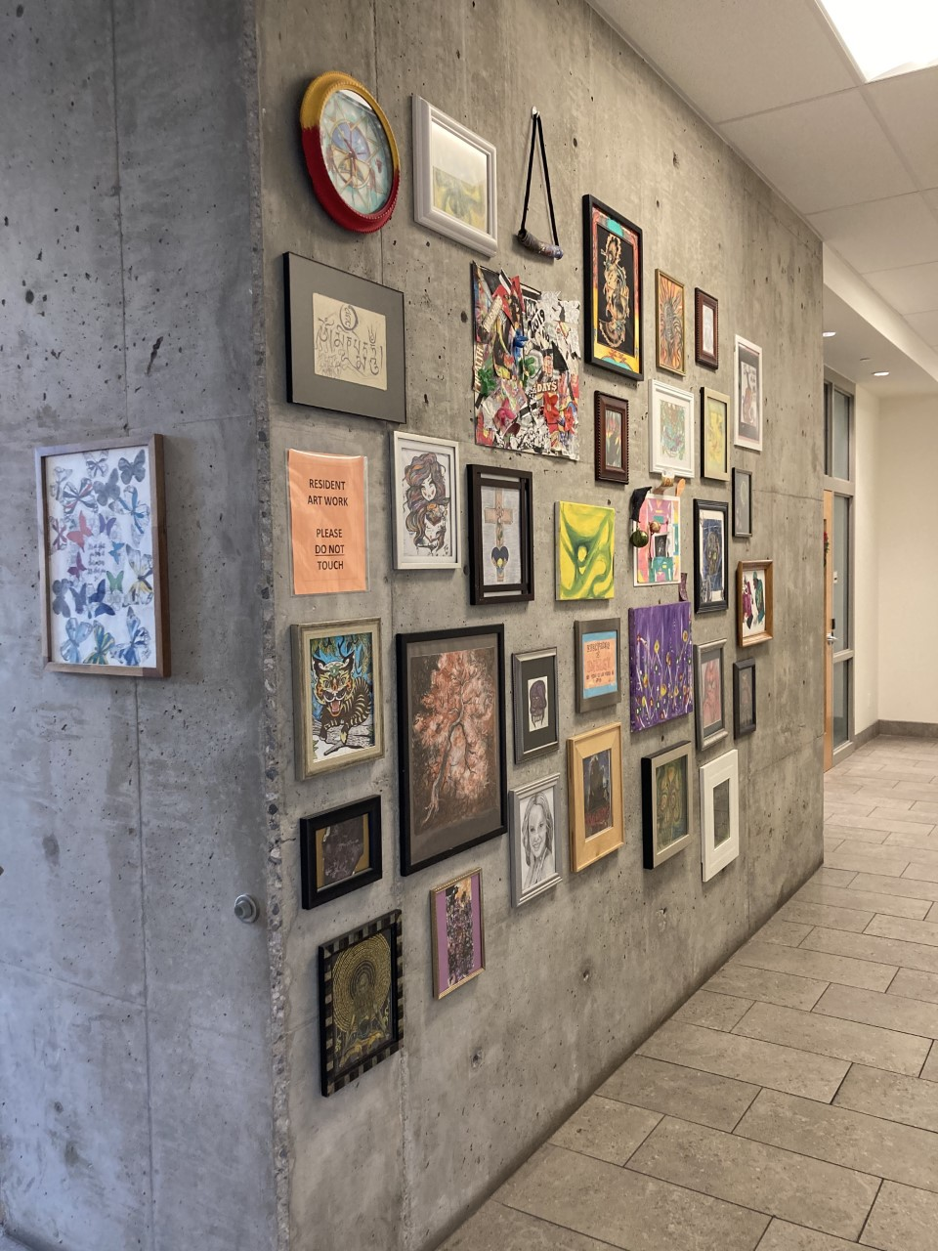
Resident Artwork at Renaissance Downtown Lofts

Slide 20
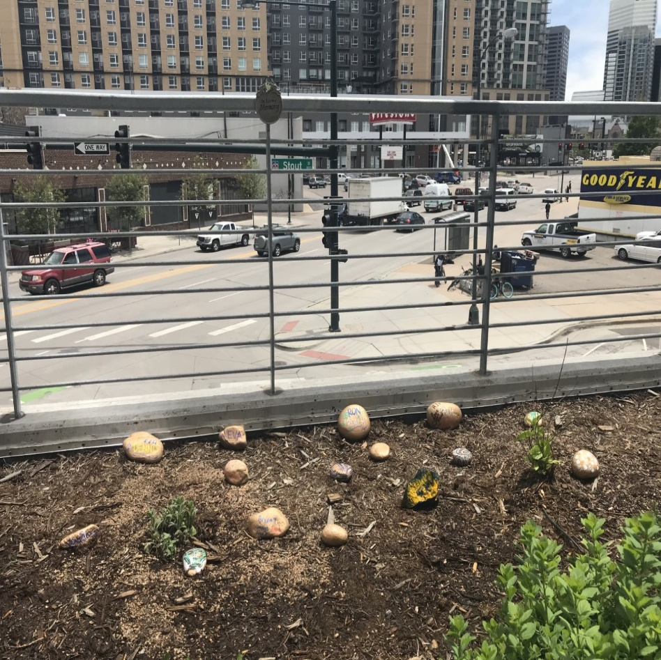
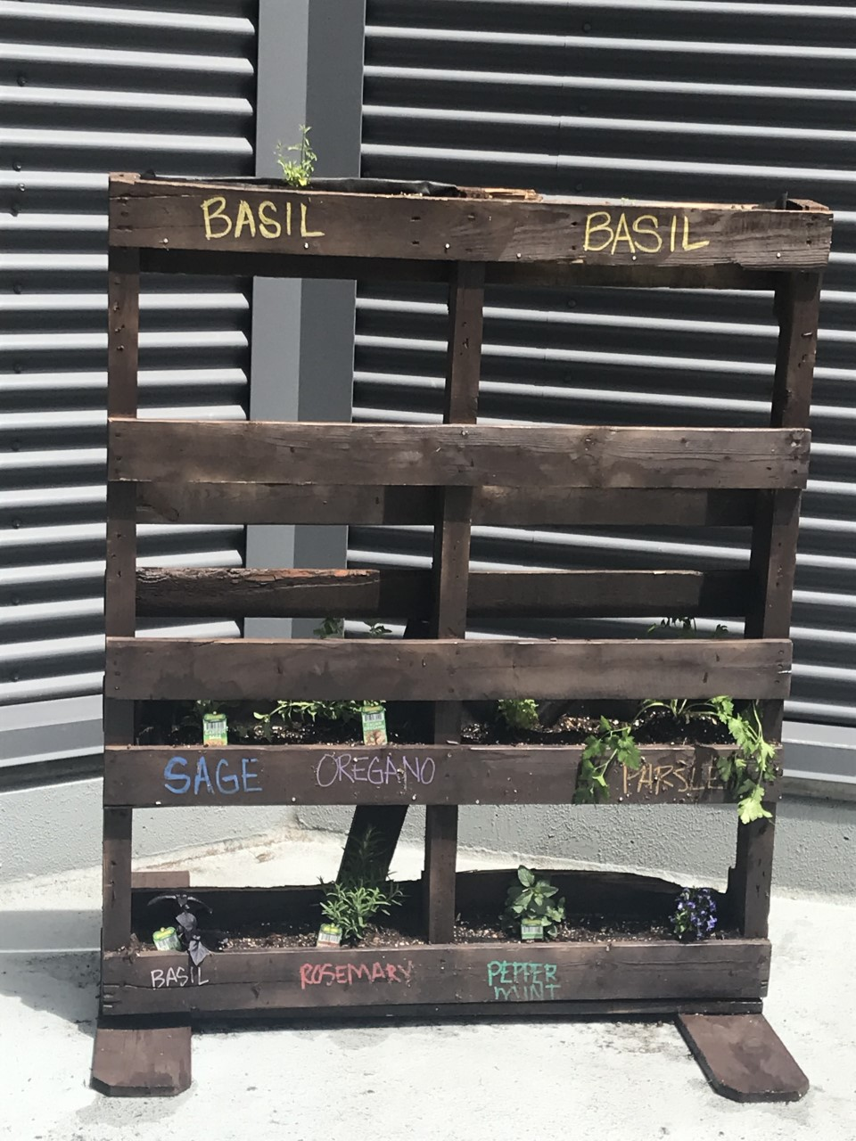
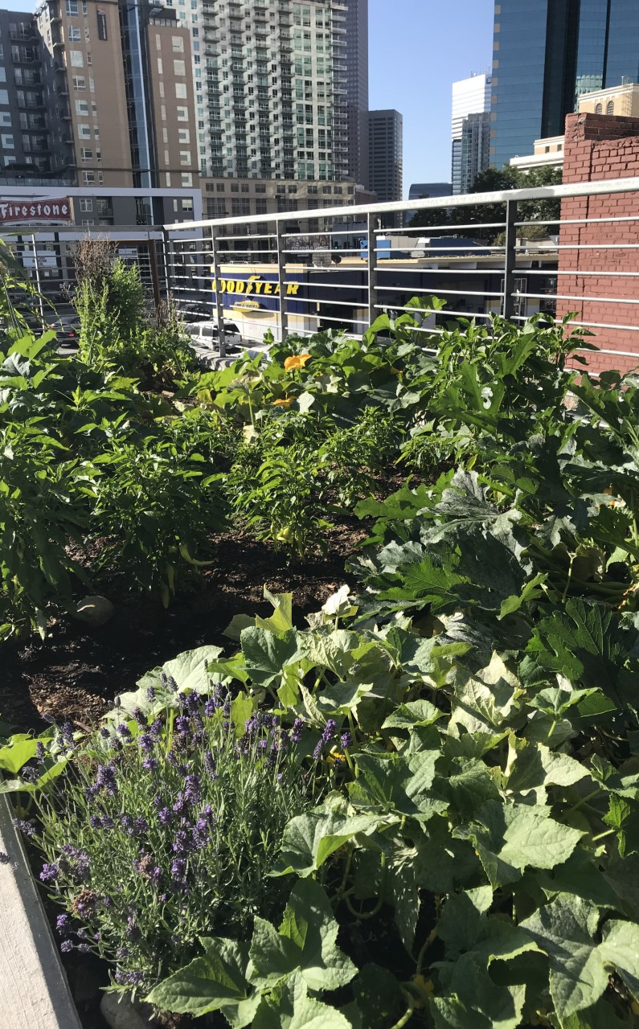
Memorial Rock Garden
Resident Rooftop Garden

Slide 21
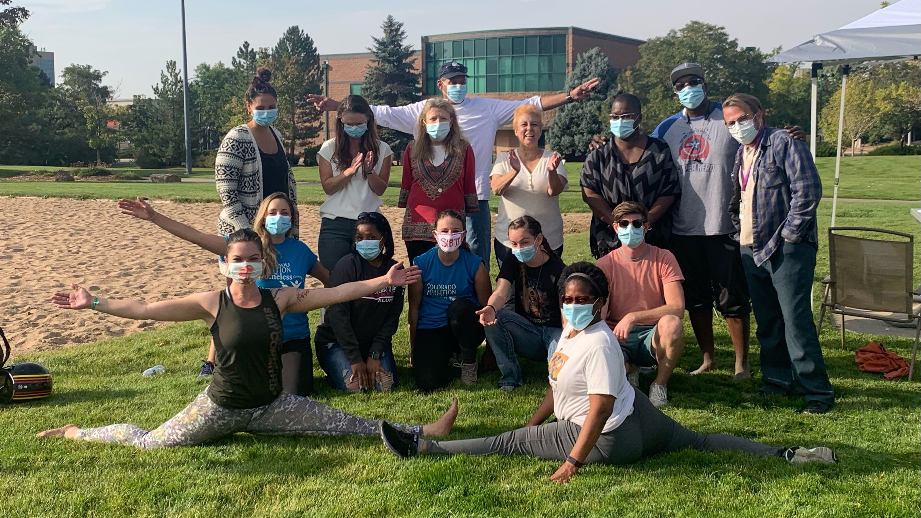

Slide 22
SIB Landlord Recruitment Process
Housing Navigation Team
Landlord Outreach and Engagement
Types of outreach
Services Provided
Landlord Incentives
Landlord Retention
Appreciation
Flexibility
Advocacy & Balance
The client and the landlord are our customer
Notes:
Housing Navigation Team- CCH has 5 housing navigators plus manager, do housing orientation and program orientation for landlords, assist with applications, sell the program, highlight the services we provide in the SIB, etc.
Outreach/Engagement- Lots of competition.
Communication is essential, we do what we can to stay at the forefront of their minds.
We have a GEO map of area where we have properties and where we need properties, try to recruit landlords in areas where we don’t have housing options.
Navigation team calls proactively to check in on clients, to make sure there are no needs, this leads to landlords reaching out to us directly when they have vacancies,
We serve as single point of contact, save money on marketing and advertising for their units since we have clients in the cue, we facilitate faster inspection on units, educate landlord on what is required to pass inspection, facilitate the lease up, some landlords don’t have time to attend this, they only have to meet to provide the keys. We dispatch supportive services as appropriate, assist with payments.
Retention: Twice a year landlord appreciation, send cards with all staff signing, working on a website where we will have a landlord page where landlords can submit units, Currently have electronic form they can notify us of vacancies, navigators respond within 24 hours.
Biggest key to success is communication, response times to landlords. Get first payment paid ASAP.

Slide 23
Lessons Learned
Participants accept housing when offered – debunk myths
Importance of community and interdepartmental collaborations
Denver PD, Sheriff’s Department, Judges, Probation & Parole
Street Outreach, Health Center, Safety and Property Management
Service provider presence at court helped to reduce sentences for program participants
Jail In-Reach is critical
High vulnerability of population—need for linkage to healthcare
Notes:
All but 1 or 2 clients accepted housing when offered

Slide 24
Additional Lessons Learned
Importance of community building for program participants:
Focus with RDL building - “Get to know your neighbor” events
Group social outings
Temporarily housing participants in close proximity
Community Governance Boards
Importance of Flex Funding for Property Damages and Client Needs
Build up stock of units prior to start of program, Client choice is critical
Tenant Based vs. Project Based vouchers
Lease up schedule associated with payment model presented challenges
Self-care/resiliency of team

Slide 25
Outcomes

Slide 26
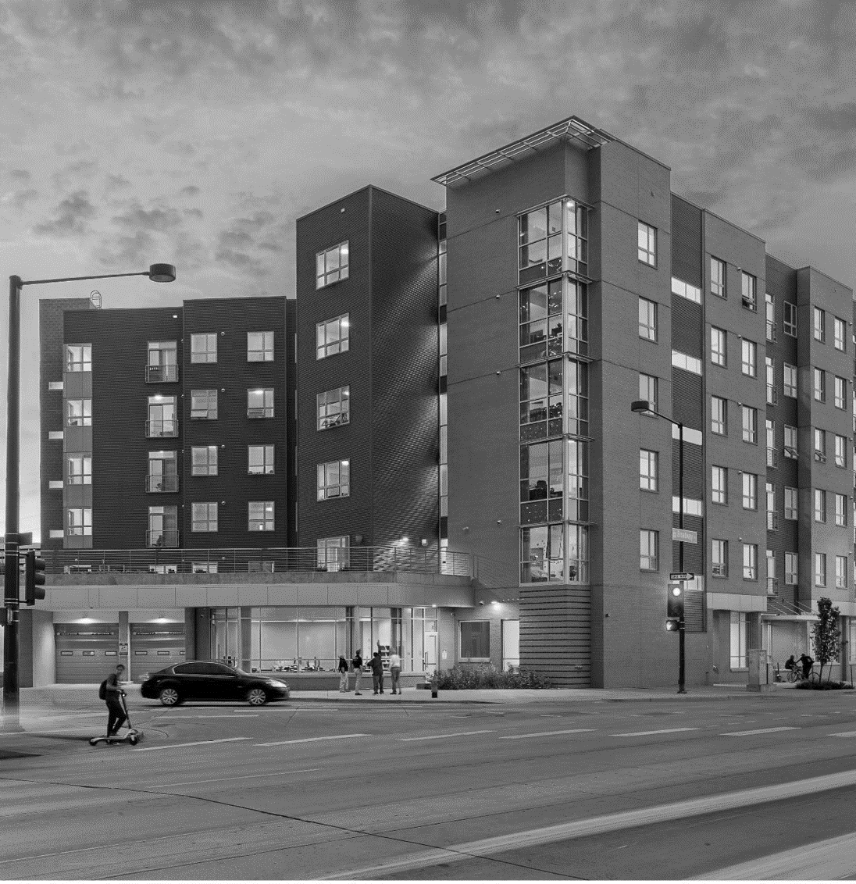
Supportive Housing Works
Social Impact Bond
At one year, 86% of participants remained in stable housing at one year; at three years, 77% remained in housing.
People in supportive housing used less emergency health care and received more office-based care on average than people receiving usual services.
Housing + services works
40% Fewer Arrest
65% Reduction in Detox Use
40% Fewer ER Visits

Slide 27
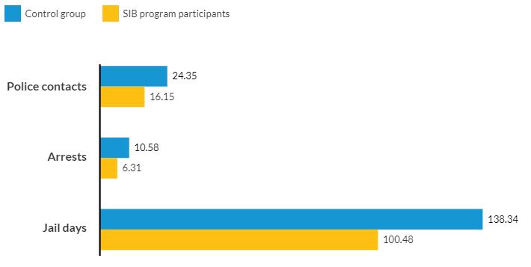
People in supportive housing had fewer interactions with the criminal justice system on average than people receiving usual services.
-34%
-40%
-27%
Notes:
(People in supportive housing had fewer interactions with the criminal justice system on average than people receiving usual services.)
People experiencing homelessness are more likely to interact with police and to face citations, arrests, and incarceration.
The Denver SIB shows that supportive housing reduces interactions with the criminal justice system among people experiencing homelessness and a history of arrest. Over three years, people referred to supportive housing had an average 34 percent reduction in police contacts and 40 percent reduction in arrests because of supportive housing.
SIB participants also spent less time in jail (an average of 38 fewer days in jail) . Over three years, participants referred to supportive housing had an average 30 percent reduction in unique jail stays and 27 percent reduction in total jail days.

Slide 28
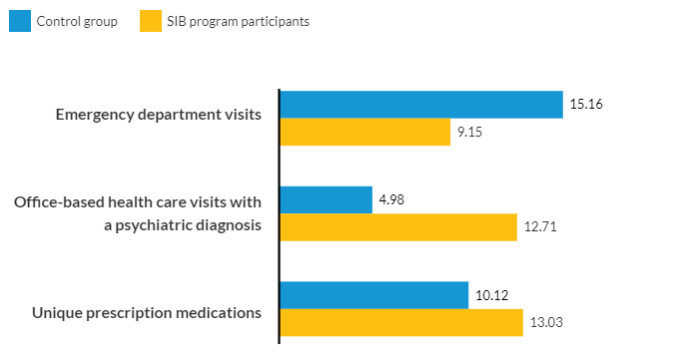
People in supportive housing used less emergency health care and received more office-based care on average than people receiving usual services.
-40%
+155%
+29%
Notes:
(People in supportive housing used less emergency health care and received more office-based care on average than people receiving usual services.)
People experiencing chronic homelessness are more likely to have physical or mental health challenges, but the homelessness-jail cycle does not connect them with the health services they need. As a result, they often use emergency services like detoxification facilities and emergency rooms for their health problems.
The Denver SIB initiative broke this harmful pattern. Over two years, participants referred to supportive housing had an average 40 percent decrease in emergency department visits, a 155 percent increase in office-based health care visits for a psychiatric diagnosis, and a 29 percent increase in unique prescription medications.
The Denver SIB also helped reduce the use of short-term or city-funded detoxification facilities that aren’t intended to provide long-term care and follow-up. Over three years, participants referred to supportive housing had an average 65 percent reduction in the use of these detoxification facilities.

Slide 29
Approximately half of the total per person cost of the Denver SIB was offset by avoided costs for emergency public services.
Notes:
(Approximately half of the total per person cost of the Denver SIB was offset by avoided costs for emergency public services.)
Denver SIB participants had almost $7,000 less in total annual, per person costs associated with emergency public services compared with the control group. The biggest avoidances were in reduced jail, ambulance, and emergency department costs.
Finally, we analyzed what it would cost to scale the Denver SIB supportive housing program to realize the maximum cost benefit. Our analysis showed that to serve all 1,209 people experiencing chronic homelessness in Denver County, according to the latest point in time count, would cost between $14.6 million and $18.7 million annually, but $8.3 million of that total cost could be offset by savings in emergency public services.

Slide 30
SIPPRA Social Impact Partnership to Pay for Results Act

Slide 31
SIPPRA
Pay for Success designed to save federal government money – Centers for Medicaid and Medicare (CMS)
PSH for high utilizers of health systems and jail systems.
125 persons to be served- Robust Randomized Control Trial.
Service funding for ACT and PSH Services from Social Investors.

Slide 32
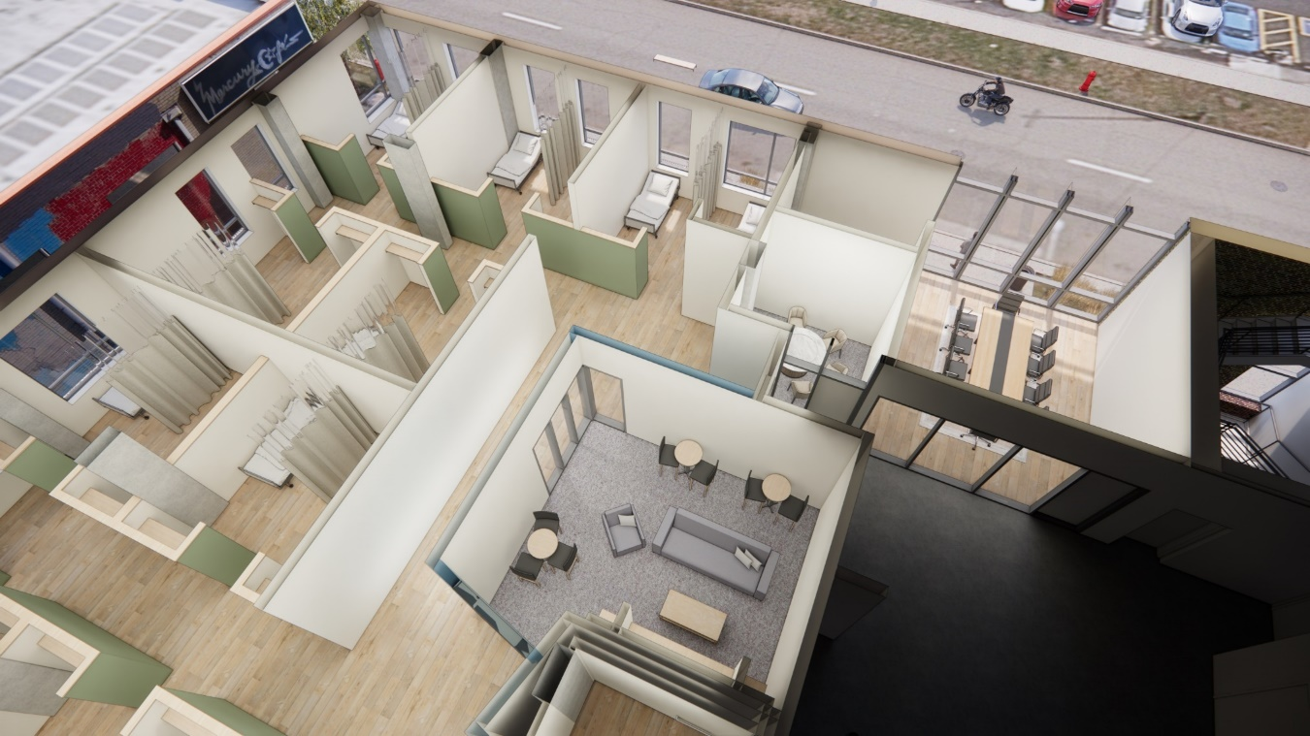
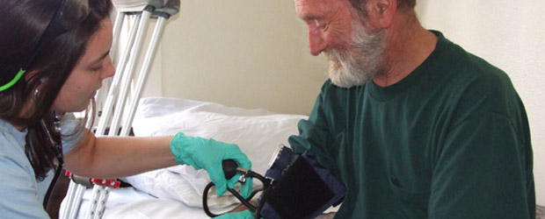
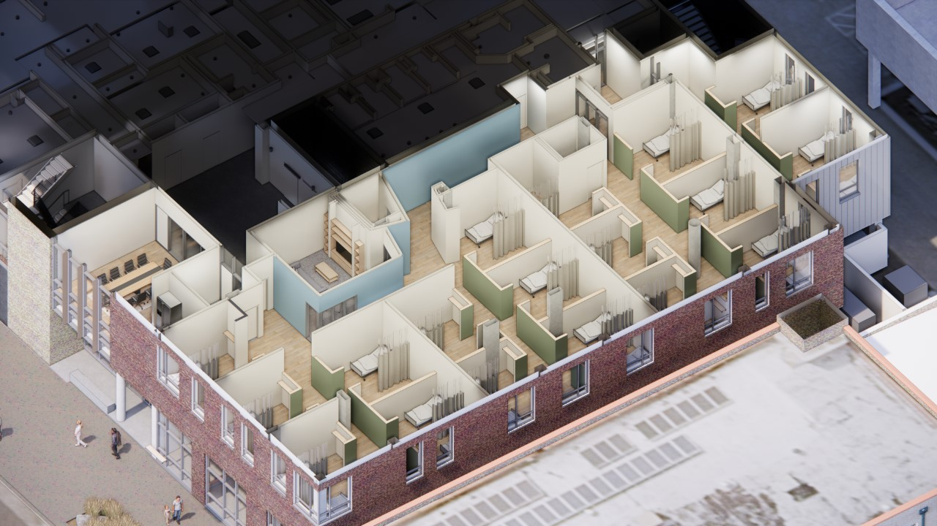
Stout Street Recuperative Care & Legacy Lofts
75 Recuperative Care Beds
98 PSH Units
Primary care, including 24/7 Nursing Support
Behavioral health, therapy, and psychiatry
Case management – focused on permanent supportive housing, housing navigation, & appropriate levels of care for discharge
Peer and health navigation
MAT² for clients with SUD³ – focused on recovery, discharge planning, & OD⁴ prevention.
Clinical Pharmacist medication management.

Slide 33
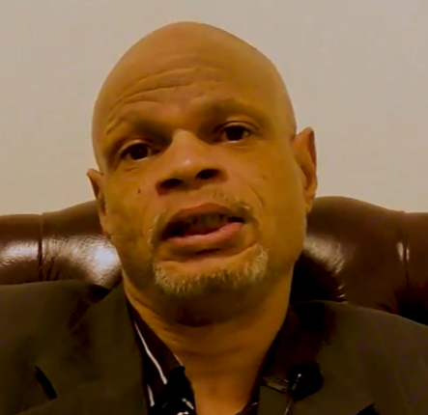
SIB Participants in their own Words... https://drive.google.com/file/d/1GAXZq4ak-wKtw5v-tHEcvvH2sue3ed_M/view

Slide 35
Questions ?

Slide 36
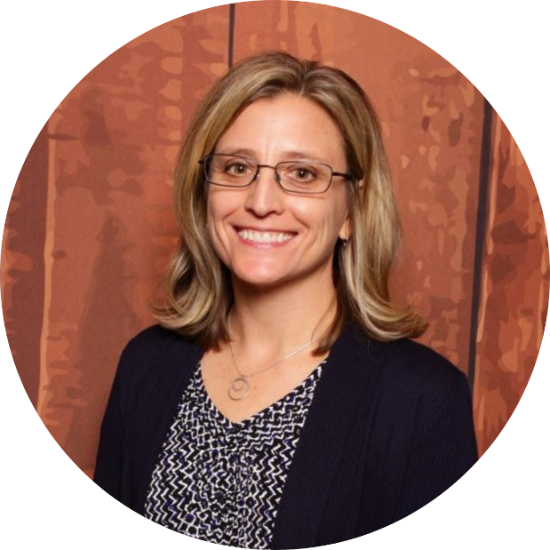
Connect with Us
Lisa Thompson, DNP lthompson@coloradocoalition.org
Walter Boyd, SIB Participant
boydwalter52@gmail.com
Carrie Craig, MSW, LCSW ccraig@coloradocoalition.org
Coalition Emails
coloradocoalition.org/subscribe
Facebook @COCoalition
LinkedIn
@COCoalition
Twitter
@COCoalition

