Slide 1
Deaths of Profound Despair
Mortality Disparities of Unhoused People in Santa Clara County
Georgia Bright, Jamie Suki Chang, Katherine Saxton, Michelle A. Jorden, Andy Gutierrez, Katherine Xia
Santa Clara University Department of Public Health
Santa Clara County Medical-Examiner/Coroner’s Office
Santa Clara County Office of the Public Defender
Notes:
Hello all and thank you for having me! My name is Georgia and I am an undergraduate student at Santa Clara University. I am studying Public Health, Biology, and Sociology and I will be graduating in June! Today, I will be talking about the research that I have worked on alongside my mentor and research adviser, Professor Chang, as well as community partners over the past three years. We are looking at mortality rates and causes of death of unhoused individuals living in Santa Clara County, and comparing these with rates and causes of death on the general population.

Slide 2
Presentation Roadmap
Future Work
Research
Background
Notes:
So, I’d like to begin with an overview of today’s presentation. First, I will share some background to situate Santa Clara County and our unhoused community. Then I will discuss the our methodological approach for examining unhoused mortality, and then I’ll go over the findings. Finally I’ll close out with the extensions of this work that we’re currently working on, as well as recommendations for policy changes.

Slide 3
01
Background
Santa Clara County and our Unhoused Community
Notes:
So, let’s get started with some background about Santa Clara County.

Slide 4
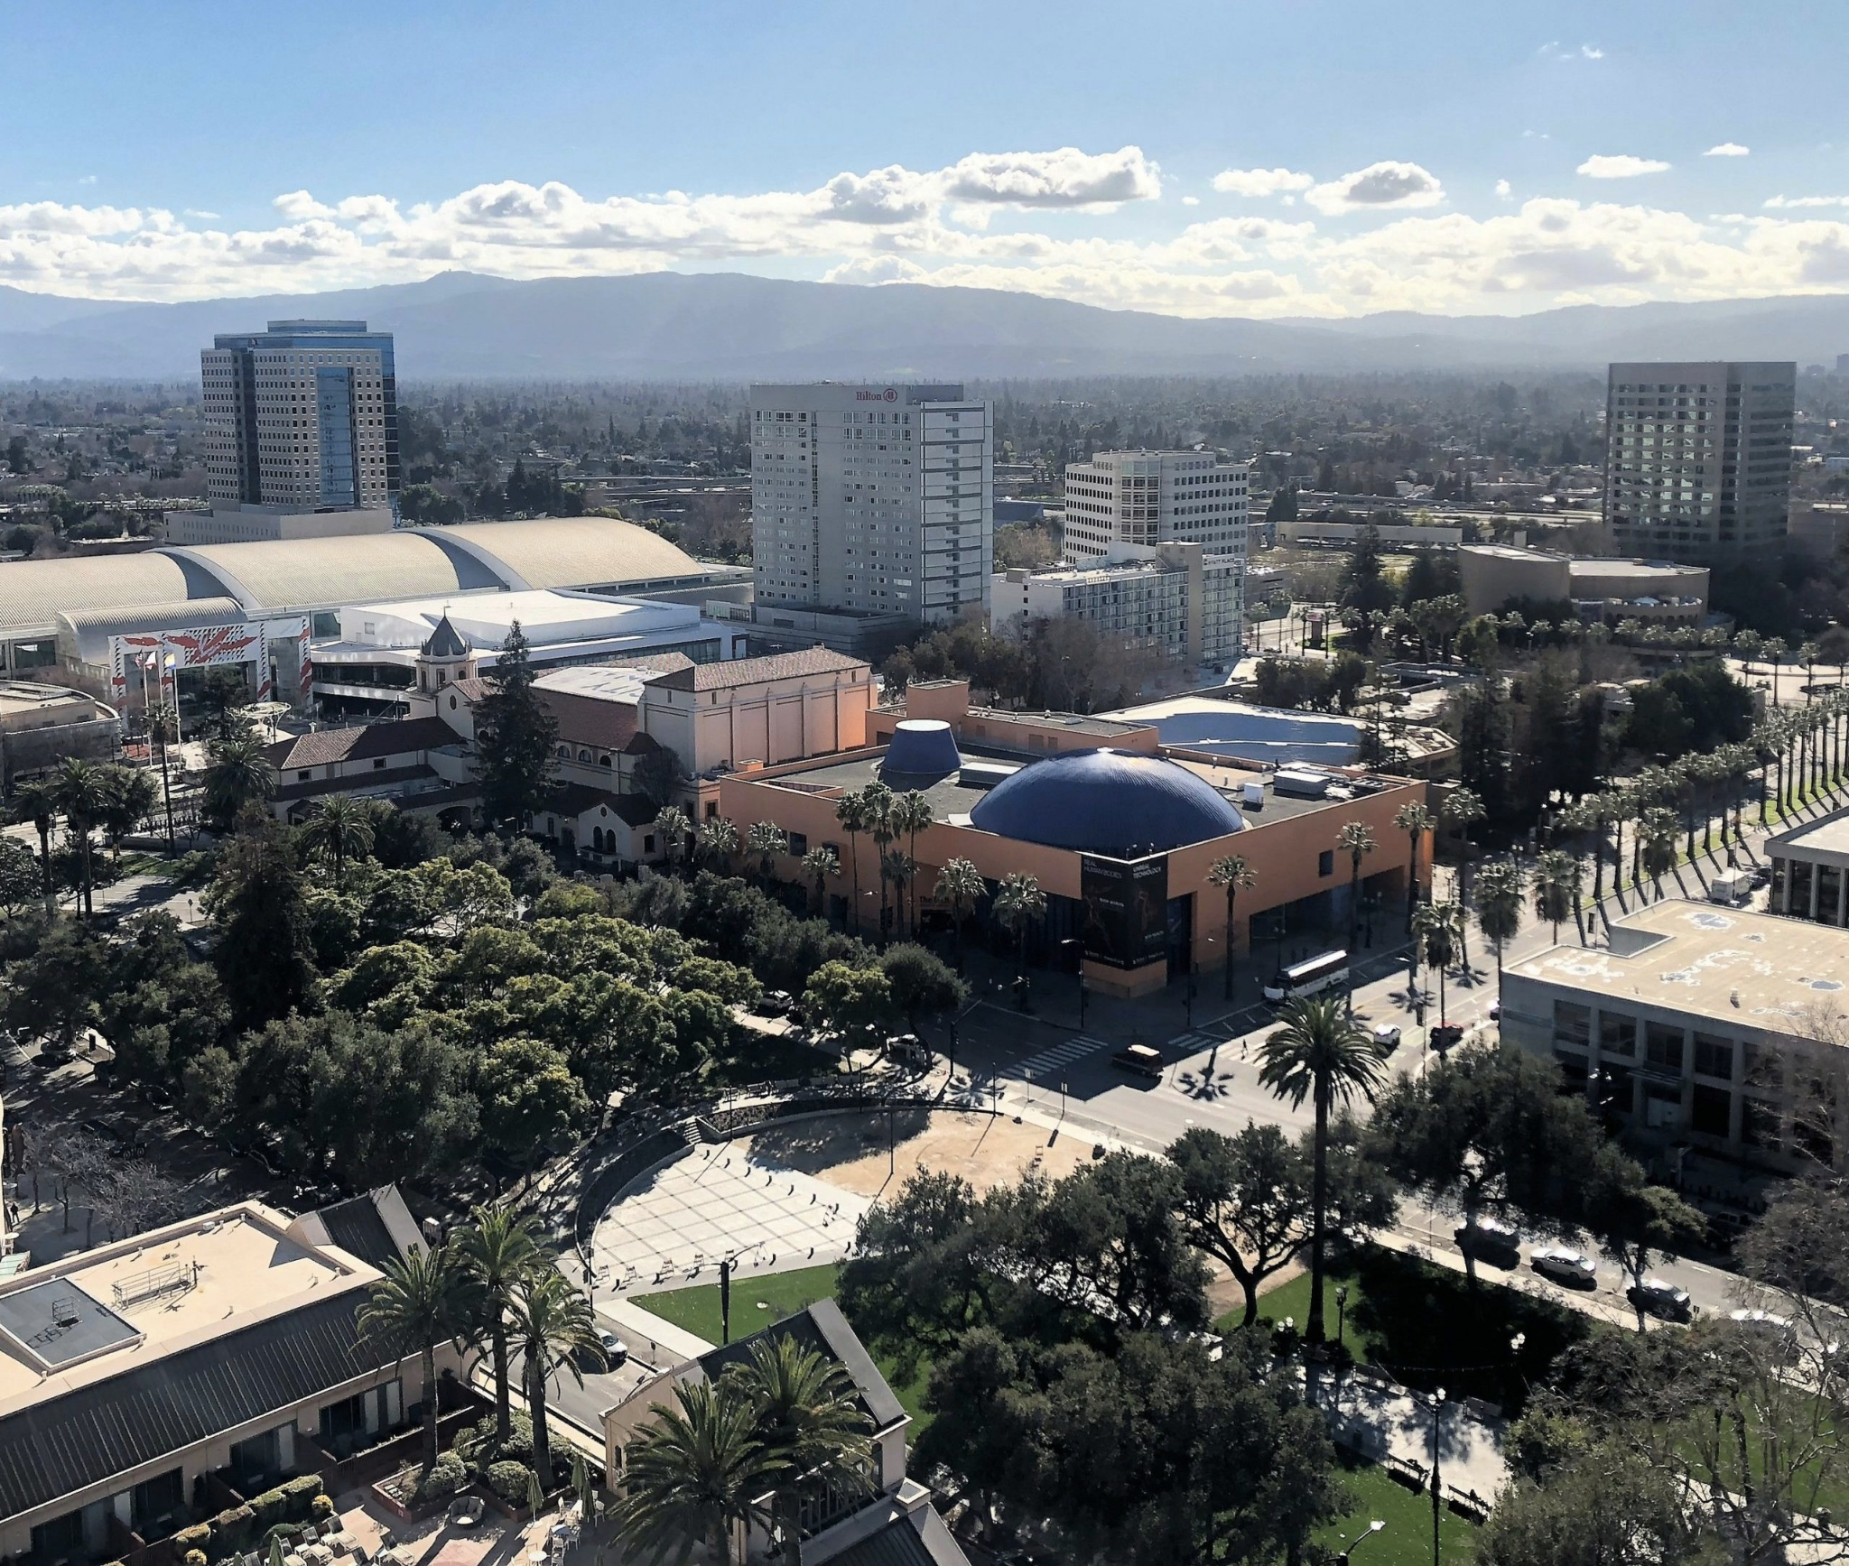
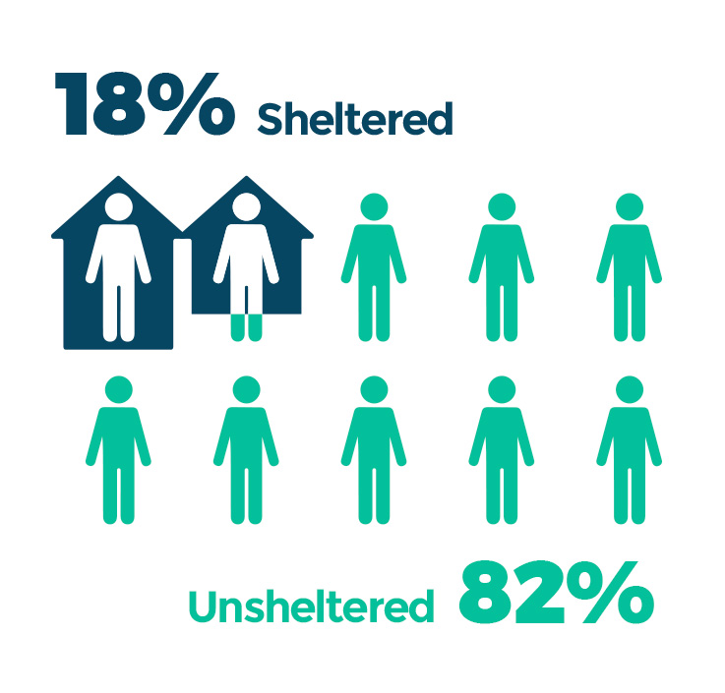
Notes:
Santa Clara County is in the heart of the Silicon Valley. Huge tech companies have transformed what was once a typical, mid-side community of suburbs and rolling hills surrounding San Jose. The housing crisis is extreme in San Jose, with the median single family home costing $1.4 million)\. It’s a region where people very acutely feel the impacts of the Bay Area housing crisis, and there is a very large homeless population.
There are some factors that make SCC unique in terms of homelessness. First, SCC unhoused population is growing rapidly. I’ll get to that in a moment on the next few slides.
Second, historically, there has been a lot of resistance against building both short- and longer term solutions to homelessness, despite the severe need. Because of a confluence of factors, there is a major lack of shelters in SCC. As a result the vast majority - over 80% - of people who are unhoused are also unsheltered. According to a recent SPUR report, SCC has the largest unsheltered-unhoused population by proportion in the nation.
Cost: https://sanjosespotlight.com/how-much-do-you-need-to-earn-to-buy-a-home-in-san-jose-more-than-240k-a-year/
SPUR: https://www.spur.org/publications/urbanist-article/2017-10-23/homelessness-bay-area
Photo credit: https://sanjosespotlight.com/why-downtown-san-jose-struggles-to-find-its-sense-of-place-architecture-redevelopment/

Slide 5
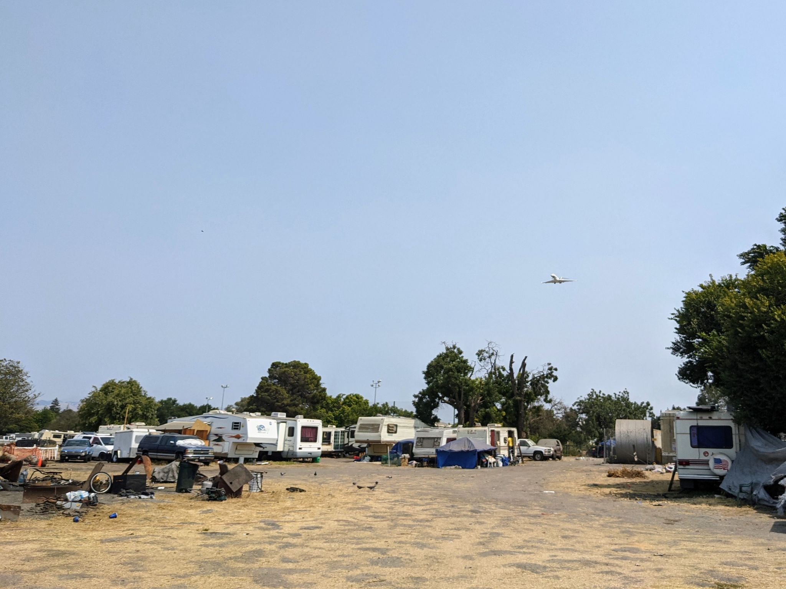
Add a couple photos from the encampment visits
Notes:
Third, SCC is a very large and dispersed county - about 50x the size of San Francisco. Therefore while the typical image of someone experiencing houselessness is someone on the street, many people who are unhoused in SCC actually live in the hidden, more forested areas of the region, such as along the banks of the Coyote and Guadalupe Rivers. These areas, while situated in the city, are actually quite invisible and hidden.
Finally, in terms of policy, there has been a focus in the county on permanent supportive housing. As such, there is a supportive housing department in SCC. However, there’s no homelessness department, and there’s been a major lack of emphasis on homeless supportive services, whether that be through shelters, safe parking, or encampment management.

Slide 6
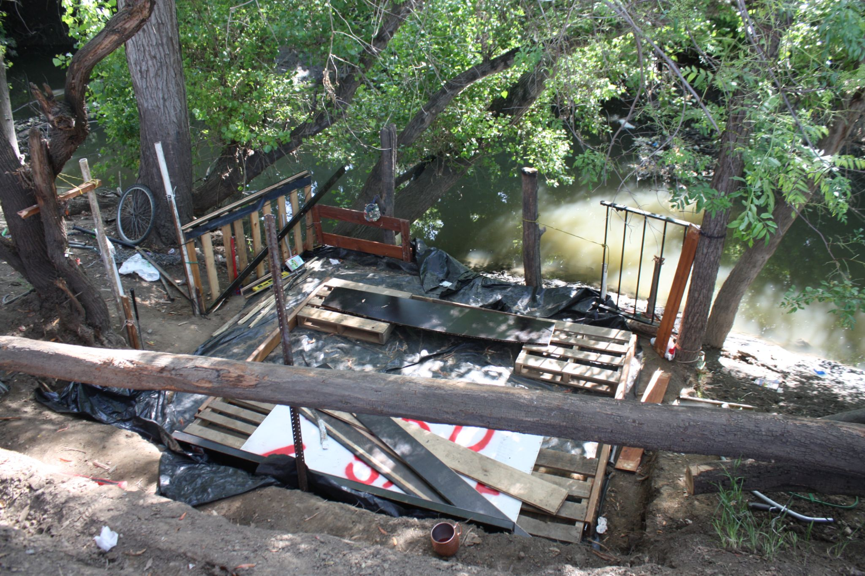

Slide 7
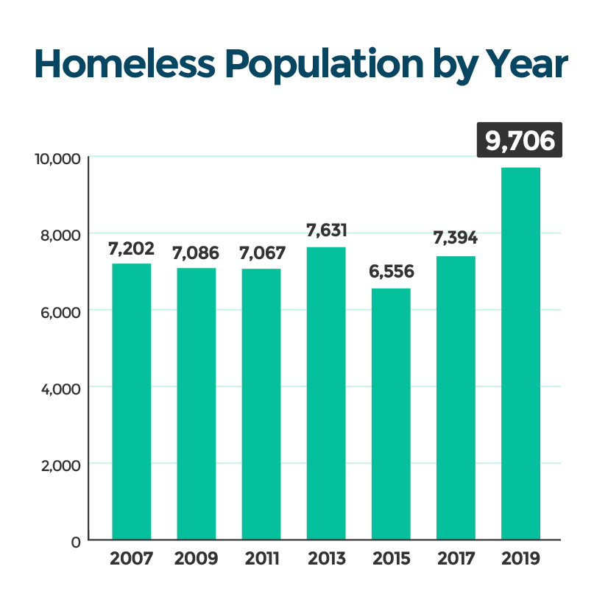
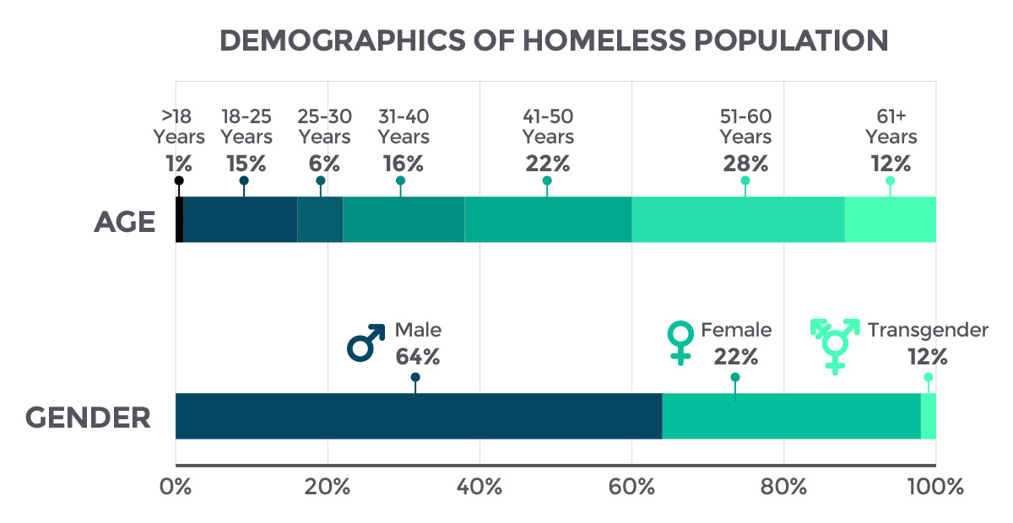
Background:
Demographics of unhoused people in SCC
Notes:
Moving on to some statistics. In Santa Clara, the number of unhoused individuals has remained relatively stable over the past decade, but has shown a sharp increase over the past few years.
In terms of demographics, Santa Clara has more males than females experiencing homlessness. We also tend to have an older population with 40% of unhoused people being over the age of 50, there is also a sizeable middle aged population.
Photo credit: https://destinationhomesv.org/understanding-homelessness/numbers/

Slide 8
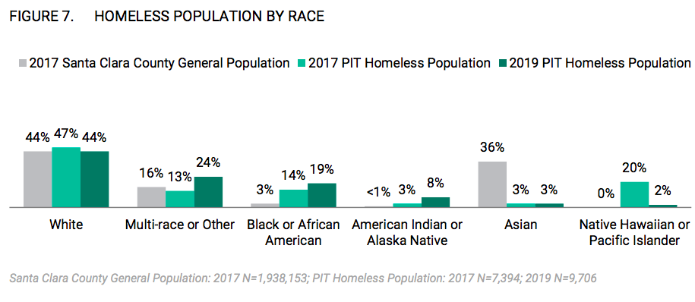
Background:
Race/ethnicity of unhoused people in SCC
43%
Hispanic or Latinx
in 2019
Notes:
Here you can also see how the racial demographics of the unhoused population compare to the SCC’s general population.
The first thing to note here is that people who are unhoused are disproportionately POC. You can see here the rapidly increasing number of Black, Native American, and Multi-Racial people. The only exception here are APIs. We are actually currently investigating API mortality to better understand why APIs are not showing up in the data and better understand their experiences.
There is also a large Latinx population with 43% of unhoused individuals in 2019 identifying as Hispanic or Latinx
All of this data comes from the 2019 PITC.
Another important thing to note that is that in 2019, 43% of unhosued individuals identified as Hispanic or Latinx. (needs explanation?)
(might be able to condense this slide)
Few notes of racial composition of unhoused people in SCC:
1- People who are unhoused are disproportionately POC (Black, Latino, Native American, and Multi-Racial) - the only exception is APIs - but we’re actually investigating API mortality as well, and we’ll discuss some of the complexities of API homelessless later on in this presentation.
2- Proportions of unhoused POC has grown rapidly since 2017

Slide 9
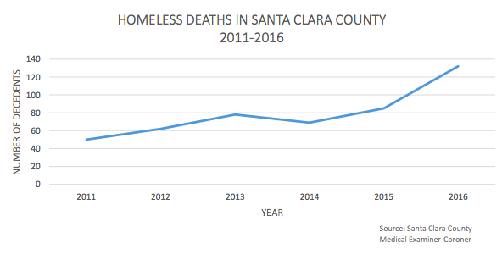
“The number of homeless deaths in Santa Clara County increased 164% from 2011 to 2016. The number of deaths affecting the homeless population continues to rise.”
Notes:
We first became aware of increasing homeless mortality from this concerning report released in 2017 by the SCC Medical Examiner-Coroner. In this report, the Medical Examiner highlighted that there was a 164% increase in homeless mortality since 2011. This number was increasing rapidly at the time with a 55% increase between 2015-16 alone.
Since then, we have continued tracking unhoused mortality trends in Santa Clara County.

Slide 10
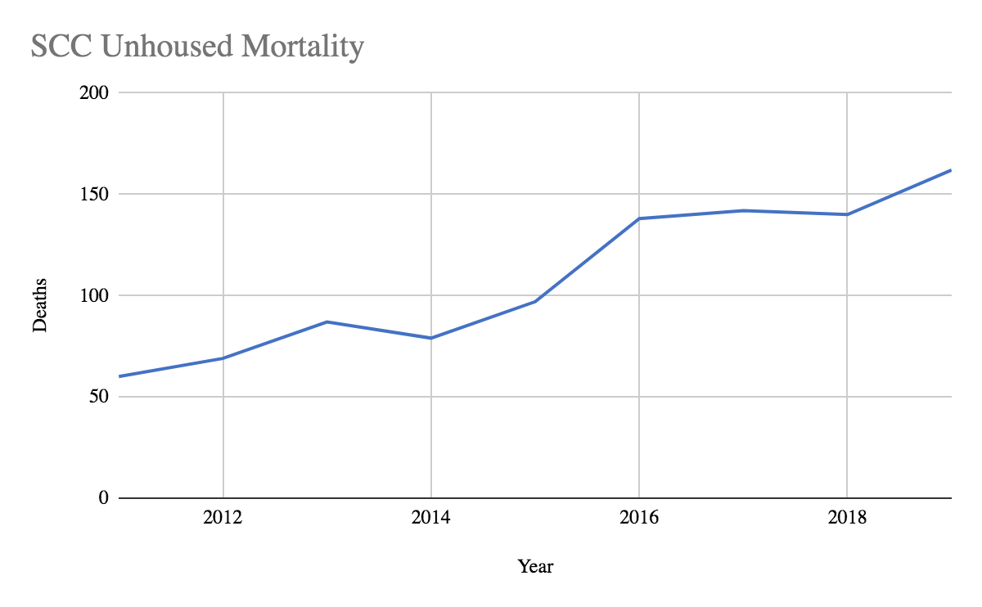
Deaths of unhoused people have QUADRUPLED in 10 years:
60 deaths in 2011 → 250 deaths in 2021
Notes:
(make graph prettier)
Since the initial 2017 report, deaths have continued to increase, spiking again in 2019. Deaths of unhoused people have QUADRUPLED in 10 years:
This led us to want to understand what exactly was driving this mortality trend and what could be done about it. Here are some of the questions we wanted to answer with our research.

Slide 11
Research Questions
What are the demographic backgrounds of people who are dying?
Are unhoused people dying from different causes of death than the general population?
What is the relationship between these disparities and structural determinants such as shelter status or social status?
Notes:
To better understand unhoused mortality trends, we asked:
What are the demographic backgrounds of people who are dying?
Are unhoused people dying from different causes of death than the general population?
And, What is the relationship between these disparities and structural determinants such as shelter status or social status?
Before trying to answer these questions, let’s take a look at how our research was conducted.
To delete:
Disparities in Structural determinants? Deaths of Despair and Environmental causes

Slide 12
02
Methods
Notes:
This leads us to the beginning of our research. I’d like to first walk you through the methods

Slide 13
Is a death a homeless death?
Data Source:
ME Office Medico-legal investigation
Circumstances surrounding death
Interview people who knew the deceased
Verify with next-of-kin
Notes:
Now, One of the biggest challenges we face in examining homeless deaths is determining if a specific case is indeed a homeless individual or not. There is no requirement for including housing status on death records, and therefore it’s often up to each county to determine 1) whether to record or count homeless deaths at all, and 2) how to do it.
We’re actually part of a larger group of people across the Bay Area who are discussing current practices for examining homeless mortality - what we’ve learned so far is that there are no real standards for recording homeless mortality and different county systems do it completely differently - if they’re doing it at all!
Our data set comes from the Medical Examiner-Coroner’s office, who has been very proactive in determining and recording homeless deaths. To determine whether the individual was unhoused when they died, the MEC carries out a 3-step medicolegal death investigation. First, her team will examine the circumstances and environment attending a death. Then, they interview people who knew the deceased individual. And finally, will verify with next-of-kin.
In the data set we obtained, there was a total of 974 unhoused deaths between January 2011-December 2019.

Slide 14
Methods - Cause of Death: Narrative Descriptions
Examples
Hypertensive and atherosclerotic cardiovascular disease
Gunshot wound of chest
Hypoxic respiratory failure Intracranial Hemorrhage Chronic methamphetamine use
Hypothermia complicating dilated cardiomyopathy
Complications of diabetes mellitus
Multiple blunt force injuries including skull fracture
Complications of chronic alcohol abuse
Notes:
We needed to prepare this data for analysis. The MEC provides the cause of death for each person as a narrative, clinical description, as seen with a few examples here, rather than ICD codes. Another challenge we encountered was when the death was caused by multiple conditions, as you can see in the third example here. To overcome this, we created the following flow charts to categorize each cause of death. Then, we interpreted the narrative descrption for each case and place them into one of the following categories.

Slide 15
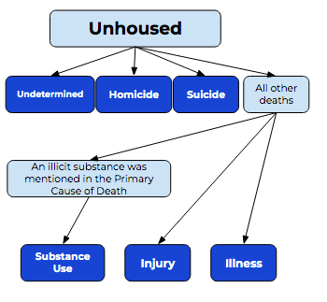
Notes:
We created a total of six unique categories
The first pass we did through the data was to identify undetermined deaths, homicides, and suicides. This determination was made by the MEC so this was very straight forward.
From there we identified any cases that mentioned an illicit substances in the primary cause of death, and identified these cases as Substance Use. We did not count cases that had illicit substances mentioned along with their other conditions.
We then identified the remaining cases as due to either an illness or an injury. in addition to these six categories, we created further subcategories for substance use, injury, and illness but we will discuss these a bit more later.

Slide 16
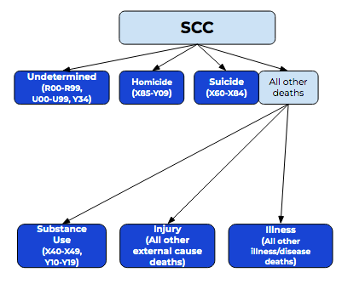
Notes:
We followed the same process for all deaths in Santa Clara County, which served as our general population over the same time period, We collected this data from the CDC WONDER Underlying Cause of Death database. The primary difference in the two data sets is that the CDC provides ICD-10 codes for the cause of death, as opposed to a narrative desciption.
Here you can see the ICD-10 codes that we assigned to each of the categories that we had previously created for the unhoused data set. This allowed us to proceed with statistical analysis between the two groups.

Slide 17
Structural Determinants of Health:
Theory-Driven Analysis:
Environmental Conditions:
Lack of Shelter = more unsheltered unhoused
Deaths of Despair
= declining economics leading to increased mortality
Deaths connected to environmental conditions and the risks of being unsheltered outdoors.
Deaths involving suicide, drug or alcohol poisoning, and alcohol-related chronic liver disease.
Notes:
We also developed two categories based on theoretical frameworks for further analysis. Both of these theoretical frameworks are intended to get at the underlying, structural determinants of health (or SDH). While many mortality studies have focused on individual factors, we wanted to take an upstream approach and examine how systems affect unhoused mortality.
The first is environmental conditions which are deaths connected to the risks of being unsheltered outdoors. Because we did not have data on the shelter status at the time of death, we instead created a new category of deaths that involved increase risk due to living OUTDOORS. Some examples of causes of death that went into this category are drownings, starvation, fire, exposure to the elements, or injuries sustained by vehicles.
Next we wanted to analyze the concept of Deaths of Despair, which was coined by Case and Deaton in 2015. We thought this would be an interesting analysis, because one of the main impacts of this concept was that it focuses on how a decline in social status and economic position shapes mortality outcomes. The original study noted mortality disparities among poor, non-college educated White men following the 2008 recession, positing that lowering social status resulted in increased mortality. While there is still debate over what all can be considered a death of despair, the consensus of the literature is that these are deaths caused by suicide, drug or alcohol poisoning, and alcohol-related chronic liver disease. We wanted to examine how different the rates of death of despair is in the unhoused population versus the general population.

Slide 18
Findings
01
Unhoused people have higher mortality rates
02
Unhoused people are dying younger, and are male
03
Unhoused people die from distinct causes of death
04
Unhoused people die from more traumatic and preventable causes
Notes:
This leads us to our findings. As an overview, we found that…
Unhoused people have higher mortality rates than the general population and that this disparity is increasing.
Unhoused people are dying at younger ages, and tend to be male
Unhoused people die from distinct causes of death, which are different from the general population
And 4) Unhoused people die from more traumatic and preventable causes of death

Slide 19
Finding 1
Unhoused people have higher mortality rates than the general population, and the disparity is increasing
Unhoused
SCC
 | deaths per 100,000 population
2011 | 849.02
2019 | 1669.07
 | deaths per 100,000 population
2011 | 506.86
2019 | 527.79
197% increase
4% increase
Notes:
Moving right along, for our first finding, we looked at mortality rates. The mortality rate among the unhoused population increased 197% from 2011 to 2019. Meanwhile, the mortality rate among the general population in SCC has increased by only 4% during that same time.
We also found that this increase cannot be explained by the increasing unhoused population. While there was a 37% increase in the population of unhoused people in SCC between 2011-2019, there was a 170% increase in the number of unhoused deaths.

Slide 20
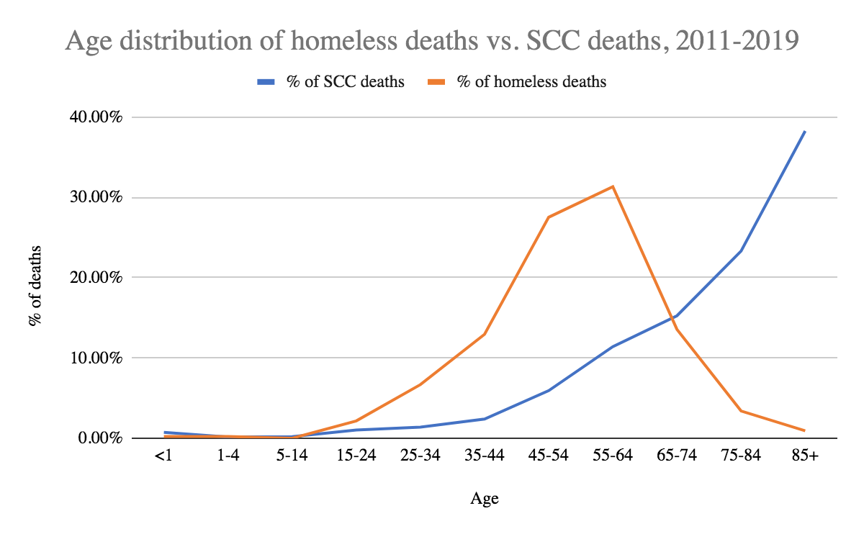
Finding 2
Unhoused people are dying younger, deaths are not due to aging populations, and deaths are more common among men
Notes:
In our second finding, we examined the demographics of the people who died. I will note that we did not have race/ethnicity data at the time of this paper, so we won’t focus on that aspect much during this presentation, however, we now have access to that information and are exploring it further..
First let’s look at age: There is a distinct difference in the age distribution of unhoused deaths compared to the general population. Through indirect standardization, we found that the standardized mortality ratio for unhoused people is 3.8, suggesting that unhoused people are 3.8 times more likely to die than the general population, adjusting for age.
\

Slide 21
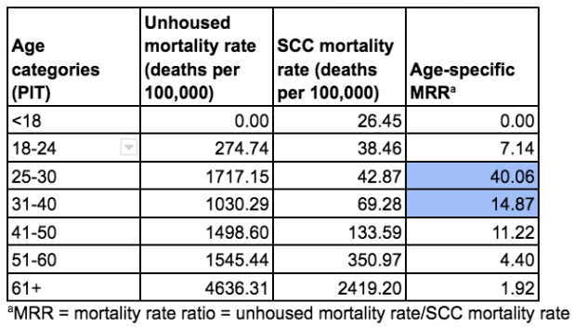
Finding 2
Unhoused people are dying younger, deaths are not due to aging populations, and deaths are more common among men
Unhoused = 53.3 y/o
SCC = 83.1 y/o
30 year difference
Sex alone cannot explain incresed risk
Table B. Age-specific mortality rates for the SCC unhoused population and the SCC general population (n= 974 deaths; 88,658 deaths respectively) and age-specific mortality rate ratios in 2019.
Notes:
However, we also noticed that adjusting for age concealed some of the age-specific risks. Here in Table B, you can see the age-specific mortality rate ratios, highlighting that unhoused people aged 25-30 were 40 times more likely to die compared to people of the same age in SCC. SImilarly, unhoused people aged 31-40 were about 15 times more likely to die.
Overall, the average age of death for unhoused people was 53.3 years old. This is in contrast to the general population of SCC which is one of the healthiest counties in the country and has the 3rd highest life expectancy in California. The life expectancy in SCC is 83.1 years, a nearly 30 year discrepancy.
We also adjusted for sex and were able to deterine that although our sample had a higher proportion of men, and despite the fact that men experience higher mortality rates for women, this could not explain the increased risk of death.

Slide 22
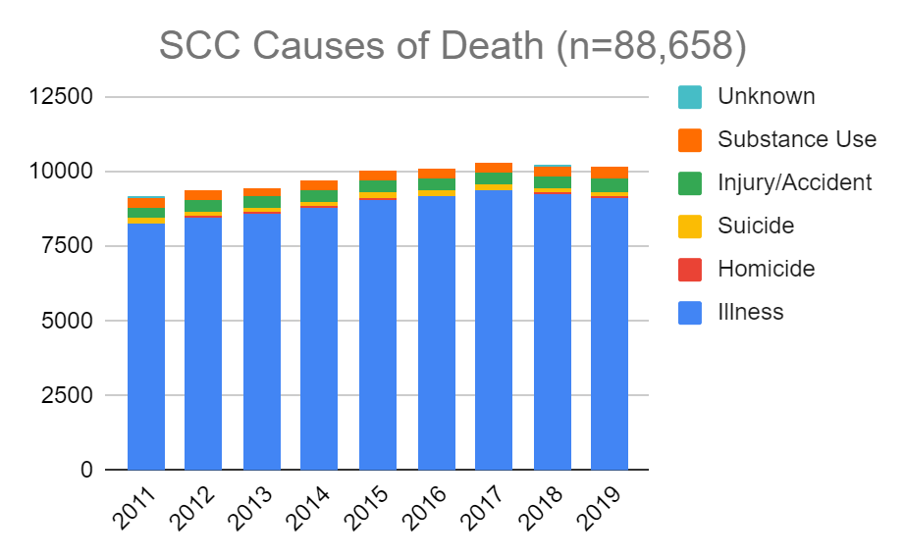
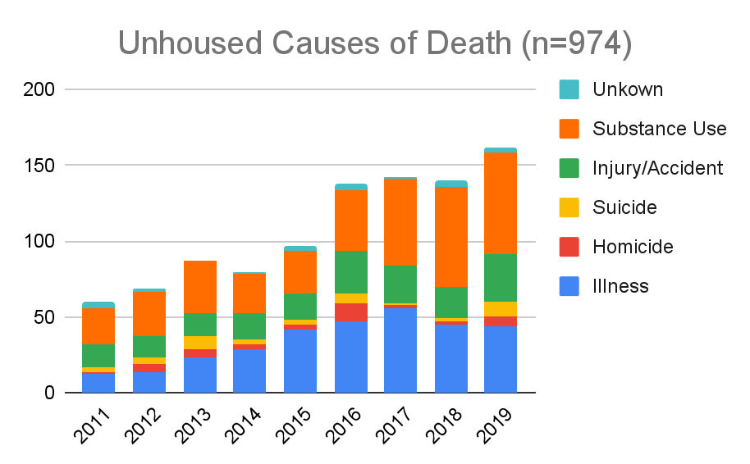
Finding 3
Unhoused people die from distinct causes of death
Figure A. Number of deaths per year for the SCC general population and the SCC unhoused population between 2011-2019, displayed by cause of death categories.
Notes:
For our third findings, we looked specifically at the causes of death to see if unhoused people were dying from different causes than the general population. We found that while more than 90% of deaths in the general population were due to illness, unhoused deaths were greatly impacted by substance use, injury and suicide, with only 32.0% due to illness.
Unhoused ppl are disportionately more likely to die from substance use, injuries (often violent injuries), suidide, and homicide than the general population.
We also created subcategories for the substance use, illness, and injury categories.

Slide 23
Finding 3
Unhoused people die from distinct causes of death
Substance Use
Methamphetamine- 37%
Alcohol- 30%
Polysubstance Use- 23%
Injury
Blunt Force Injury- 46.5%
Injury Involving Vehicles- 19.5%
Illness
Cardiovascular- 46.8%
Respiratory- 12.2%
Cancer- 8.3%
Notes:
To share a little breakdown of these larger categories, For the unhoused population, 37% of substance use deaths involved methamphetamine only, 30% alcohol only, and 23% involved more than one substance.
For injuries, most deaths were caused by blunt force or an injury involving a vehicle.
And finally, for illness, the top 3 causes of death were cardiovascular diseases, respiratory diseases, and cancer.

Slide 24
Finding 4
Unhoused people die from more traumatic and preventable causes
Environmental Conditions
Unhoused
SCC
5.24%
0.73%
Notes:
(create chart for environmental)
For our final finding, we looked at those structural determinant-based categories we talked about earlier. To recap the first category we will be talking about are deaths due to environmental conditions. Again, these are deaths that occured in connection with the risks of living outdoors. Environmental causes made up over 5% of the total unhoused deaths, whereas they made up only 0.73% in the general population. Thats over 7 times more environmental deaths for the unhoused.
While this percentage stayed under 1% in the general population for every year that year that we analyzed, it was much more variable for the unhoused; in 2015, 12.7% of unhoused deaths were environmental causes of death.
The top three causes of death represented here were injuries involving vehicles, exposure to elements, and drownings.

Slide 25
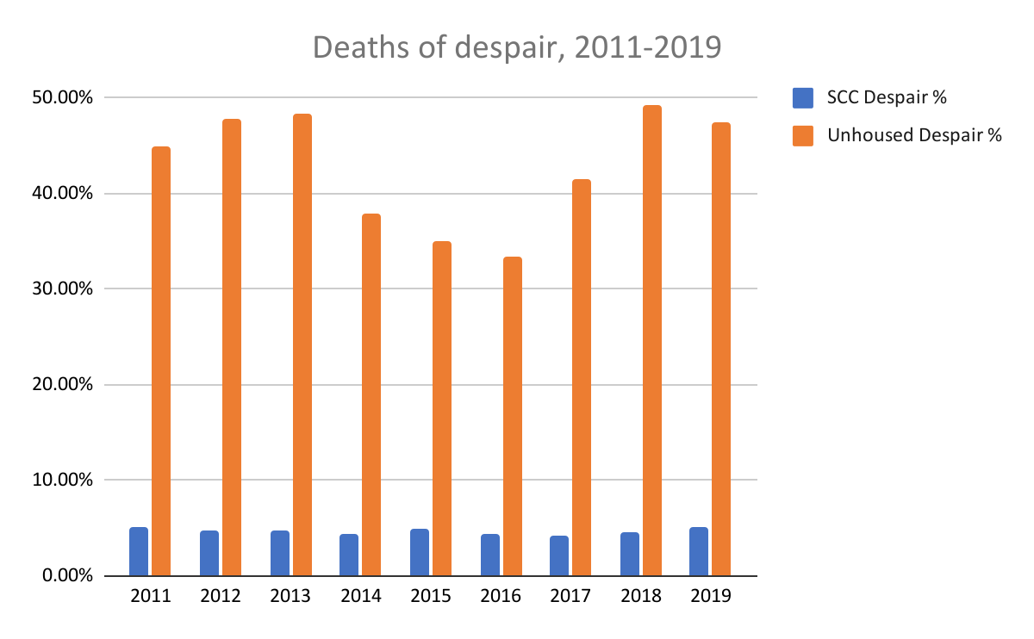
Finding 4
Unhoused people die from more traumatic and preventable causes
Notes:
The second category we analyzed was based on the concept of deaths of despair which are deahts as a result of suicide, drug or alcohol poisoning, and alcohol-related chronic liver disease. Here you can see the distribution of deaths of despair for each year.
In total, death of despair made up 4.7% of deaths in the general population and 42.8% of unhoused deaths, a 9 fold difference. You can see that these deaths did not even dip below 30% in any given year. And this brings us to the end of our findings.

Slide 26
03
Future Work
Notes:
Where does all of this leave us and what implications does this have for future policy?

Slide 27
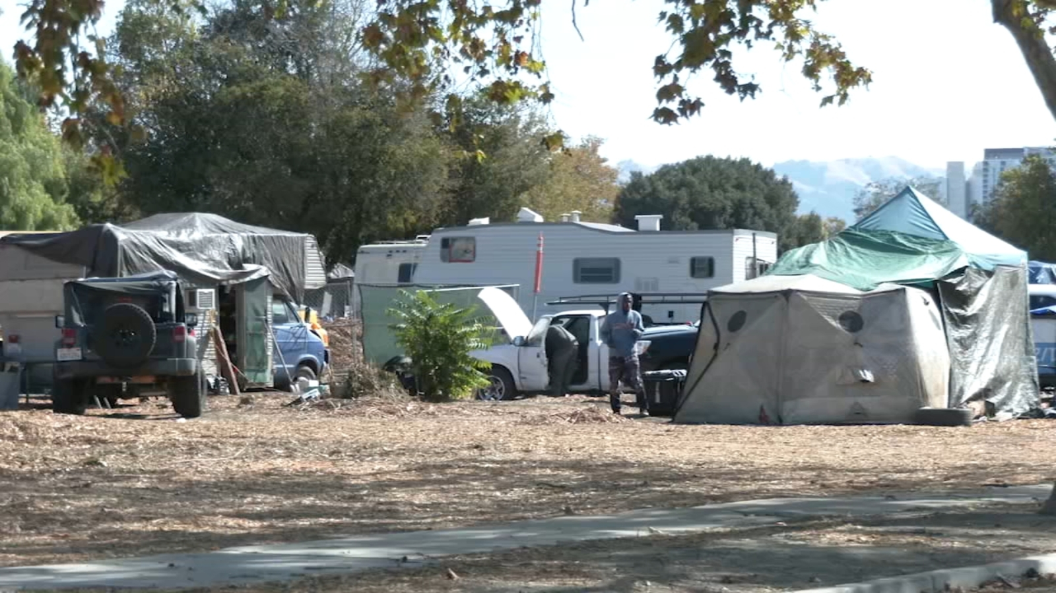
Structural Determinants
systems >> individual factors
Notes:
photo credit: https://abc7news.com/san-jose-homeless-encampment-airport-sj-faa/11144935/
We hope that our research adds to the growing literature calling to task policymakers to consider how structural vulnerabilities impact health. Through our analysis of environmental causes of death and deaths of despair, we show that people without housing are uniquely and severely impacted by traumatic and preventable deaths. Many of these deaths are directly caused by living outdoors, being without shelter of any form. That really points to the utter failure of our shelter systems in SCC.

Slide 28
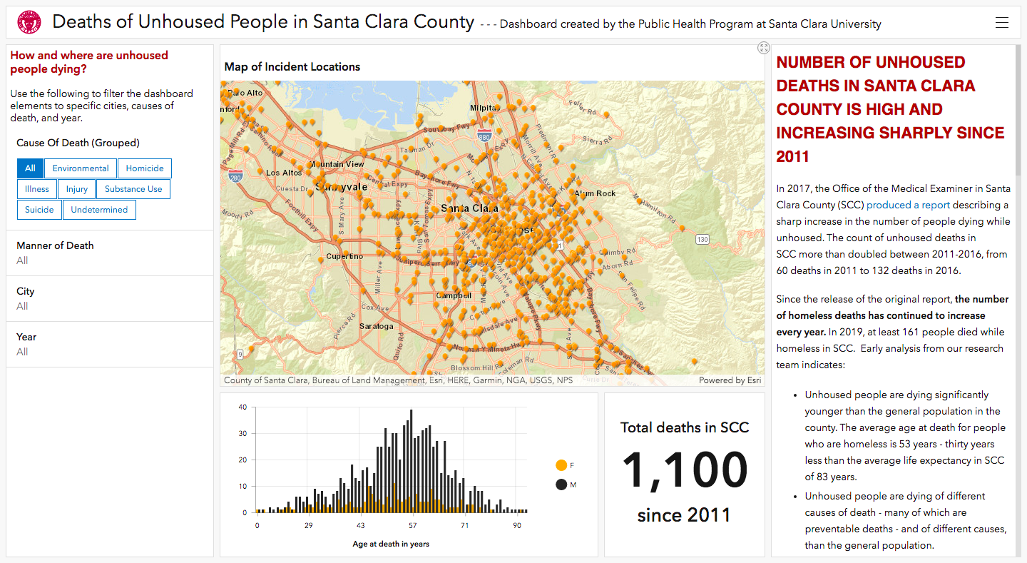
Notes:
To take a deeper look at how structural factors can influence homeless mortality, we wanted to display this data in a visual format. We developed a publicly available ArcGIS dashboard that displays the locations of deaths of unhoused ppl in SCC, as well as their cause of death and demographics. The goal is really to provide a platform for examining the underlying geographic-, neighborhood-level, and policy level determinants of unhoused mortality. We continue to update and expand this dashboard annually.
By mapping visually, we hoped to illuminate these structural causes more clearly.
For example, we noticed that many deaths occured along major roads, or were clustered in groups.
Unhoused people deciphered the ways certain zoned areas were less likely to be swept, like areas that were under the jurisdiction of trains/transit, or industrial zoning, or unzoned areas. These regions, because they are less likely to be abated, have higher concentrations of unhouse people.
We have continued tracking mortality since 2011 and the dashboard is currently updated through 2020.

Slide 29
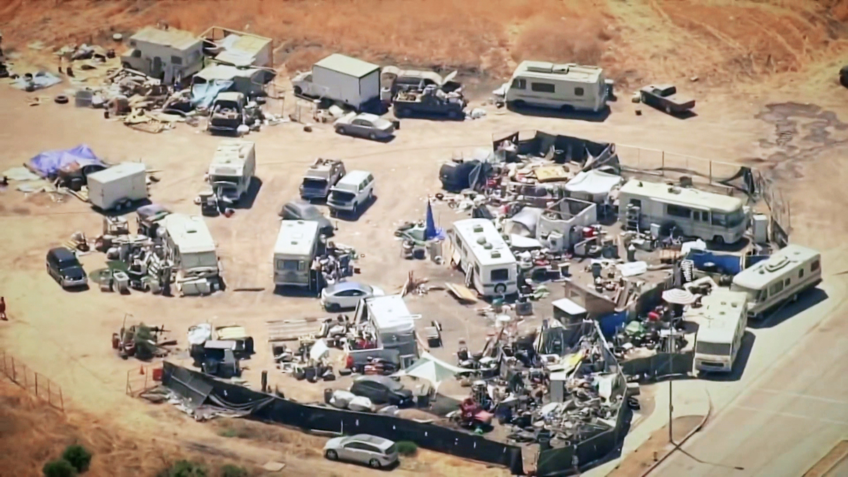
Immediate Action
Permanent Housing
Shelters
Safe sleeping sites
Safe parking locations
Managed encampments
Notes:
photo cred: https://www.nbcnews.com/tech/apple/homeless-silicon-valleys-shadow-get-help-sustainable-change-elusive-rcna2039
Next, we hope we have conveyed the urgency of the situation in SCC, both with the rate that mortality is increasing and with the types of death people are experiencing. While permanent housing is the gold standard, a variety of approaches need to happen to accommodate the quantity and diversity of the unhoused community in Santa Clara.
Other solutions such as improving/expanding the current shelter system, creating safe sleeping and parking sites, and managing encampments that already exist should all be explored. Also, short- and long-term hotel stays or rental assistance ought to be explored for people who are unhoused. We really want to emphasize that housing is the solution - but we need intermediary solutions too, such as shelters, and assistance for people in encampents.

Slide 30
Need for better data
No standardized approach
No requirement for data collection
Good data allows for targeted system-level solutions
Epidemiological research
Notes:
Next, our work highlights the need for a system atic and widespread approach to unhoused mortality data collection. As we mentioned before, there is no one standard approach or even a requirement to record housing status at the time of death. The consequence of this is missing important and devastating trends like we have shown you today. You need to know what is happening in order to address it.
For example, our data shows the huge number of deaths involving methamphetamine, yet most current public health efforts are focused on opioids. This suggests that efforts need to pivot and doing so will have a huge impact. All in all, data helps us create tailored and effective solutions-- and that requires a system in place for data collection.
Finally, There is little if any research on how local, state, and national homelessness policies such as encampment abatements or health delivery systems affect mortality.
There is a need for more epidemiological research on upstream structural and social factors and how they contribute to unhoused mortality. It is crucial to understand how health risks and outcomes are shaped, if we want to address them and create meaningful solutions.

Slide 31
Thank you
Questions?
gbright@scu.edu
(559) 862-3783
jschang@scu.edu
Please keep this slide for attribution

