Slide 1
Suicide Prevention, Homelessness, and Best Practices
Presented by Terri Cooley-Bennett, LCSW, LSCSW, CCDP-D, TTS
Swope Health Outreach Services Manager
National Healthcare for the Homeless Council 2022

Slide 2
Suicide Prevention, Homelessness, and Best Practices
LEARNING OBJECTIVES:
Recognize risks and be able to define and identify what constitutes suicidality, especially among individuals who are unhoused or homeless
Demonstrate knowledge regarding current research relating to homelessness and suicidality
Display awareness and describe best practices regarding prevention and provider self-care strategies

Slide 3
Definitions, Symptoms, and Risk Factors for Suicidality

Slide 4
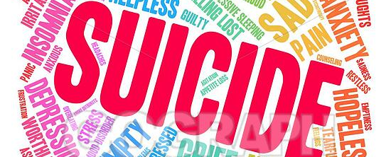
Suicide is defined by Galaif, Sussman, Newcomb, & Locke as a “Serious Health Problem”
Suicidality is the occurrence of suicidal thoughts or suicidal behavior
Source: https://www.ncbi.nlm.nih.gov/pmc/articles/PMC3134404/
SUICIDE DEFINITIONS
Suicide Prevention, Behavioral Health, and Best Practices

Slide 5
SUICIDE DEFINITIONS
Defined as death caused by self-directed injurious behavior. There is an intent to die as a result of the behavior.
A Suicide Attempt is a non-fatal, self-directed, potentially injurious behavior with intent to die as a result of the behavior. An attempt might not result in injury.
Suicidal Ideation refers to thinking about, considering, or planning suicide.
Source: https://www.nimh.nih.gov/health/stastics/suicide.shtml#part_154968

Slide 6
SUICIDE WARNING SIGNS AND RISK FACTORS
POLLING QUESTION
WHAT IS THE MOST COMMON RISK FACTOR INDICATING THAT SOMEONE MAY BE SUICIDAL?
1. Withdrawal from Social Contact
Change in Normal Routines
Depression
Suicide Prevention, Behavioral Health, and Best Practices

Slide 7
SUICIDE WARNING SIGNS OR SUICIDAL THOUGHTS
Talking about suicide
Getting the means to attempt or commit suicide
Withdrawal from social contact
Mood Swings
Preoccupation with death, dying, or violence
Feeling trapped or hopeless
Increased use of substances
Change in normal routines such as eating and sleeping patterns
Risky or self-destructive behaviors
Giving away belongings or “getting affairs in order”
Saying goodbye to others as if they won’t be seen again
Personality changes, severe anxiety or agitation, particularly in conjunction with other warning signs
Source: https://www.mayoclinic.org/diseases-conditions/suicide/diagnosis-treatment/drc-20378054
Trauma and Suicide
4/4/2022

Slide 8
RISK FACTORS FOR SUICIDE
Depression and other mental disorders
Substance Use Disorder (often combined with a mental disorder)
Prior Suicide Attempt
Family History of Suicide
Family Violence including physical or sexual abuse
Firearms in the Home
Incarceration
Exposure to suicidal behavior of others, such as family members or peers
Note: many people who have these risk factors are not suicidal
Source: National Institute of Mental Health; Suicide: A Major, Preventable Mental Health Problem, Facts about suicide and suicide prevention among teens and young adults

Slide 9
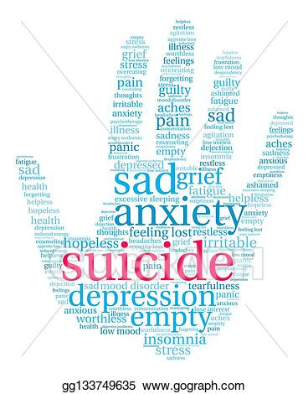
SIGNS THAT MAY BE REASON FOR CONCERN
Talking about wanting to die or kill oneself
Looking for a way to kill oneself, such as searching online or buying a gun
Talking about feeling hopeless or having no reason to live
Talking about feeling trapped or in unbearable pain
Talking about being a burden to others
Increasing the use of alcohol or drugs
Acting anxious or agitated; behaving recklessly
Sleeping too little or too much
Withdrawing or feeling isolated
Showing rage or talking about seeking revenge
Displaying extreme mood swings
Source: National Institute of Mental Health; Suicide: A Major, Preventable Mental Health Problem, Facts about suicide and suicide prevention among teens and young adults
Suicide, Mental Health, Prevention, & Self Care
4/4/2022

Slide 10
Prevalence of Suicide

Slide 11
Suicide- A Leading Cause of Death in the United States
According to the Centers for Disease Control and Prevention (CDC) WISQARS Leading Causes of Death Reports, in 2019:
Suicide was the tenth leading cause of death overall in the United States, claiming the lives of over 47,500 people.
Suicide was the second leading cause of death among individuals between the ages of 10 and 34, and the fourth leading cause of death among individuals between the ages of 35 and 44.
There were nearly two and a half times as many suicides (47,511) in the United States as there were homicides (19,141).

Slide 12
Suicide- A Leading Cause of Death in Missouri
Missouri is ranked 14th highest in the nation with a suicide rate of 18.33 (per 100,000, age adjusted) in 2018. The national rate is 13.42.
Over 1,000 Missourians died by suicide in 2016
Suicide is the 10th leading cause of death in Missouri and nationally:
2nd leading cause of death among 10-34 year-olds
4th leading cause of death among 35-54 year-olds
Source: https://www.mimh.edu/content/uploads/2015/03/Where-We-Stand-2018-8-1-18-Final.pdf

Slide 13
MISSOURI- Suicides
Rates have increased by over 30 % since 1999
Source: https://www.mimh.edu/content/uploads/2015/03/Where-We-Stand-2018-8-1-18-Final.pdf

Slide 14
Suicide- A Leading Cause of Death in Many States & Varies State to State
The 10 states with the highest suicide rates are (in order of the highest rates per 100K) as cited by the World Populations Review (2021):
Wyoming (29.3 per 100k)
Alaska (28.5 per 100k)
Montana (26.2 per 100k)
New Mexico (24 per 100k)
Colorado (22.1 per 100k)
Utah (21.2 per 100k)
South Dakota (20.9 per 100k)
Oklahoma (20.5 per 100k)
Idaho (20.4 per 100k)
Oregon (20.4 per 100k)

Slide 15
MEANS OF SUICIDE
POLLING QUESTION
WHICH TYPE OF SUICIDE IS THE PRIMARY MEANS OR MOST LETHAL?
Suffocation (hanging)
Poisoning (over-dose)
Firearms
All of the above
Suicide Prevention, Behavioral Health, and Best Practices

Slide 16
Means of Suicide- Nationally
Firearms was the most common method used in suicide deaths in 2016
Firearms accounted for 22,963 deaths (almost half of all suicide deaths)
Suffocation was the 2nd most common means of suicide
There were 11,642 deaths by suffocation
Poisoning was the 3rd most common means of suicide
6,698 persons died by poisoning
Other methods
3,662 persons used other means to complete suicide
Source: The National Institutes of Mental Health: https:nimh.nih.gov/health/statistics/suicide/shtml

Slide 17
CASE EXAMPLES FROM SUICIDE ATTEMPT SURVIVORS
https://www.youtube.com/watch?v=kQ4XCNZdKfI
https://www.youtube.com/watch?v=sRo5Db_7yVI&list=PLh6FCUFIJEL-4R2td8UO6uehN2GWF3z8D&index=3&t=92s

Slide 18
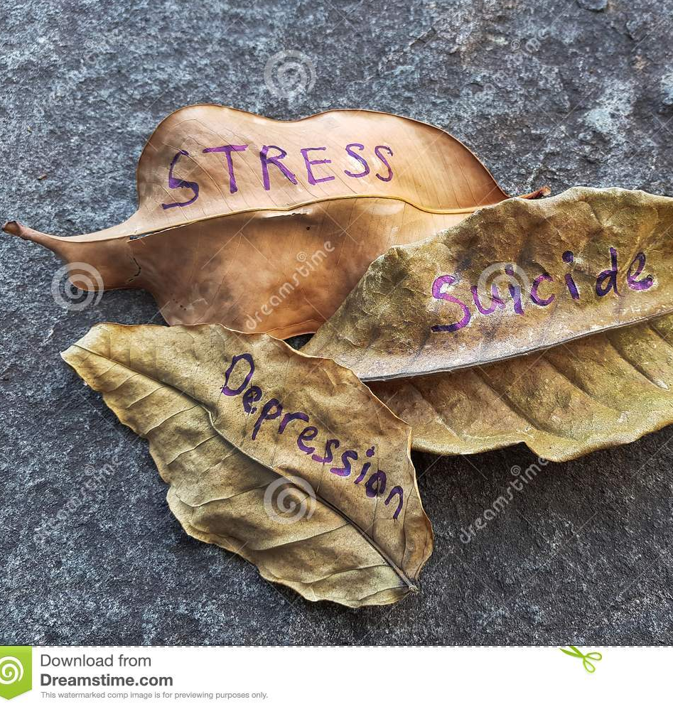
WHY ARE SUICIDE RATES RISING?
Researchers believe there is “an increased sense of isolation among Americans, as well as economic factors and a rise in mental illness”.
Some researchers point to the rise of technology, while others disagree
CDC reports indicate suicide is connected to other forms of violence, such as bullying, sexual violence, or child abuse
Source: https://www.livescience.com/62781-why-are-suicide-rates-rising.html
Suicide, Mental Health, Prevention, & Self Care
4/4/2022

Slide 19
SUICIDE AND MENTAL DISORDERS

Slide 20
DEPRESSION, SUBSTANCE USE, AND SUICIDALITY
A Substance Use Disorder increases the chance of developing Depression
Depression increases the chance of developing a Substance Use Disorder
Intoxication and Withdrawal from some substances causes Depression
Two populations with the highest rates of suicide are those with Depression and Substance Use Disorders
Source: Managing Depressive Symptoms in Substance Abuse Clients During Early Recovery: A Treatment Improvement Protocol Tip 48. SAMSHA, 2008

Slide 21
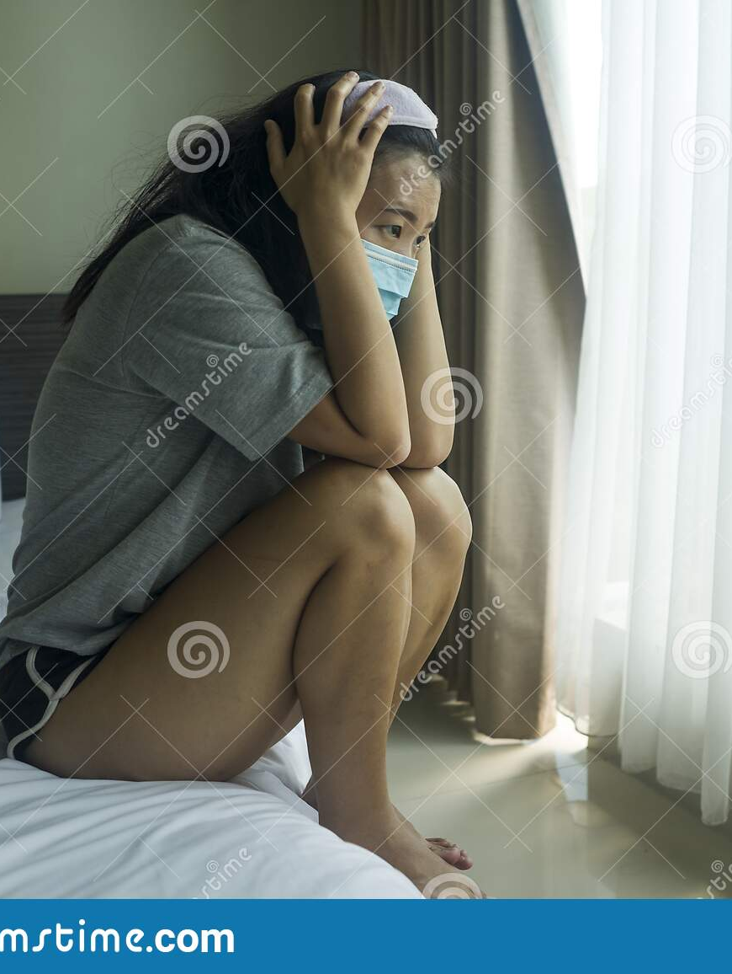
DEPRESSION, SUBSTANCE USE, AND SUICIDALITY
Major Depressive Disorder (MDD) is the psychiatric diagnosis most commonly associated with completed suicide and about 2/3 of people who complete suicide are depressed at the time of their deaths
Source: https://www.ncbi.nlm.nih.gov/pmc/articles/PMC3134404/

Slide 22
DEPRESSION AND SUICIDALITY
In order to diagnose a Major Depressive Disorder, (Single and Recurrent Episodes), a person must have 5 out of 9 symptoms
One of the possible symptoms of a Major Depressive Disorder is Recurrent Thoughts of Death or Suicide
Please note: it’s possible to have depression WITHOUT having thoughts of death or suicide if at least 5 other symptoms of the Major Depressive Disorder are present
Source: Nussbaum, A. (2013), The Pocket Guide To The DSM-5 Diagnostic Exam
Suicide, Mental Health, Prevention, & Self Care
4/4/2022

Slide 23
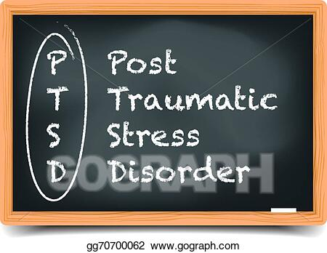
POST TRAUMATIC STRESS DISORDER, DEPRESSION, AND SUICIDALITY
According to the DSM-5 (APA 2013), Major Depression may or may not be preceded by a trauma
Symptoms do not over-lap. Depression and PTSD are differential diagnosis
PTSD is associated with suicidal ideation and childhood abuse increases suicide risk
Source: Diagnostic and Statistical Manual of Mental Disorders, Fifth Edition DSM-5 (American Psychiatric Association: 2013)
Suicide, Mental Health, Prevention, & Self Care
4/4/2022

Slide 24
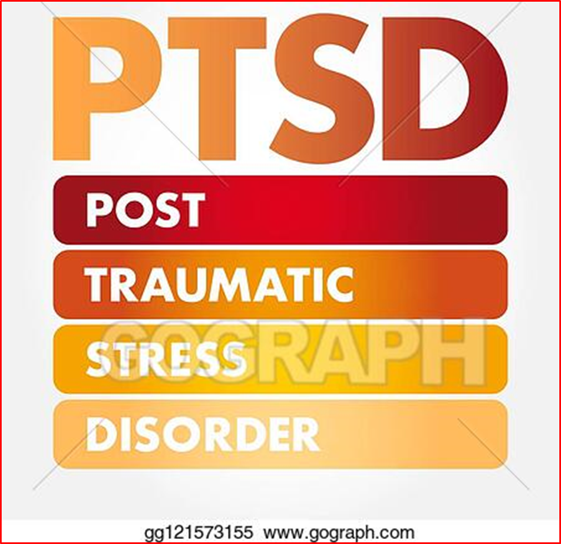
Trauma and Stressor-Related Disorders
Disorders in this sub-group include those in which exposure to a traumatic or stressful event is listed explicitly.
Source: Diagnostic and Statistical Manual of Mental Disorders, Fifth Edition DSM-5 (American Psychiatric Association)

Slide 25
CHILDHOOD TRAUMA AND SUICIDE
“Today, a significant evidence-base suggests that people with four or more ACEs are two to five times as likely to develop clinical depression, substance use disorders, suicidality, and numerous chronic health conditions including diabetes, cancer, cardiovascular and respiratory diseases compared to people with no ACEs.”
Source: Homelessness & Adverse Childhood Experiences: The health and behavioral health consequences of childhood trauma, National Health Care for the Homeless Council (February 2019)

Slide 26
PERSONALITY DISORDERS AND SUICIDALITY
BORDERLINE PERSONALITY DISORDER
“is a pervasive pattern of instability and interpersonal relationships, self-image, and affects, and marked impulsivity that begins by early adulthood and is present in a variety of contexts.”
“Physical and sexual abuse, neglect, hostile conflict, and early parental are more common” in those with Borderline Personality Disorder.
Source: Diagnostic and Statistical Manual of Mental Disorders, Fifth Edition DSM-5 (American Psychiatric Association: 2013)

Slide 27
PERSONALITY DISORDERS AND SUICIDALITY
Parasuicidal or Suicidal Behavior is one of the symptoms of Borderline Personality Disorder
Source: Nussbaum, A. (2013), The Pocket Guide To The DSM-5 Diagnostic Exam
Suicide, Mental Health, Prevention, & Self Care
4/4/2022

Slide 28
PERSONALITY DISORDERS AND SUICIDALITY
BORDERLINE PERSONALITY DISORDER
“Premature death from suicide may occur in individuals with this disorder, especially in those with co-occurring depressive disorders or substance use disorders”
Source: Diagnostic and Statistical Manual of Mental Disorders, Fifth Edition DSM-5 (American Psychiatric Association: 2013)

Slide 29
CHILDHOOD TRAUMA, ADVERSITY, AND SUICIDALITY
Nadine Burke Harris discussed Childhood Trauma and how it affects health across a lifetime.
See her Ted Talk on youtube:
https://www.youtube.com/watch?v=95ovIJ3dsNk&list=WL&index=83&t=0s

Slide 30
CORRELATIONS BETWEEN SUICIDE AND SPECIAL POPULATIONS

Slide 31
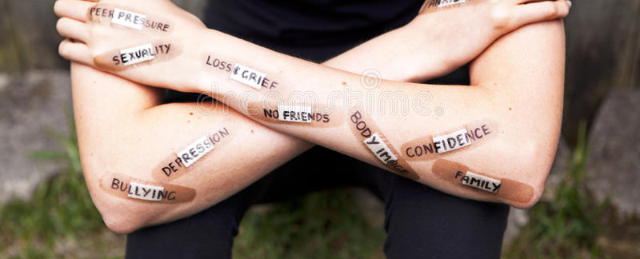
ADOLESCENTS, SUICIDALITY, AND MENTAL HEALTH
As noted in prevalence, suicidality among teens is alarmingly high
Authors in this study, in which 30 empirical studies were reviewed, believe DEPRESSION is the most significant biological and psychological risk factor for teen suicide
At the time of this study, 20-40% of adolescents report a depressed mood
More than 3 out of 4 report consuming alcohol by the end of high school
The risk of suicide is increased to more than 50% in depressed adolescents
Source: https://www.ncbi.nlm.nih.gov/pmc/articles/PMC3134404/

Slide 32
DOMESTIC ABUSE OR INTIMATE PARTNER VIOLENCE AND SUICIDE
Research indicates that experiences of domestic abuse are often associated with greater levels of psychological maladjustment including higher levels of suicide behavior (such as suicidal ideation). Little research indicates what may account for the connection between domestic abuse and suicide behavior.
Source: Chang, Kable, Yu, and Hirsch (October 2014), Understanding the Relationship between Domestic Abuse and Suicide Behavior in Adults Receiving Primary Care: Does Forgiveness Matter, Social Work (Volume 59, Number 4)

Slide 33
INTIMATE PARTNER VIOLENCE AND SUICIDE
Black Women experience higher rates of Intimate Partner Violence
Women in abusive relationships experience poorer mental health such as higher levels of posttraumatic stress disorder, lower levels of self-esteem, and higher levels of anxiety
Women who have experienced intimate partner violence (IPV) have increased risk of substance abuse or become suicidal compared with women who have not experienced IPV
Source: St. Vil, Sabri, Nwokolo, Alexander, and Campbell (January 2017); A Qualitative Study of Survival Strategies Used by Low-Income Black Women Who Experience Intimate Partner Violence; Social Work (Volume 62, Number 1)

Slide 34
TRANSGENDER AND SUICIDALITY
A study was conducted by the National Gay and Lesbian Task Force in which 6,456 transgender and gender non-conforming individuals were surveyed and is the largest study to date
“transgender respondents who experienced rejection by family and friends, discrimination, victimization, or violence have a higher risk of attempting suicide”
“78% of respondents who suffered physical or sexual violence at school reported suicide attempts, as did 65 percent who experienced violence at work.”
Source: American Foundation and the Williams Institute (2014), Suicide Attempts among Transgender and Gender Non-Conforming Adults: Findings of the National Transgender Discrimination Study

Slide 35
TRANSGENDER AND SUICIDALITY
Suicide attempts were highest among 18-24 years olds (45%), Multi-racial (54%) and American Indian/Alaskan Native (56%), individuals with lower levels of education, and individuals with lower incomes among those surveyed
Prevalence of attempts is elevated among those who disclose they are transgender or non-conforming (50%) and among those who say that others always “can tell” (42%) or most of the time “can tell” (45%)
Rates of suicide attempts were lowest among Cross-Dressers who were assigned Male at birth
Source: American Foundation and the Williams Institute (2014), Suicide Attempts among Transgender and Gender Non-Conforming Adults: Findings of the National Transgender Discrimination Study
Trauma and Suicide
4/4/2022

Slide 36
VETERANS AND SUICIDALITY
“Veterans are at far greater risk than civilians to die by suicide”
Source: Missouri Institute of Mental Health Missouri Suicide Prevention: Resources for Veterans
Trauma and Suicide
4/4/2022

Slide 37
MILITARY MEMBERS, VETERANS AND SUICIDALITY- RISK FACTORS
PTSD/Traumatic Brain Injury
Physical Illness or Chronic Pain
Alcohol or Substance Misuse
Easy Access to Lethal Means
Recent, Severe Loss (especially marriage or relationship) or threat of significant loss
Difficult Times (Holidays, Anniversaries, 1st Week after Release from Hospital, 1st Week after Discharge)
Personal or Family History of Mental Health Issues
Prior Suicide Attempt
History of Violence
Financial Issues/Pending Legal or Disciplinary
Source: Missouri Institute of Mental Health Missouri Suicide Prevention: Resources for Veterans

Slide 38
MILITARY MEMBERS, VETERANS AND SUICIDALITY
Research identifies the period of separation from the military as a period of elevated risk.
Transition to civilian life for veterans who served in combat is difficult- over 50 % described the readjustment to civilian life as a “real struggle”
Veterans who have sustained psychological or physical injuries have difficulty in resuming their roles and participating in the community
The most common risks are mental health issues such as posttraumatic stress disorder (PTSD), substance use disorders, depression, and anxiety
Veterans diagnosed with PTSD have more difficulties than those who have not experienced PTSD Symptoms
The risks encountered with the readjustment and reintegrating into civilian life can cause there to be a higher risk for suicide
Source: Pease, Billera, and Gerard (January 2016), Military Culture and the Transition to Civilian Life: Suicide Risk and Other Considerations; Social Work (Volume 61, Number 1)

Slide 39
POLICE OFFICERS, FIRST RESPONDERS, AND SUICIDALITY
“Police officers are at a higher risk of suicide than any other profession. In fact, suicide is so prevalent in the profession that the number of police officers who died by suicide is more than triple that of officers who were fatally injured in the line of duty.”
https://www.addictioncenter.com/news/2019/09/police-at-highest-risk-for-suicide-than-any-profession/

Slide 40
HOMELESSNESS AND SUICIDALITY

Slide 41
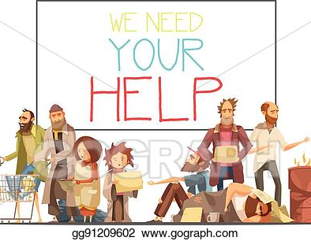
HOMELESSNESS
According to HUD, there are 4 Broad Categories of Homelessness:
Individuals living in a place not fit for human habitation
Individuals losing their night-time residence within 14 days
Families with children or unaccompanied youth (up to age 24 years) unstably housed
Individuals fleeing or attempting to flee domestic violence

Slide 42
PREVALENCE OF PERSONS EXPERIENCING HOMELESSNESS
HUD’s 2018 Annual Homeless Assessment Report to Congress reports national totals from Point In Time Counts (PIT)
552,830 persons experienced homelessness on a single night in 2018, an increase of 0.3 percent since 2017.
Homelessness among veterans fell 5.4 percent
Homelessness experienced by families with children declined 2.7 percent nationwide since 2017
Source:
https://www.hudexchange.info/news/hud-reports-homelessness-unchanged-in-u-s-in-2018-with-notable-declines-among-veterans-and-families-with-children/ Retrieved 7/15/2019

Slide 45
HOMELESSNESS, TRAUMA, AND SUICIDALITY
A 2012 study found suicide rates to be 10 times higher for homeless individuals as compared to the general population and more than half of the individuals experiencing homelessness had thoughts of suicide or have attempted suicide
In 2017, a study showed that more than 40% of teens experiencing homelessness struggled with depression. School-aged children and youth who were homeless were 3 times more likely to attempt suicide
For programs receiving 330 (h) funding, the number of patients diagnosed with mental health conditions has increased each year with an increase in depression and other mood disorders
68% of individuals who are homeless reported they had experienced psychological distress in the past month (American Journal of Public Health. 2015/11)
Source: National Healthcare for the Homeless Council (2018), Suicide and Homelessness: Data Trends in Suicide and Mental Health Among Homeless Populations, www.nhch.org

Slide 46
SUICIDE PREVENTION

Slide 47
SUICIDE PREVENTION
POLLING QUESTION
WHAT IS BEST PRACTICES FOR SUICIDE PREVENTION?
Screening all individuals for suicidality
Screening high-risk individuals for suicidality
Screening all teens for suicidality
Suicide Prevention, Behavioral Health, and Best Practices

Slide 48
SUICIDE PREVENTION
“Identifying persons who may be at risk for suicide is a key part of a comprehensive approach (/effective-prevention/comprehensive-approach) to suicide prevention.”
“Family members, friends, teachers, coaches, coworkers, and others can play an important role in recognizing when someone is at risk or in crisis and then connecting that person with the most appropriate course of care.”
Source: Suicide Prevention Resource Center, http://www.sprc.org/comprehensive-approach/identify-assist

Slide 49
SUICIDE PREVENTION
SCREENING FOR SUICIDE RISK
There are many tools for screening persons at risk.
“…it is important to have resources and systems in place to connect anyone identified as being at risk to appropriate follow-up care and assistance.”
Source: Suicide Prevention Resource Center, http://www.sprc.org/comprehensive-approach/identify-assist

Slide 50
SUICIDE PREVENTION
Programs that are more effective:
Follow-up the suicide risk assessment with a comprehensive evaluation of the risk and needs in order to develop a care plan
Share information about local resources that are appropriate for the population
Help build care transitions and linkages in the community
Share information about hotlines and other crisis services
Source: Suicide Prevention Resource Center, http://www.sprc.org/comprehensive-approach/identify-assist

Slide 51
MAYO CLINIC TEEN SUICIDE PREVENTION VIDEO
https://www.youtube.com/watch?v=3BByqa7bhto&list=PLh6FCUFIJEL-4R2td8UO6uehN2GWF3z8D&index=2&t=0s

Slide 52
TREATMENT: AFTER AN ATTEMPT

Slide 53
SUICIDE PREVENTION
POLLING QUESTION
WHEN AN INDIVIDUAL IS SUICIDAL OR HAS MADE AN ATTEMPT, WHAT IS BEST PRACTICES FOR TREATMENT?
Developing a Safety Plan
Removing Lethal Means
Identifying Trigger Thoughts
All of the above
Suicide Prevention, Behavioral Health, and Best Practices

Slide 54
AFTER AN ATTEMPT
Next Steps for the Future/Recommendations for Individuals who have attempted suicide:
Create a Safety Plan
Learn to Live Again
Realize everyone’s recovery is different
Remove means for hurting self
Identify what triggers thoughts
Learn about mental illness
Learn about crisis hotlines
Participate in a mutual peer-support group
Get involved in life
Source: US Department of Health and Human Services Substance Abuse and Mental Health Services Administration (2009); After An Attempt: A Guide for Taking Care of Yourself After Your Treatment in the Emergency Department

Slide 55
BEST PRACTICES REGARDING VICARIOUS TRAUMA AND SELF-CARE FOR PROVIDERS

Slide 56
VICARIOUS TRAUMA, SECONDARY STRESS, AND COMPASSION FAITIGUE

Slide 57
RESILIENCE
The capacity to prepare for, cope with and grow through adversity.
Source: National Resilience Institute, 2019

Slide 58
RESILIENCE
“I learned that courage was not the absence of fear, but the triumph over it”
-Nelson Mandela

Slide 59
RESILIENCE
The ability to bounce back from adverse experiences and to avoid long term negative effects;
A sense of hope that is basic to our capacity to feel healthy. Nurturing and sustaining hope is the fuel that drives resilience.
Source: Richard Allan Aronson, MD, MPH, March 2006

Slide 60
STRATEGIES FOR MANAGING COMPASSION FATIGUE
Peer Support
Supervision and Consultation
Training
Personal Psychotherapy or Counseling
Maintaining balance in one’s life
Engaging in spiritual activities that provide meaning and perspective
Source: SAMHSA (2014) Tips for Disaster Responders: Understanding Compassion Fatigue

Slide 61
SELF-CARE AND RESILIENCE
How do you take care of yourself?
What strategies have you implemented for preventing and managing Vicarious Trauma, Burn-out, and Compassion Fatigue?

Slide 62
SELF-CARE AND RESILIENCE
Source: www.OlgaPhoenix.com

Slide 63
CONCLUSION, WRAP-UP, AND QUESTIONS

Slide 64
FOR MORE INFORMATION, CONTACT THE PRESENTER:
Terri Cooley-Bennett, LCSW, LSCSW, CCDP-D, TTS
Outreach Services Manager at Swope Health Services; Workshop Presenter and Speaker for the Missouri Chapter of the National Association of Social Workers, the Missouri Department of Mental Health, the Missouri Credentialing Board, the University Of Kansas School of Social Welfare Continue Education Program, and Others.
tcooley-bennett@swopehealth.org
Suicide, Mental Health, Prevention, & Self Care
4/4/2022

