Slide 1
Planning Homeless Persons Memorial Day Events
October 20, 2011
Presented by:
Joseph Benson, NCAB Steering Committee,
Valarie Dowell, NCAB Regional Rep and
Katy Valesky, Consumer Advocate
National Health Care for the Homeless Council
This presentation is supported through a National Cooperative Agreement with the Health Resources and Services Administration.

Slide 2

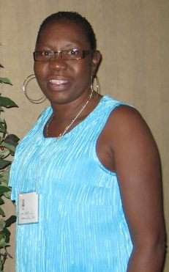
Valarie Dowell
Valarie Dowell is Regional Representative for HRSA Regions 5&7. She is a Community Health Worker from Cincinnati, Ohio and provides staff support for the Cincinnati Health Network. She is very organized and interested helping others help their neighbors. She would love to hear from CAB members so she can help connect them with each other, regional events, and NCAB - ncab@nhchc.org.

Slide 3

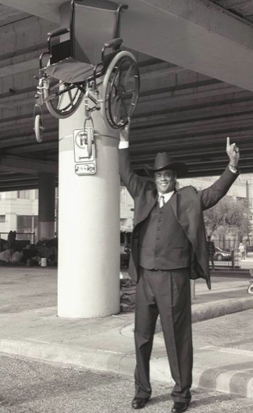
Joseph Benson
Joseph is a member of the NCAB Steering Committee and has served as a consumer representative on the Health Care for the Homeless Houston Board of Directors since 2004. Joseph is the Chair of the HCH Houston CAB, as well. He would love to connect with CABs in Texas and surrounding states to help connect them with each other, regional events, and NCAB - ncab@nhchc.org.

Slide 4
What is Homeless Persons’ Memorial Day?
Annual event to bring attention to the tragedy of homelessness and to remember our homeless friends who have paid the ultimate price for our nation's failure to end homelessness.
In most communities, it takes place on December 21st - the longest night of the year

Slide 5
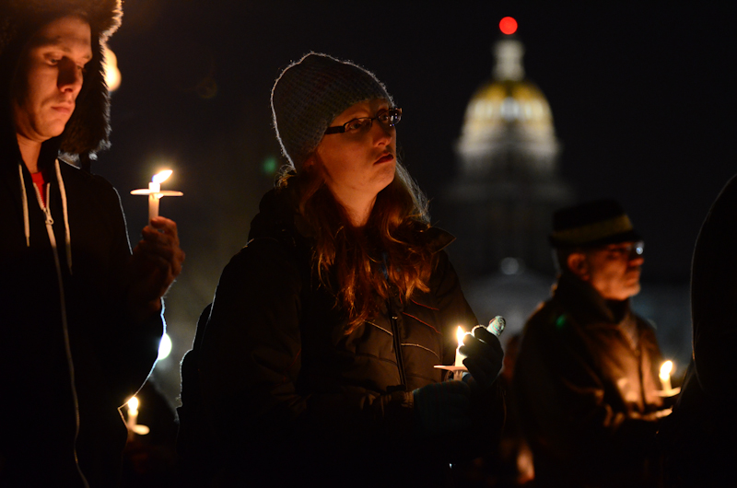

Slide 6
Why is Homeless Persons Memorial Day Important?
In 2010, 141 communities participated in the 21st Annual National Homeless Persons’ Memorial Day and honored the more than 1,900 people who died without homes last year.
Raises awareness of homelessness and the severity of the consequences
Allows those who are still homeless the closure and healing that comes from remembering their friends in a public way
Refocuses our attention on those whose lives can still be saved

Slide 7
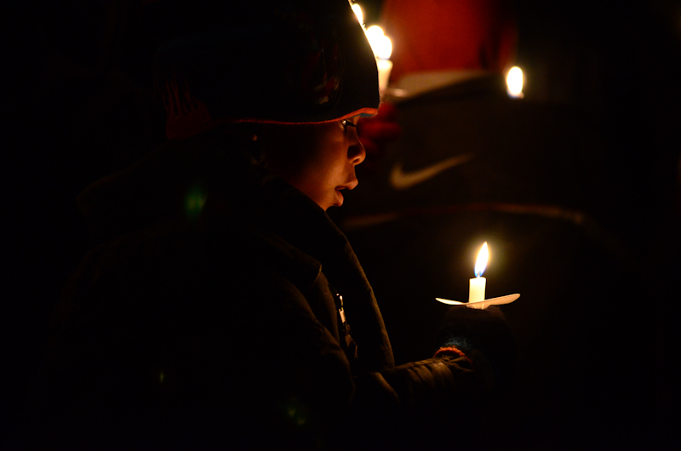

Slide 8
In Your Community
Start now to collect the names of people who died homeless since December, 2010. Most communities do not have standard data for this, so it may take some digging. Start with homeless health providers, the local health department, public officials, and those who are still a part of the homeless community to gather names.
Invite several organizations in the community to participate: state and local coalitions for the homeless, service providers, shelters, housing programs, outreach, volunteers, places of worship, etc.

Slide 9
Overview of Toolkit
Organizing an Event to Commemorate National Homeless Persons’ Memorial Day
2010 Memorial Day Event Locations
Sample Flyers, Agendas, Press Releases, State Proclamations, City/County/State Resolutions
Highlights of 2010 Memorial Day Events
List of Homeless Deaths in 2010
Street Sense article, December 2010

Slide 10
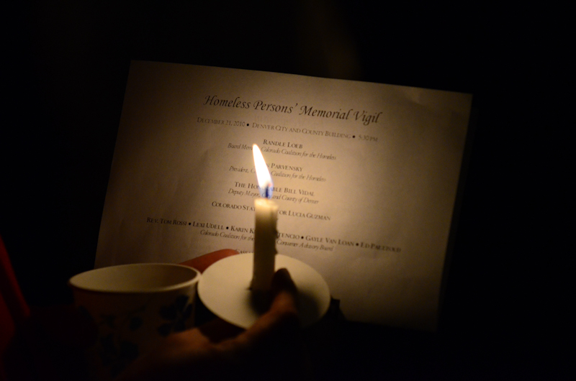

Slide 11
Successful Events
Candle vigil or some other similar physical representation
Reading of names of those remembered, especially by a currently or formerly homeless individual(s)
Multiple-denomination prayer service (consider culture of your area - Native American? Christian? Buddhist? Muslim? all of the above?)
Remarks from prominent community leader (consider Mayor or someone from Mayor’s office, homeless services provider, other elected official, current or formerly homeless community leader)
Music, poetry, chants, eulogies, remembrances, proclamations, calls to action

Slide 12
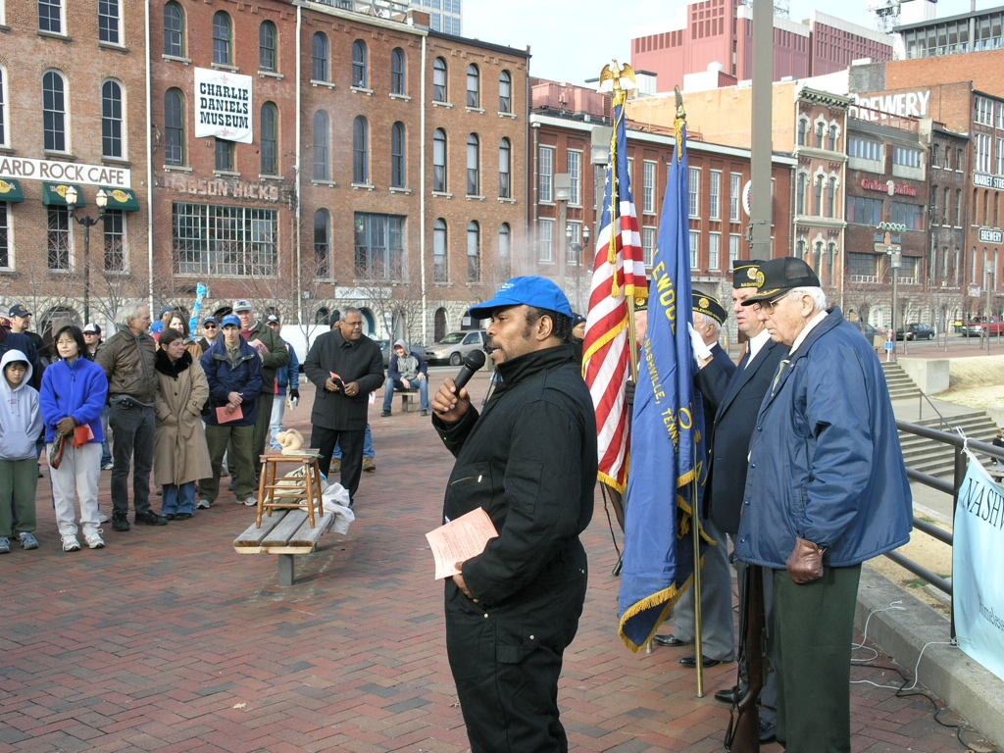
12

Slide 13
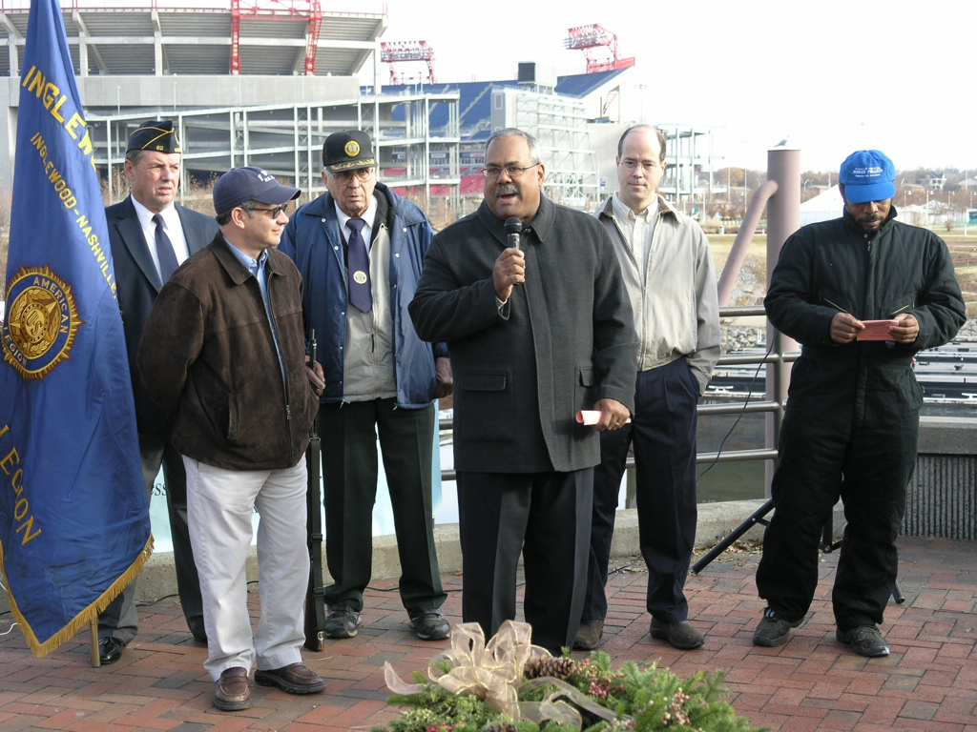

Slide 14

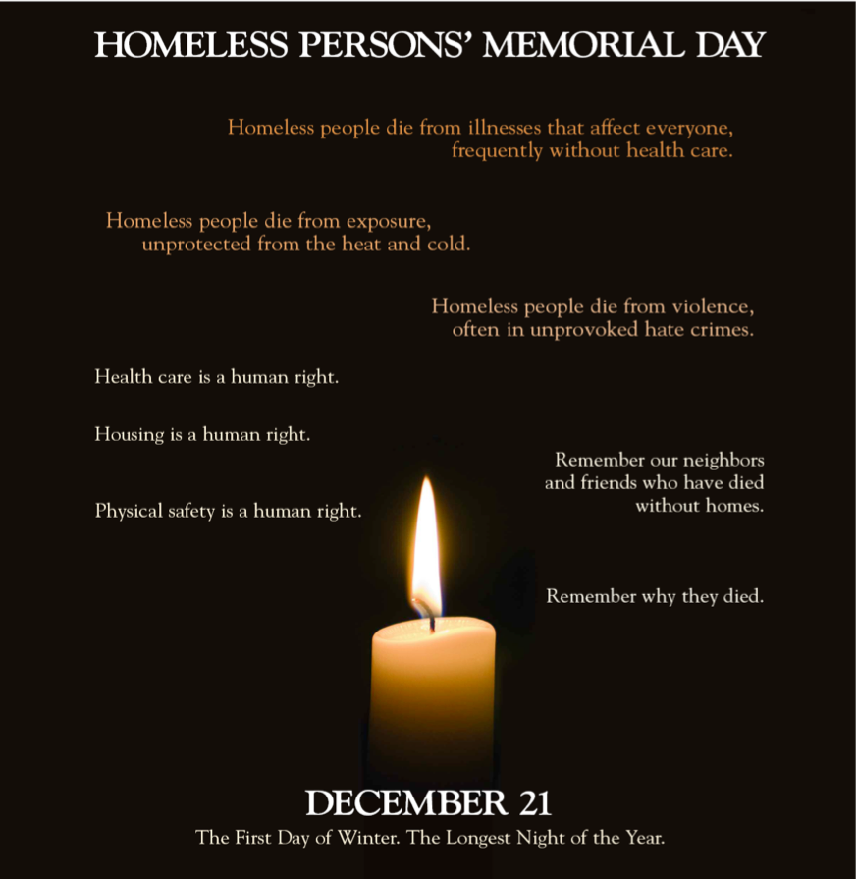

Slide 15
Consumer/NCAB Role
The National Consumer Advisory Board (NCAB) shares that the best HPMD events are those where consumers of homeless services be involved to the greatest extent possible in the planning and implementation of these events.
NCAB is gathering data on the names of those remembered this year and will post those names on their website at http://www.nhchc.org/memorialday.html
Write a story for your local street paper advertising or commemorating the event (and submit a link so your article can be featured in next year’s manual)

Slide 16
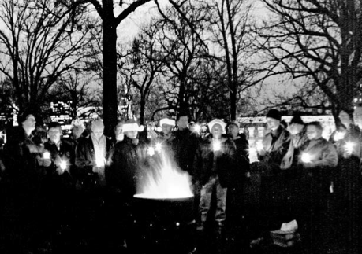

Slide 17
Resources
http://www.nhchc.org/memorialday.html
    Planning Manual Link
    Survey Link
    Poster
    Examples
    Technical Assistance
Contact us:
    Joseph Benson: jbenson@searchhomeless.org
    Katy Valesky: kvalesky@nhchc.org
  Thank you to our partners at the National Coalition for the Homeless. Visit them at nationalhomeless.org for more information on their important work.

Slide 18
Question and Answer
Upcoming Webinars
  Addressing Key Preventive Health Measures in Health Care for the Homeless Settings, October 27, 2011, 12:30PM EDT
  Patient Centered Medical Home Case Study featuring Yakima NHC, November 3, 2011, 2:00PM EDT

Slide 19
Resources
http://www.nhchc.org/memorialday.html
    Planning Manual Link
    Survey Link
    Poster
    Examples
    Technical Assistance
  Thank you to our partners at the National Coalition for the Homeless. Visit them at nationalhomeless.org for more information on their important work.

Slide 20
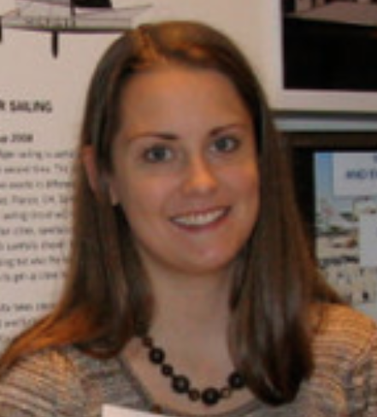
Question and Answer
Katy Valesky is a Consumer Advocate at the National HCH Council.
Contact us: ncab@nhchc.org
    Joseph Benson: jbenson@searchhomeless.org
    Dan Rabbitt: drabbitt@nhchc.org
    Katy Valesky: kvalesky@nhchc.org

Slide 21
Upcoming Council Webinars
  Addressing Key Preventive Health Measures in Health Care for the Homeless Settings, October 27, 2011, 12:30PM EDT
  Patient Centered Medical Home Case Study featuring Yakima NHC, November 3, 2011, 2:00PM EDT

Slide 22
Thank you for your participation.
Upon exiting you will be prompted to complete a short online survey. Please take a minute to complete the survey to evaluate this webinar production.

